Slide 1
Welcome!!! Mr. Heidenthal
Electricity
Graphic Communication, Applied Graphics, Advanced Graphics

Slide 2
Class Philosophy
Hold student accountable for being on time and acting professional
Work ethic & effort = success
Elective does not mean Easy
My goal is to grow students from their freshman year until they are fully prepared for whatever their future endeavors may be after graduation.

Slide 3
Class Info
Discipline is handled in accordance to district policy
I try to handle as many issues “in house” as possible.
Grading
O = No credit & CANNOT be made up
M = Grade of O, but CAN be made up (before MP grading deadline)
EX = Excused or Excempt from assignment. Has no impact on overall grade.
Most effective form of communication with me is e-mail
cheidenthal@northernyork.org

Slide 4
Student Resources
Teacher Website
About me Page
Access to course Syllabus & links to other resources.
https://www.northernpolarbears.com/Page/9824
Schoology
Learning Management System used to access and submit assignments as well as check grades.
nycsd.schoology.com
You should have been given a Parent Access Codes by the district, if not please e-mail and I can provide that for you.

Slide 5
Student Resources continued…...
Microsoft 365
Classwork Resource
Access to Word, PowerPoint, Excel ect via desktop Apps or you can use the web versions by going to the website below and having students log in using their e-mail accounts.
www.office.com

Slide 6
Teacher Website
About Me
Access to Syllabus
Links to Schoology

Slide 7
Schoology
ALL CLASSES
Online classroom management system where assignments are provided and/or handed in.
Will contain the most accurate grades.
Parents can also create accounts to monitor any assignments that may be posted or upcoming due dates.

Slide 8
Schoology

Slide 9
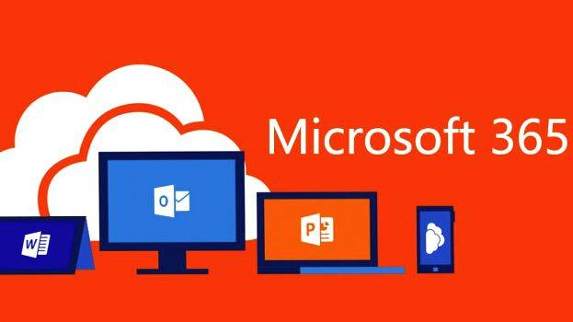
Microsoft 365
Highly Recommend students download the OneDrive app (Free) on their phone if possible.

Slide 10
Questions?
Please e-mail me at cheidenthal@northernyork.org with any questions OR if you would like to request a Parent Access Code for your students Schoology Page.
Thank you for your time!

