Slide 1
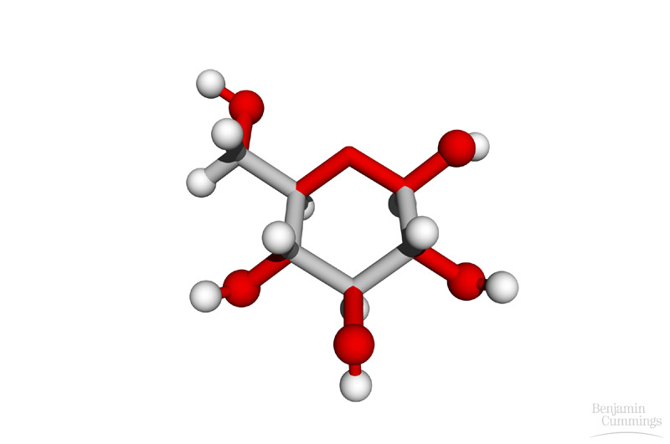
Molecules of Life!
Fall 2009 Life Science
7th Grade

Slide 2
Elements
Any substance that cannot be broken down into simpler substances.
The smallest unit of an element is an atom.

Slide 3
Compounds
Two or more elements that combine chemically – creates a Molecule!

Slide 4
Inorganic Compound
Compounds that DO NOT contain the element Carbon (C). Ex. Water, sodium chloride (table salt).

Slide 5
Organic Compound
Contain the element Carbon. Groups are carbs, lipids, proteins, and nucleic acids…

Slide 6
Molecules of LIFE!!!!
There are four categories of molecules that are essential to life!
Carbohydrates
Lipids
Proteins
Nucleic Acids

Slide 7
1. Carbohydrates

Slide 8
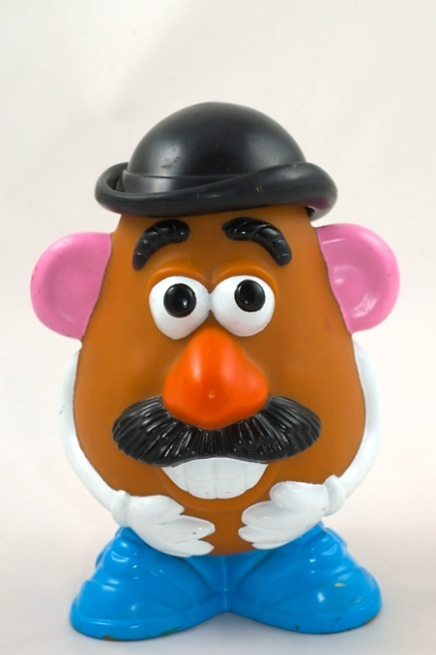
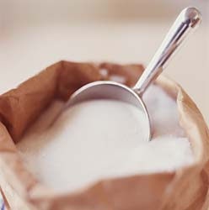
CARBS!
1. Carbohydrates
Main source of energy
Examples
Sugar and starch; foods such as bread, fruit, potatoes

Slide 9
CARBS!
A monomer or single unit is called a Monosaccharide
Glucose!
Starch

Slide 10
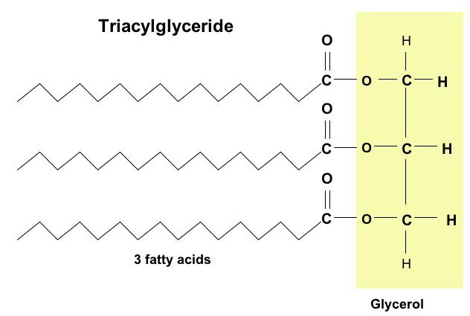
2. Lipids (fats and oils)

Slide 11
LIPIDS
Also an energy rich compound and are the major component of cell membranes
Lipids are broken into two main categories
Fats: solid at room temperature (saturated) ☹
Oils: liquids at room temperature (most are unsaturated) ☺

Slide 12
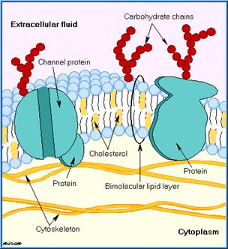
LIPIDS
Examples: Butter (fat), canola oil, cell membrane
MONOMER: Fatty ACID

Slide 13
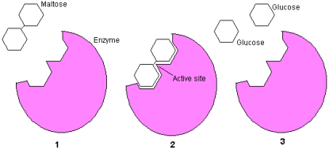
3. Proteins

Slide 14
Proteins
Proteins perform many different functions inside an organism.
Such as, growth and repair of body structures, providing energy, fighting germs, and many more.
They are large organic molecules that contain C, H, O, N, and sometimes S.
Fingernails are made of keratin, a protein!!!

Slide 15
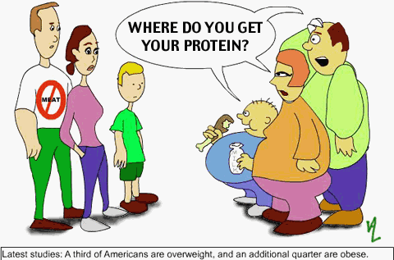
PROTEIN!
Protein is found in
Eggs, fish, meat, and beans
Another important function of proteins are as enzymes
Enzymes are biological catalysts, a substance that speeds up or slows down chemical reactions

Slide 16
PROTEINS!
Proteins are composed of many amino acids

Slide 17
Amino Acids
A small chemical that is linked chemically to other amino acids to form proteins.

Slide 18
Hormone
Chemical produced in your endocrine glands.
They speed up or slow down the activities of various organs in your body.

Slide 19
Enzyme
A type of protein that speeds up chemical reactions in living things. You have several enzymes that help to begin the digestion of food in your mouth.

Slide 20
4. Nucleic Acids

Slide 21
Nucleic Acids
Nucleic Acids are called the “blueprints of life”

Slide 22
Nucleic Acids!
There are two major kinds of nucleic acids
DNA stores all the biological information to produce the organism
RNA is able to read the message in DNA and use it to construct proteins

Slide 23
tRNA
Transfer RNA is located in the cytoplasm & carries an amino acid to a protein chain. It gets its “message” from your RNA.

Slide 24
Nucleic Acids!
Nucleic Acids are composed of monomers called nucleotides

