Slide 1
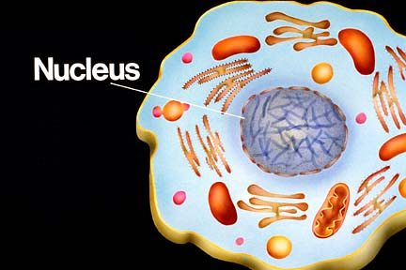
The Structure of DNA
Deoxyribonucleic Acid
Notes:
Introduction to DNA 3- Name 3 traits that are the most common in our class population.
2-Name 2 traits that are considered “dominant”
1-Name 1 way traits are passed from generation to generation…..
=DNA.
1. So what is that word that means, passed from generation to generation? (Inherited)
DNA is Inherited from parents
All animals and plants on Earth share something in common: they all use the same code to grow and function.
This code can be found in bacteria, elephants, oak trees, and humans. It’s the “master plan” for all organisms, like the source code for a computer program.
It’s the reason your toes are on the ends of your feet (where they belong) instead of on your hands or hanging off the edges of your ears.
2. This code is called DNA, which is shorthand for Deoxyribo Nucleic Acid.
3. DNA exists as long molecules within the nucleus of almost every cell in an organism.

Slide 2
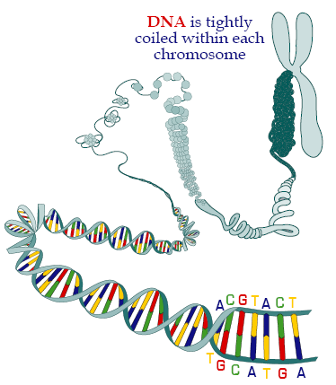
The DNA in each cell is coiled up tightly and packed into compact units called chromosomes.
Notes:
4. As Chromosomes

Slide 3
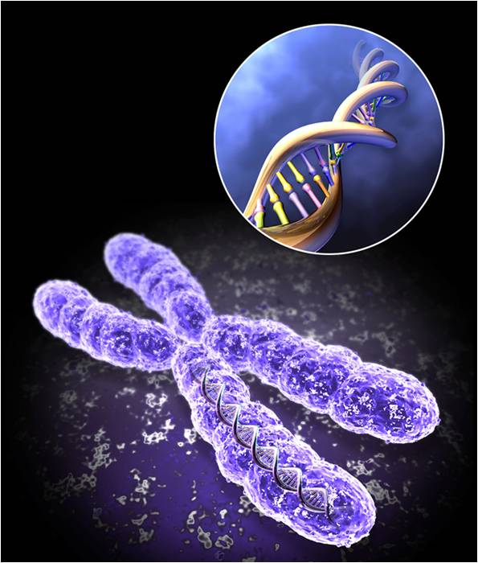
Notes:
5. DNA is made of…….

Slide 4
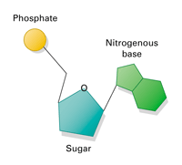
Building block (monomer) of DNA is the nucleotide. A nucleotide consists of a sugar, phosphate and nitrogen base. (eSPN)
Notes:
Nucleotides
Sugar
Phosphate
Base

Slide 5
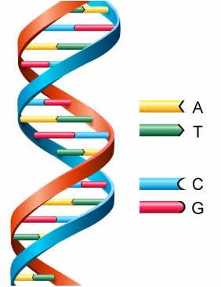
Nucleotide= Sugar, Phosphate, Base:
DNA contains four different nitrogenous bases.
Adenine (A)
Guanine (G)
Cytosine (C)
Thymine (T)
A bonds to T and
C bonds to G
Notes:
Base = ATCG
6. DNA is in the form of a twisted ladder called a double helix.
The rungs of the ladder make up the four-letter DNA code or alphabet: A, T, C, and G. These alphabet pieces are called bases and they bond together (in base pairs) according to special rules: A always pairs with T, and C always pairs with G [A–T C–G].

Slide 6
