Slide 1
Construction Project Updates
1. NYCSD Project Team Summary
2. Budget Update – Reno vs. New
3. Enrollment Study
4. Current Design Estimates
5. Costs Incurred for Projects
6. Timeline

Slide 2
Projects Team
Architect – Schrader Group (David, Danie, Dan)
MEP Engineer – Snyder Hoffman (Shane, Drew)
Site and Civil Engineer – K&W (Marc, Jeff)
Construction Manager – D’Huy (Jamie, Josh)
Task Force: Joe Rudy, Jason Young, Steve Kirkpatrick, Matt Meakin, Matt Johnson, Troy Sauer, Joyce Cal
Other Admin and Experts as needed

Slide 3
Updated Comparison
Current Design Budget for NMS:
$68M
Current Estimated Budget for new build:
$103-107M
Based on 164,000 square foot building.
Estimates provided by D’Huy engineering

Slide 4
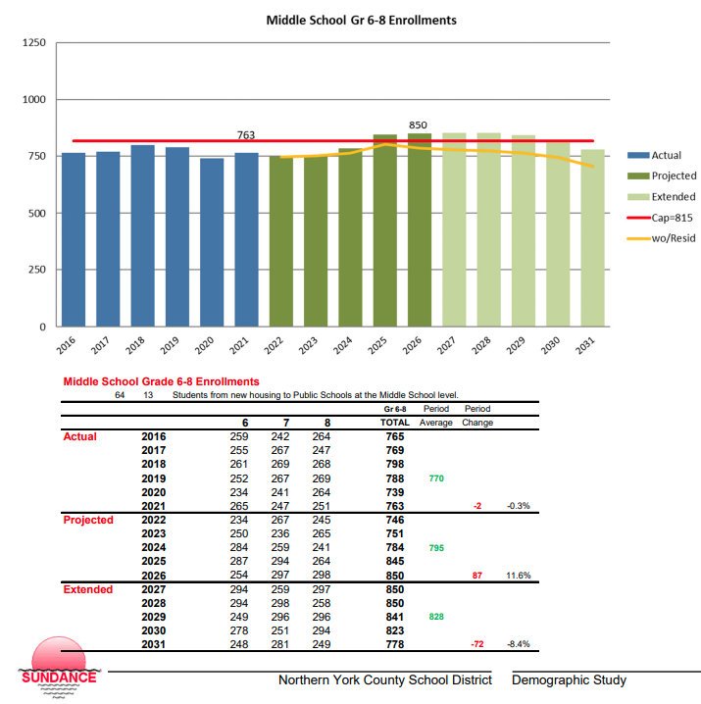
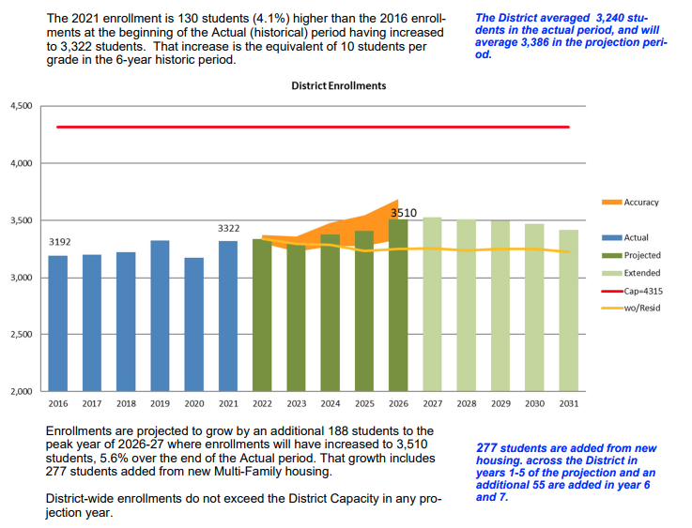
Enrollment Study
Sundance Associates
August 2022

Slide 5
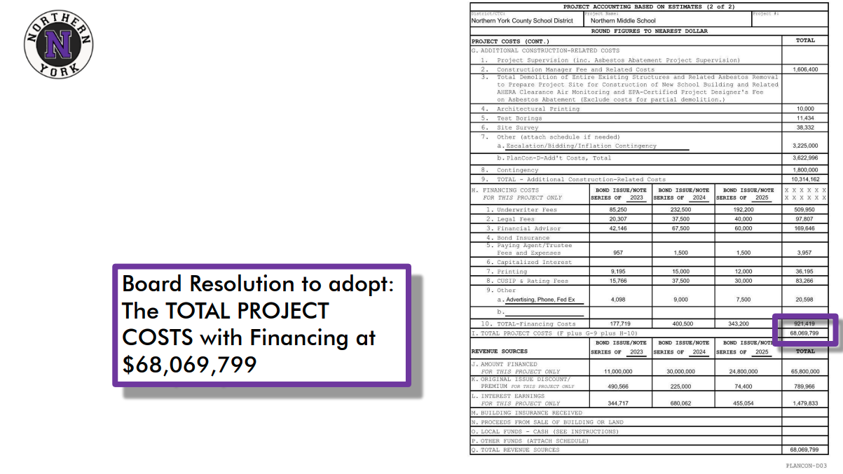
ACT 34 Approved Estimates for NMS

Slide 6
Costs Incurred as of Dec 8, 2023
Architects and Engineers
$ 1,401,021
Construction Management
$ 48,063
Surveys
$ 59,610
Permits and Other
$ 31,850
Total
$ 1,540,544

Slide 7
SEPTEMBER 2023 Presentation

Slide 8
Timeline
January 2024 – Out for Bids
February 2024 – Receive and Tabulate Bids
March 2024 – Approve Bids and Notice to Proceed
May 2024 – Begin Construction (18-24 months)

