Slide 1
Blood Basics
Forensic Science
T. Trimpe 2006 http://sciencespot.net/

Slide 2
What makes up our blood?
RED BLOOD CELLS (Erythrocytes) – The most abundant cells in our blood; they are produced in the bone marrow and contain a protein called hemoglobin that carries oxygen to our cells.
WHITE BLOOD CELLS (Leukocytes) – They are part of the immune system and destroy infectious agents called pathogens.
PLASMA – This is the yellowish liquid portion of blood that contains electrolytes, nutrients and vitamins, hormones, clotting factors, and proteins such as antibodies to fight infection.
PLATELETS (Thrombocytes) – The clotting factors that are carried in the plasma; they clot together in a process called coagulation to seal a wound and prevent a loss of blood.

Slide 3
Blood Facts
The average adult has about FIVE liters of blood inside of their body, which makes up 7-8% of their body weight.
Blood is living tissue that carries oxygen and nutrients to all parts of the body, and carries carbon dioxide and other waste products back to the lungs, kidneys and liver for disposal. It also fights against infection and helps heal wounds, so we can stay healthy.
There are about one billion red blood cells in two to three drops of blood. For every 600 red blood cells, there are about 40 platelets and one white blood cell.
http://www.bloodbankofalaska.org/about_blood/index.html

Slide 4
Genetics of Blood Types
Your blood type is established before you are BORN, by specific GENES inherited from your parents.
You inherit one gene from your MOTHER and one from your FATHER.
These genes determine your blood type by causing proteins called AGGLUTINOGENS to exist on the surface of all of your red blood cells.

Slide 5
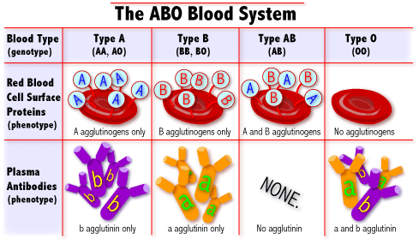
What are blood types?
Blood Types
AA or AO = Type A BB or BO = Type B OO = Type O AB = Type AB
There are 3 genotypes for blood type: A, B, & O. Since we have 2 alleles, there are 6 possible combinations.
http://learn.genetics.utah.edu/units/basics/blood/types.cfm

Slide 6
How common is your blood type?
46.1%
38.8%
11.1%
3.9%

Slide 7
Blood Transfusions
A blood transfusion is a procedure in which blood is given to a patient through an intravenous (IV) line in one of the blood vessels. Blood transfusions are done to replace blood lost during surgery or a serious injury. A transfusion also may be done if a person’s body can't make blood properly because of an illness.
Who can give you blood?
People with TYPE O blood are called Universal Donors, because they can give blood to any blood type.
People with TYPE AB blood are called Universal Recipients, because they can receive any blood type.
Rh + → Can receive + or -
Rh - → Can only receive -
Universal Donor
O
A
B
AB
Universal Recipient

Slide 8
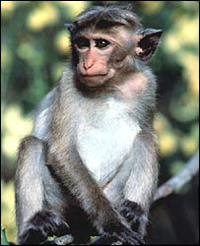
Rh Factors
Scientists sometimes study Rhesus monkeys to learn more about the human anatomy because there are certain similarities between the two species. While studying Rhesus monkeys, a certain blood protein was discovered. This protein is also present in the blood of some people. Other people, however, do not have the protein.
The presence of the protein, or lack of it, is referred to as the Rh (for Rhesus) factor.
If your blood does contain the protein, your blood is said to be Rh positive (Rh+). If your blood does not contain the protein, your blood is said to be Rh negative (Rh-).
A+ A- B+ B- AB+ AB- O+ O-
http://www.fi.edu/biosci/blood/rh.html

Slide 9
Blood Evidence
Blood samples – Can be analyzed to determine blood type and DNA, which can be matched to possible suspects.
Blood droplets – Can be analyzed to give clues to the location of a crime, movement of a victim, and type of weapon.
Blood spatter – Can be analyzed to determine patterns that give investigators clues to how a crime might have happened.

Slide 10
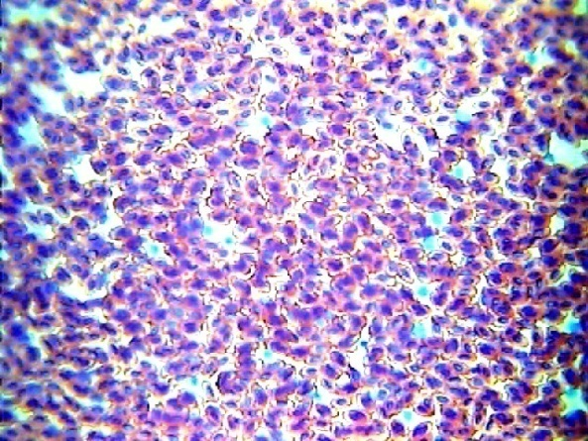
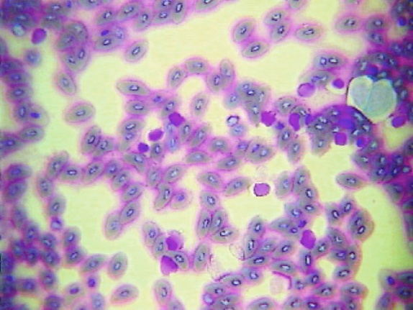
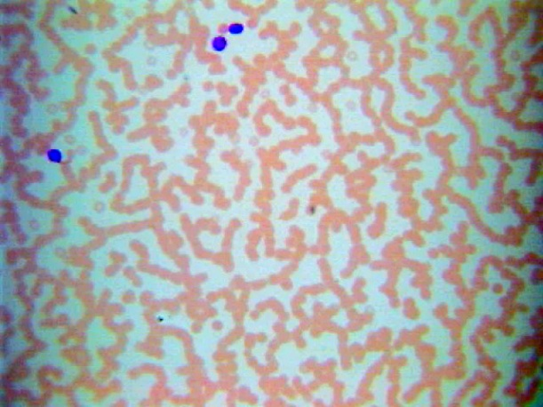
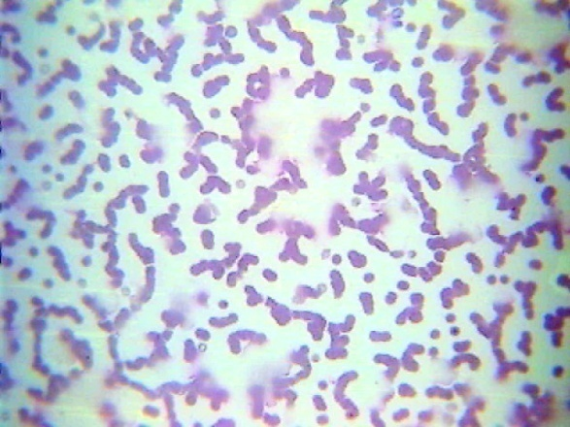
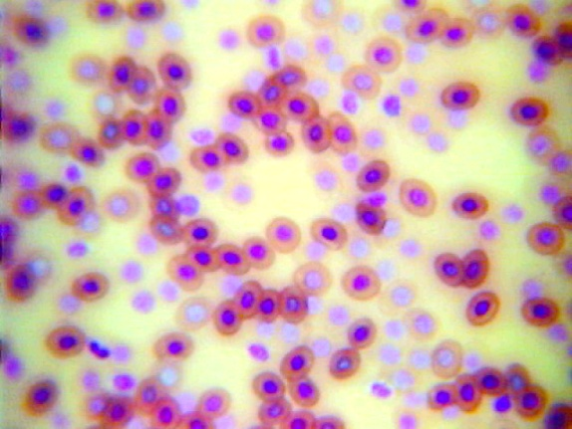
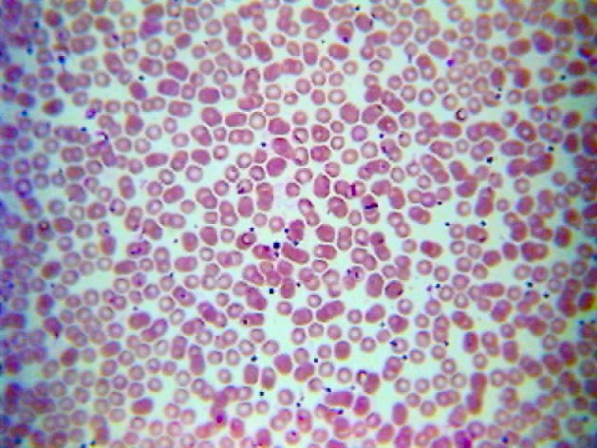
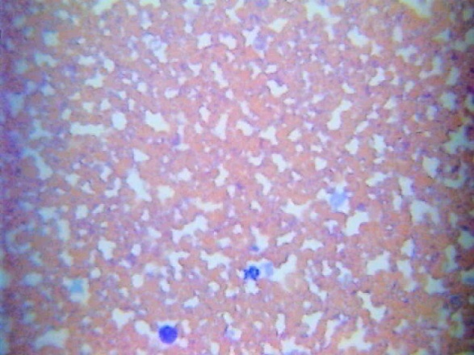
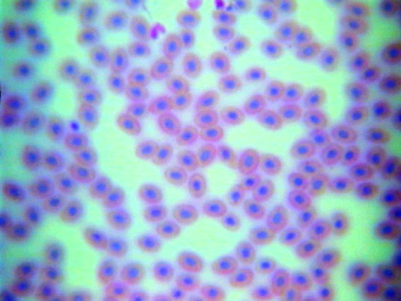
Microscopic Views
Bird Blood
Fish Blood
Horse Blood
Cat Blood
Frog Blood
Human Blood
Dog Blood
Snake Blood

