Slide 1
Radiation
Emission of energy in the form of electromagnetic waves (mostly non-ionizing) OR ionizing radiation
What is it?
What’s the difference between non-ionizing and ionizing radiation?
Ionizing radiation has enough energy to take electrons from atoms or molecules and thus giving them a charge (i.e., making them an ion)

Slide 2
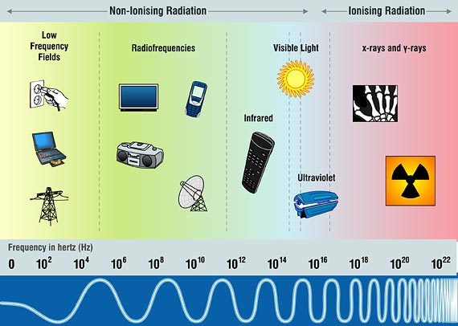
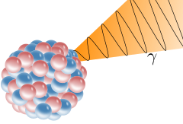
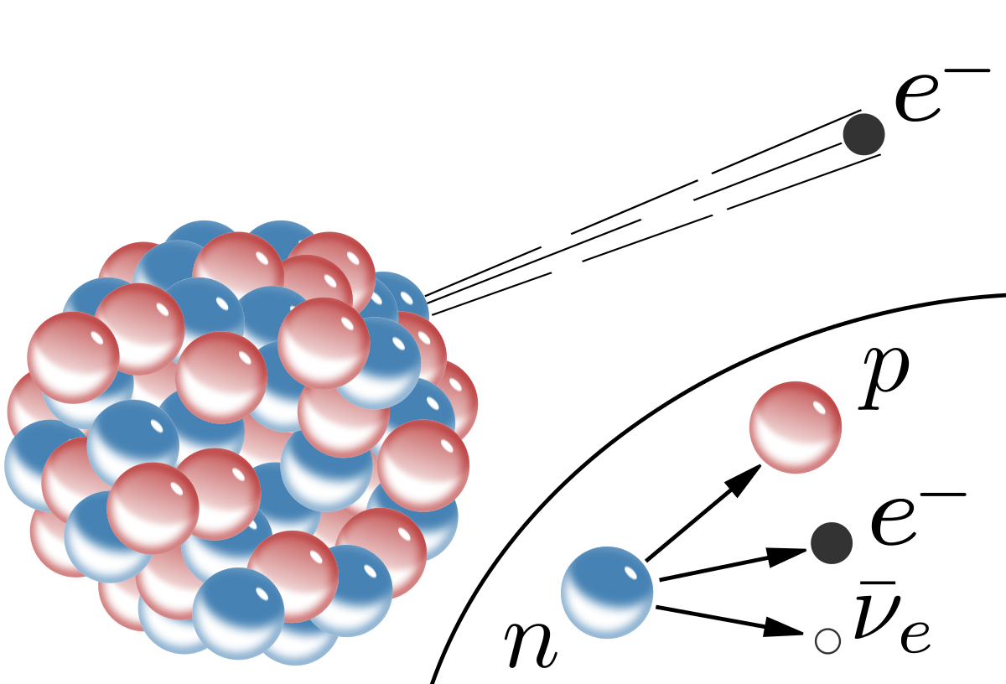
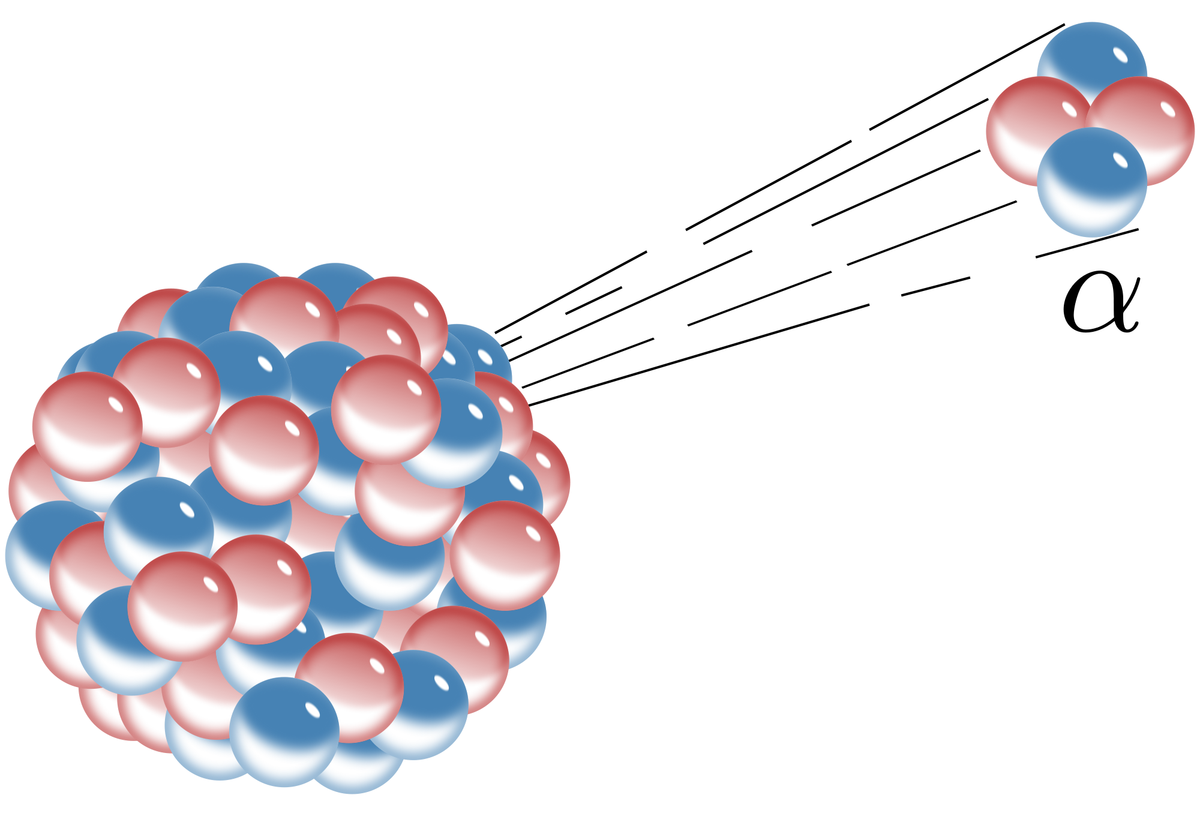
Where do we find radiation in the world today?

Slide 3
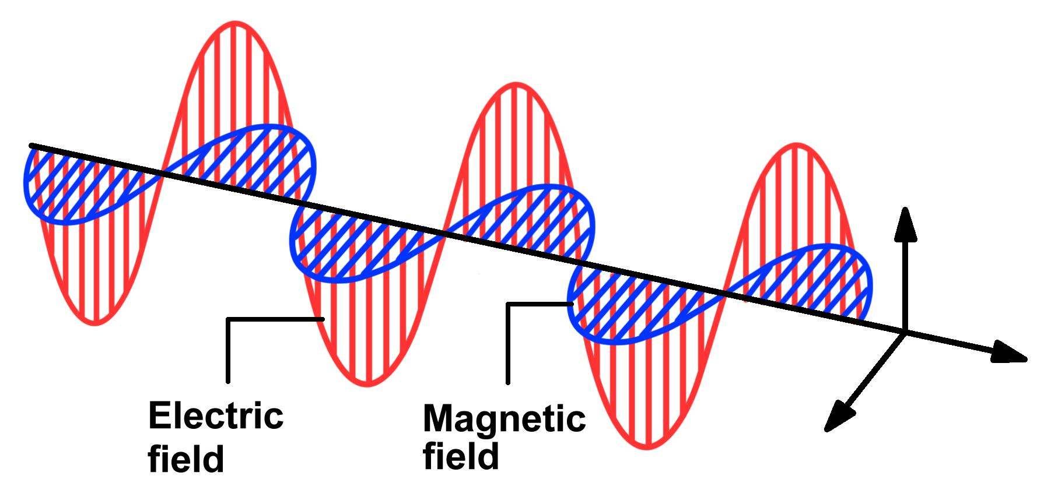
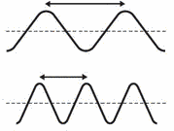
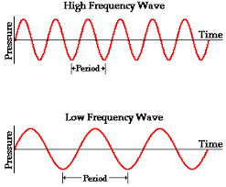
Electromagnetic Radiation
(a.k.a. EMR, EM Waves)
Electric field and magnetic field change and vary over time
Change occurs in the wavelength (λ) and frequency (ν)
Is there a relationship between λ and ν?

Slide 4
Relationship between wavelength and frequency
As wavelength increases, frequency decreases
Inverse relationship
Constant speed of all electromagnetic radiation
(In a vacuum)
c = λν
c = 3.00 x 10⁸ ^{m}/s
= speed of light
(In a vacuum)

Slide 5
CONCLUSION: EMR is essentially light of different wavelengths and frequencies
Relationship between Energy of light and frequency
E = hν
h = Planck’s constant = 6.626 x 10⁻³⁴ J·s
ν = frequency (s⁻¹ or Hz)
This is Planck’s equation. It tells the energy of a “photon” (think of a photon as a particle of light)
But what if we know the wavelength, but not frequency?
c
λ
(
c
λ
)
c = λν
= ν
E = h

Slide 6
Example #1: What is the frequency of EMR having a wavelength of 210.0 nm?
c
λ
3.00 x 10^{8 m}/s
2.10 x 10⁻⁷ m
c = λν
= ν
= ν
ν =
1.428 x 10¹⁵ Hz
Example #2: What is the energy of photon from the EMR in the previous problem?
E = hν
= (6.626 x 10⁻³⁴ J·s)(1.428 x 10¹⁵ Hz)
E = 9.462 x 10⁻¹⁹ J

Slide 7
Which has more energy: high frequency light or low frequency light?
High Frequency Light

Slide 8
Ionizing Radiation
Radiation whose energy is high enough to remove electrons from atoms and molecules
Two places we find ionizing radiation
High frequency EMR
Radioactive Decay
High-frequency UV light, x-rays, and gamma rays
Alpha and beta particles, gamma rays
LOW FREQUENCY UV LIGHT IS NON-IONIZING
Take out PROPERTIES OF IONIZING RADIATION chart (on the back of your atomic structure worksheet)

Slide 9
How do we tell certain types of light apart?
What makes different types of EMR unique? (hint: 2 related variables)
Different wavelengths and frequencies!
Detectable using spectroscopy
The “fingerprints” of the elements
Allows us to see different EMR
emitted by radiation sources
What’s the cause of these unique patterns of light?
Electrons become “excited,” meaning they take on more energy than they can handle
When they’re done being excited, they release the energy in the form of light

Slide 10
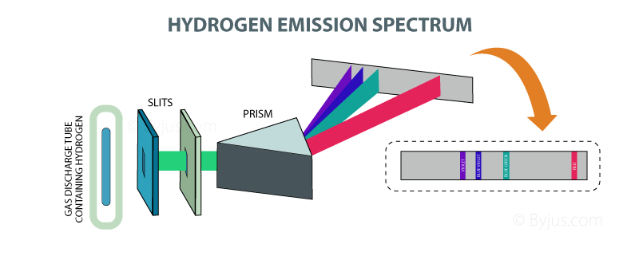
We can observe these spectra with something called a spectroscope.
Uses a diffraction gradient to separate the different types of visible light so we can see them

Slide 11
How do electrons behave within an atom?
We know that they are moving (the only time they’d stop moving is at 0 K)
But is it random movement?
Not really random. As it turns out, certain electrons have areas that they are most likely to be located, and there are different levels of organization to this.
Levels of organization
Shells
Subshells
Orbitals
Identifying “Location” of Electrons
Quantum numbers

Slide 12
Tell us the “location” of an electron in a certain orbital
Quantum Numbers
Orbital – a place where an electron is LIKELY to exist
“Location” isn’t constant because electrons are moving
4 Quantum Numbers
Principal quantum number (n)
Angular momentum quantum number (l)
(a.k.a. sublevel quantum number)
Magnetic quantum number (m_{l})
(a.k.a. orbital quantum number)
Spin quantum number (m_{s})

Slide 13
Shells
Outermost level of electron arrangement (determined by the period number; same as n)
Subshells
Next level of electron arrangement (exist within each shell), takes on a specific orientation
Orbitals
Next level of electron arrangement (exist within each subshell); each orbital holds 2 electrons
s-subshell holds 1 orbital (2 electrons)
p-subshell holds 3 orbitals (6 electrons)
d-subshell holds 5 orbitals (10 electrons)
f-subshell holds 7 orbitals (14 electrons)

Slide 14
NOTE: You are not expected to know why electrons are arranged this way. Just know that they are. This understanding involves quantum mechanics.
However, you ARE expected to know how to arrange them.
There are 3 ways we will arrange electrons in an atom
Electron configuration
Orbital filling diagram
Electron Dot diagram

Slide 15
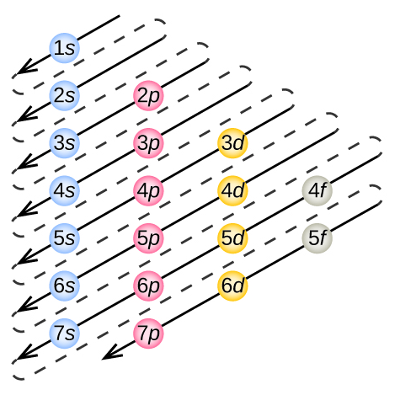
Switch to SmartNotebook for the rest of the problem

Slide 16
Electron Configurations of Elements
First, we need to determine how many subshells there are in an atom
Next, determine how many electrons surround the neutral atom
What does that mean for the charge on the atom?
Finally, we fill up all of the subshells until we’ve accounted for all of our electrons
Carbon has an atomic number of 6 and therefore has 6 electrons
Electron Configuration for a neutral Carbon atom?
Carbon is in Period 2 so it must have 3 subshells

