Slide 1
Physical Education NHS

Slide 2
Physical Education Regulations and Grading Policy
Each physical education class is worth a total of 6 points.
Points will be earned based on the physical education rubric.
Written quizzes and Physical challenges will be worth additional points.

Slide 3
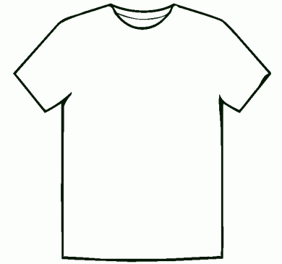
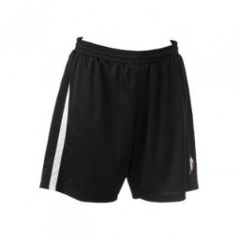
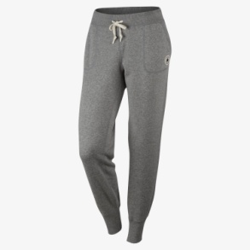
How do you earn your PE grade?
Cotton Crew-neck T-shirt
Mesh Shorts
Sweatpants or loose fitting pants
Sneakers

Slide 4
Absent from Class
Each class where a student does not participate, they are not eligible for the 6 points.
Classes not made up will be counted as a zero.
Sapphire will reflect the daily points in coordination with the school handbook:
0 = No credit earned. It cannot be made up.
M = Grade of a zero, but may be made up for (partial or full) credit.
EX = Excused or Exempt and has no impact on grade.
Absences MUST be made up in a timely manner. You will be given two cycles to complete the make up class. Please see your teacher immediately if you have limited study halls to make an alternate plan.

Slide 5
Do not have PE clothes
If a student does not have the required clothes for PE, the student will not be able to participate in class.
Grade will be entered as a zero (0).
One class can be made up for forgetting to bring clothes. After the one, they cannot be made up.

Slide 6
How do I make up a class?
Make up your class during a study hall. You can also use your lunch. If these times are limited, see your teacher and we will find a workable solution.
Report directly to the locker room. Do not go to study hall. Tell the teacher where you would be for study hall, and they will email them.

Slide 7
NHS Participation Rubric
0 Points | 1 – 2 Points | 3 Points | 4 Points | 5 Points | 6 Points
Student does not participate. OR Student cannot participate because student is: Not wearing sneakers. Not dressed for class in required uniform. Acting in an unsafe or disrespectful manner. | Student is actively engaged in 10-20% of the activities and demonstrates limited effort in activities. | Student is actively engaged in 30-40% of the activities and demonstrates limited effort in activities. | Student is actively engaged in 50-60% of the activities and demonstrates effort in activities. | Student is actively engaged in 70-90% of the activities and demonstrates effort in the activities. | Student is actively engaged the entire period (100%) and demonstrates maximum effort in all activities.

Slide 8
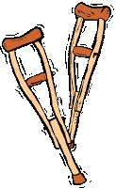
Physician’s Excuse: Illness or Injury
All medical notes go directly to the nurse.
Notes from home will not be accepted: Students can participate to the best of their ability.

Slide 9
Grade Book
Each class will be entered as an individual assignment worth 6 points.
Quizzes will be entered as an individual assignment.
Physical challenges will be entered as an individual assignment.

Slide 10
Lock Your Belongings
Please lock up your valuables. It is free to get a lock and a locker.

Slide 11
NO CELL PHONES in the GYM or the LOCKER ROOM
Lock them up to secure safely.
Do not have cell phones visible in the locker room. That is a serious privacy issue for everyone.
Do not bring cell phones into the gym.

Slide 12
Bell to Bell
Be in the locker room when the bell rings to start class.
Stay in the locker room until the bell rings to end the class period.

Slide 13
PE Activities 11-12
FITNESS for the individual
Archery/Golf
Fitness testing
Aquatics: Interval swimming; water polo; synchronized swimming; canoeing; water rescues
Weight Training/Fitness Concepts
Square Dancing
12 only (grade 11 goes to Health class):
Volleyball
Lawn Games; Group Games; Badminton Tournament; NitroBall
CPR and First Aid

Slide 14
PE Activities grades 9-10
FITNESS for the individual
Badminton/Tennis
Fitness Testing
Swimming/Aquatics
Volleyball
Weight Training and Fitness Concepts
Fitness Fun
Group Games
Nitroball

Slide 15
Tips
Use this class as a way to relieve stress.
Do your best, regardless of if you think you are ‘good’ at something or not. Effort is always applauded and rewarded.
Do not forget your PE clothes.

