Slide 1
Agronomy Crops ID
FFA Study Guide

Slide 2
Alfalfa
Plant
Seed

Slide 3
Barley
Plant
Seed

Slide 4
Bean Dry
Plant
Seedling

Slide 5
Bermuda Grass
Plant
Seed

Slide 6
Black Beans ID Seed Only
Seeds
Individual Seed

Slide 7
Broccoli
Plant
Seedling

Slide 8
Cabbage
Plants
Seedlings

Slide 9
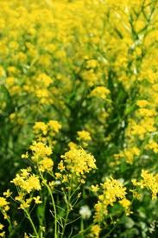
Canola
Seedling & Plant
Seed

Slide 10
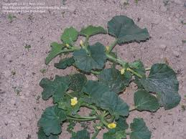
Cantalope
Plant
Seeds

Slide 11
Carrot (Root Provided)
Plant
Seed

Slide 12
Cauliflower
Plant
Seedling

Slide 13
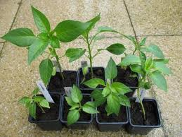
Chili Pepper
Plant
Seed

Slide 14
Corn
Plant
Seedling

Slide 15
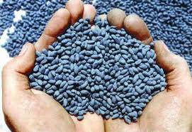
Cotton
Plant
Seed

Slide 16
Cranberry
Plant
Plant with fruit

Slide 17
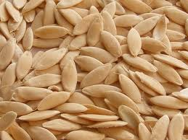
Cucumber
Plant
Seeds

Slide 18
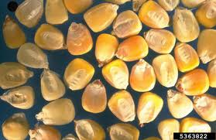
Dent Corn (Seeds Only)
Plants
Seeds

Slide 19
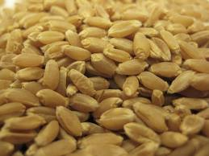
Durum Wheat (Seed Only)
Plant
Seeds

Slide 20
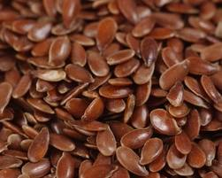
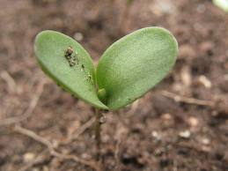
Flax
Plant
Seed

Slide 21
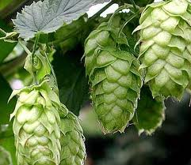
Hops
Plant
Juvenile Plant

Slide 22
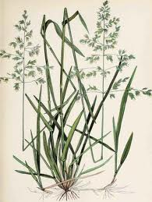
Kentucky Blue Grass
Plant
Seed

Slide 23
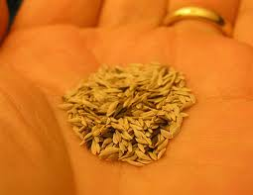
Lettuce
Plant
Seed

Slide 24
Lima Beans (Seed Only)
Seeds
Seeds

Slide 25
Oats
Plant
Seed

Slide 26
Onion
Plant
Seed

Slide 27
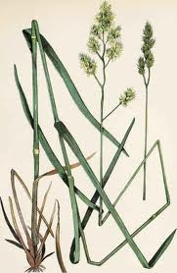
Orchard Grass
Plant
Seed

Slide 28
Peanuts
Plant
Seed

Slide 29
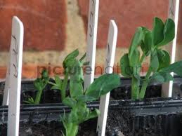
Peas
Plant
Seed

Slide 30
Pinto Beans (Seed Only)
Seed Sample
Seed Sample

Slide 31
Popcorn (Seed Only)
Seed
Seed & Product

Slide 32
Potato (Plant Only)
Plant
Young Plant

Slide 33
Red Bean (Seed Only)
Red Bean
Red Bean

Slide 34
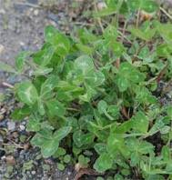
Red Clover
Plant
Seed

Slide 35
Red Wheat (Seed only)
Seed
Seed

Slide 36
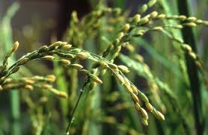
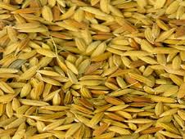
Rice
Plant
Seed

Slide 37
Rye
Plant
Seed

Slide 38
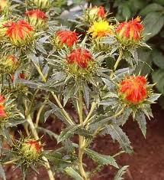
Safflower
Plant
Seed

Slide 39
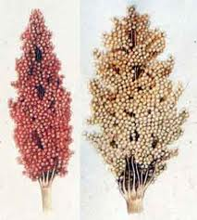
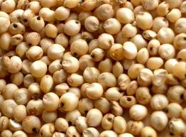
Sorghum
Plant
Seed

Slide 40
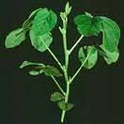
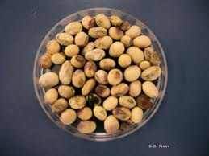
Soybeans
Plant
Seed

Slide 41
Spinach (Plant Only)
Plant
Plant

Slide 42
Squash
Plant
Seed

Slide 43
Strawberry (Plant Only)
Plant
Plant

Slide 44
Sudangrass
Plant
Seed

Slide 45
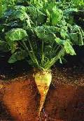
Sugar beets
Plant
Seed

Slide 46
Sugarcane (Plant Only)
Plant
Plant

Slide 47
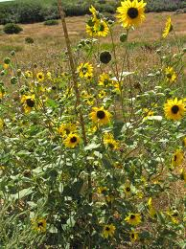
Sunflower
Plant
Seed

Slide 48
Sweet Corn (Plant Only)
Plant
Plant

Slide 49
Sweet Potato (Plant Only)
Plant
Plant

Slide 50
Sweet clover
Plant
Seed

Slide 51
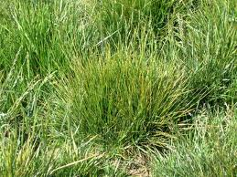
Tall Fescue
Plant
Seed

Slide 52
Timothy
Plant
Seed

Slide 53
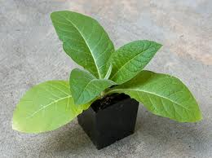
Tobacco
Plant
Seed

Slide 54
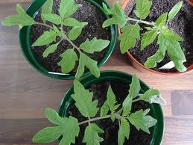
Tomato
Plant
Seed

Slide 55
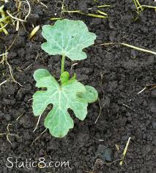
Watermelon
Plant
Seed

Slide 56
Wheat (Plant only)
Plant
Plant

Slide 57
White Beans (Seed Only)
Seed
Seed

Slide 58
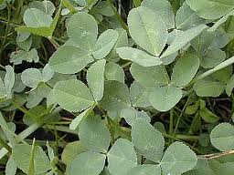
White Clover
Plant
Seed

Slide 59
White Wheat (Seed Only)
Seed
Seed

