Slide 1
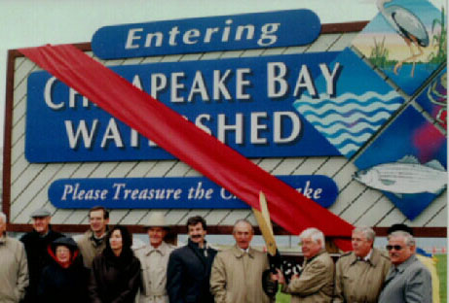
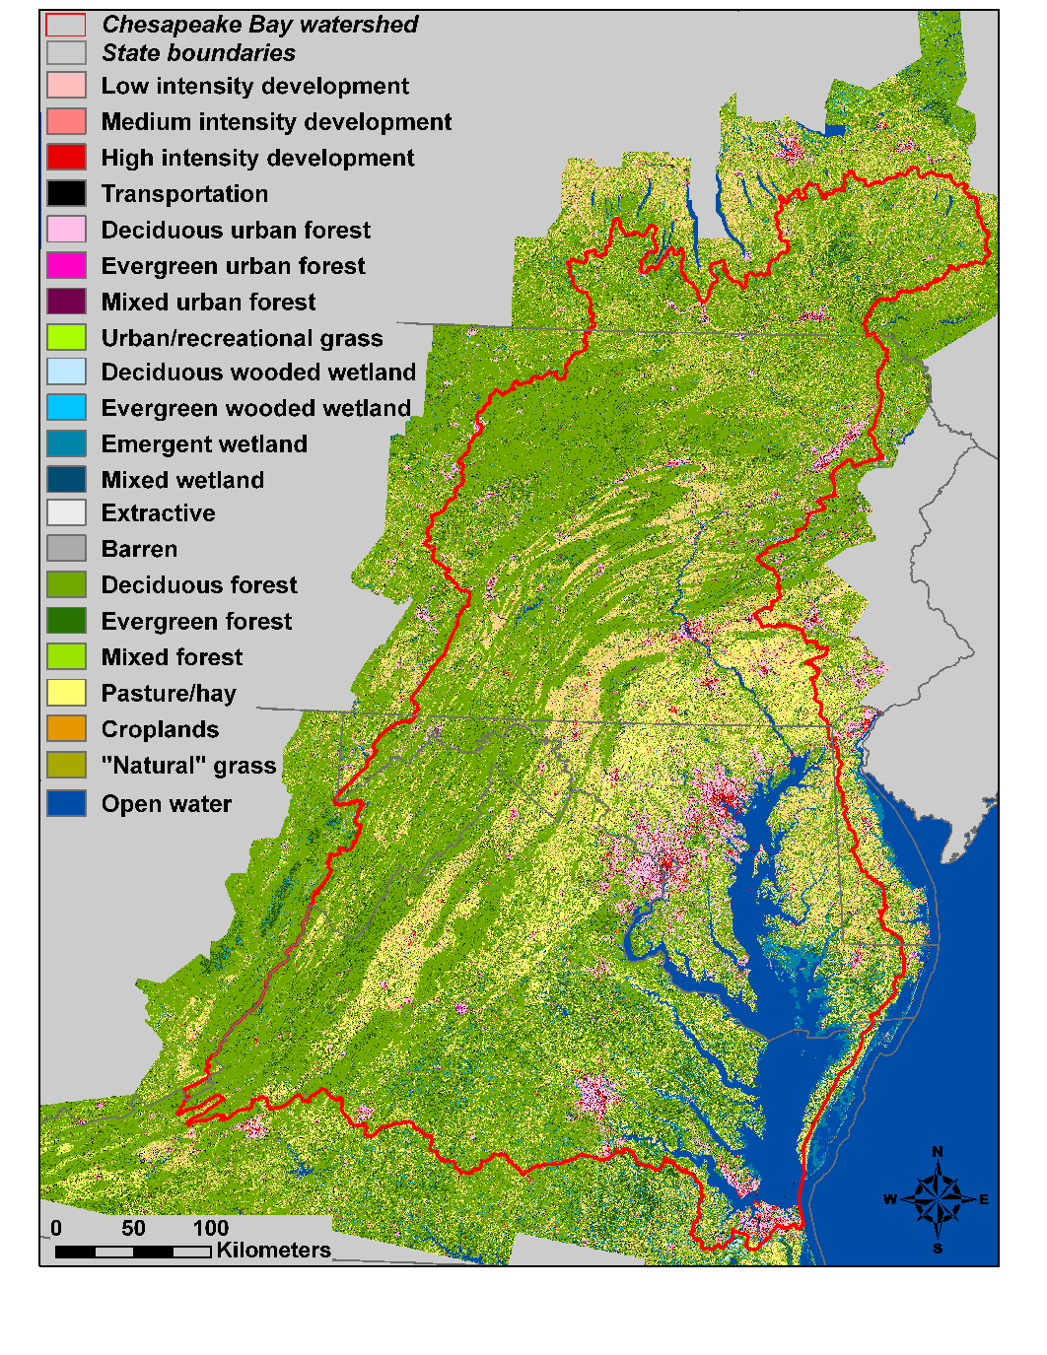
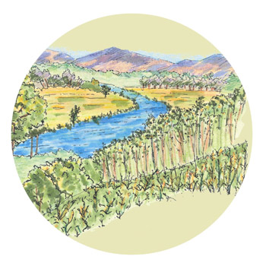
Watersheds!

Slide 2
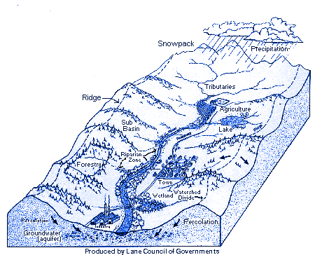
Definition
A watershed is the region draining into a river, river system, or any other body of water.

Slide 3
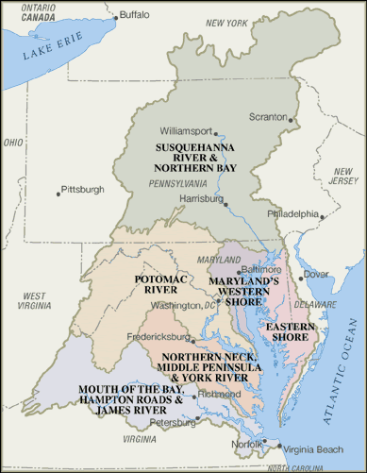
US!
We are a part of the Chesapeake Bay Watershed.
(NNN) Any others?

Slide 4
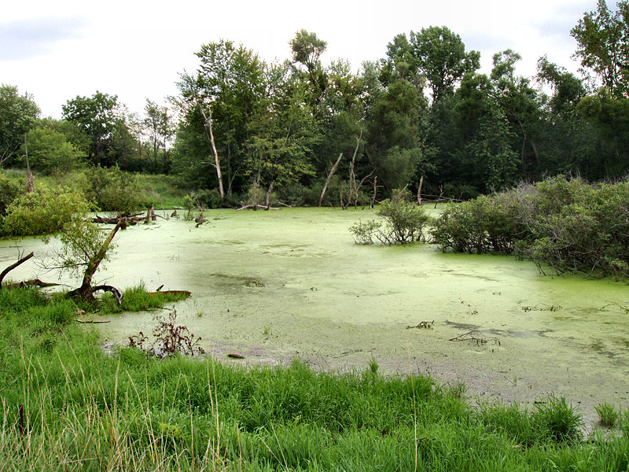
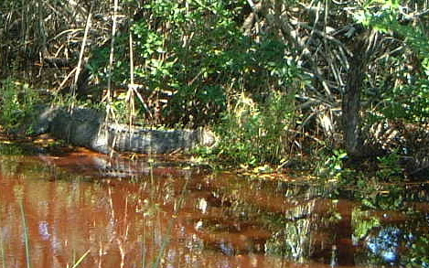
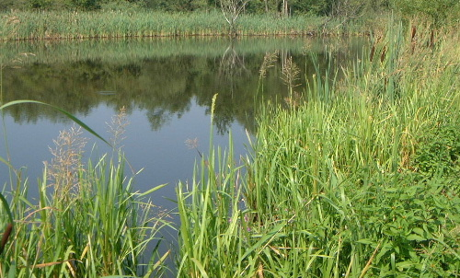
Wetland Defined!
A wetland is an area of land saturated with moisture, such as a swamp, marsh, or bog. A wetland can be fresh or saltwater.

Slide 5
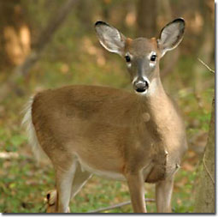
Importance?
More ___________ = More types of life?
Wetlands are important because of their biodiversity! They can support an immense variety of plants and animals!

Slide 6
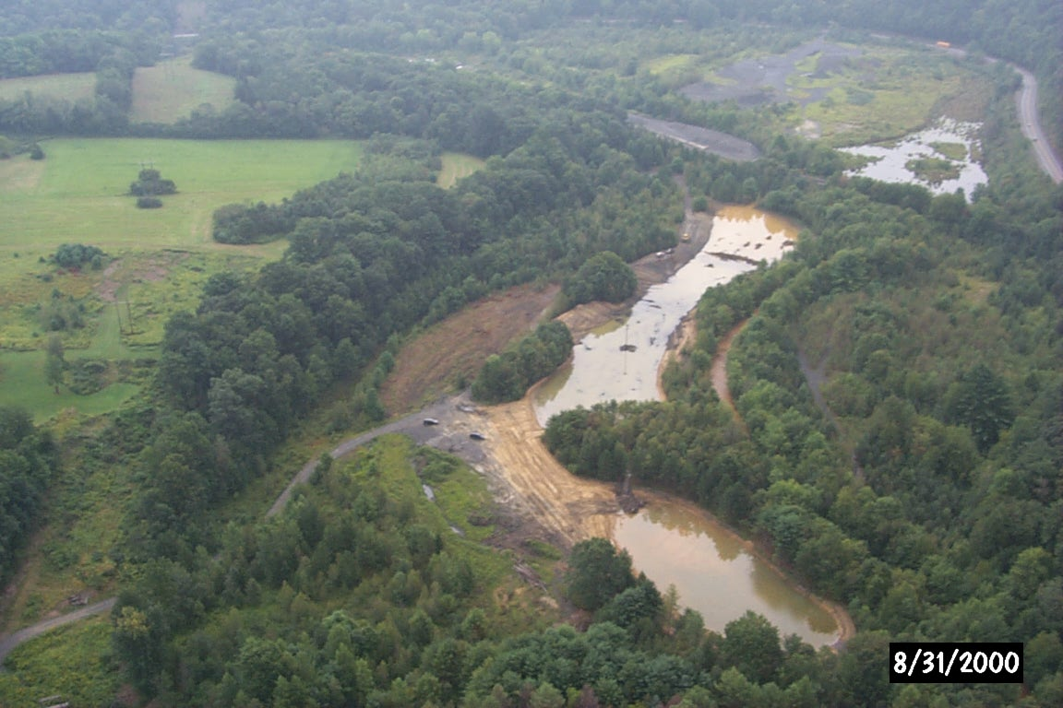
Wetlands? Watersheds????!
ALL WATERSHEDS FLOW INTO WETLANDS! Whatever the river carries gets deposited in the wetland, including pollutants! Would you want to swim in that?
BLEHCH SO GROSS!!!

Slide 7
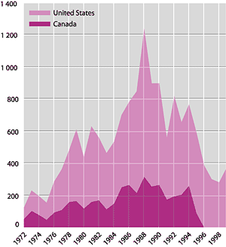
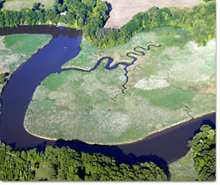
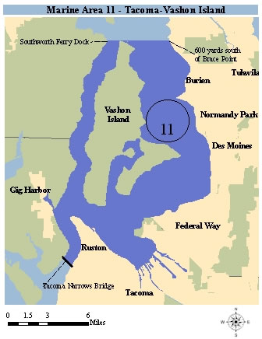
Bad effects of polluted watersheds!
Low fish numbers!!!!!
Loss of biodiversity
Poor drinking water
Loss of animal habitats
Loss of fun!

Slide 8
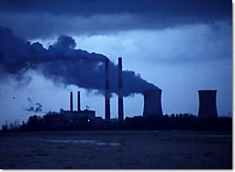
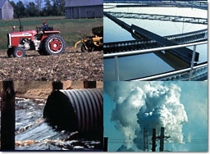
Examples of Pollutants
Fertilizers and Manure
Air pollutants
Pesticides
Industrial Chemicals
Mercury
Hydrocarbons (Result from
gas and oil being burned)

Slide 9
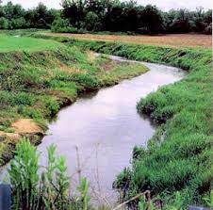
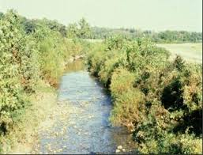
Avoiding pollution
Limit driving
Use natural fertilizers
Create a stream buffer to catch soil and run off.

