Slide 1
LEQ:
What is the #1 secret to a successful marketing campaign?

Slide 2
Do Now
If you were going to bake a delicious cake, what would be some of the most essential ingredients you would need?

Slide 3
Marketing Mix
The 4 P’s in Marketing
Product
Place
Price
Promotion

Slide 4
The # 1 Secret to any Successful Marketing Campaign
Putting the RIGHT product,
in the RIGHT place,
at the RIGHT price,
at the RIGHT time.

Slide 5
Marketing Mix
The 4 P’s in Marketing
Product:
Decisions include naming the product (brand name), product design, features, packaging, service, warranty, and how to match the target market’s wants.
Place:
Decisions include how and where a product will be distributed to get it into the consumers’ hands
Price:
Strategies should reflect what customers are willing and able to pay. Decisions relate to the list price, discounts, allowances, credit terms and promotional pricing
Promotion:
Decisions include activities related to advertising, personal selling, sales promotion, and publicity. Promotional strategies deal with how potential customers will be told about a product (message, media selected, special offers, and the timing of the promotional campaigns)

Slide 6
The Secret to the 4 P’s
Build your P’s on the RIGHT Platform
The P’s are based on the seller’s viewpoint.
A successful marketing campaign will focus on the buyer’s perspective – the customer’s viewpoint.
Once you have properly identified your target market and understand their wants and needs, you can begin to build an effective marketing mix.
Before developing your 4 P’s, you should consider your 4 C’s – the perspective of your customers.

Slide 7
Marketing Mix
The 4 C’s in Marketing
Product:
Customer Solution
Place:
Convenience
Price:
Cost (overall)
Promotion:
Communication

Slide 8
Marketing Mix
The target market is in the center, to show that all the Marketing Mix decisions are made with the customer in mind.
Product
Target
Market (customer profile)
Place
Price
Promotion

Slide 9
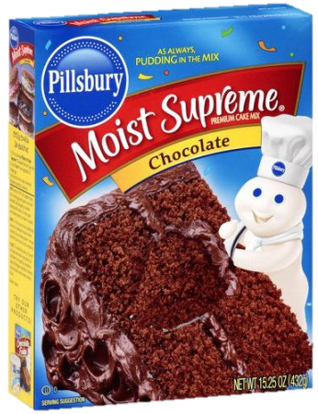
The 4 P’s with the Customer in Mind
What questions should we consider in our Marketing Mix?
Product: Cake Mix
Quality
Variety
Packaging
Benefits
Branding
(moist, pudding in the mix)
(flavors, sugar-free, gluten-free)
(colors, appeal, helpful info)
(easy, great taste, impressive)
(familiarity, trustworthiness)
Place:
Convenience
Price:
Cost (overall)
Promotion:
Communication

Slide 10
Summary
The #1 Secret to Developing a Successful Marketing Campaign is to…
Create an effective Marketing Mix using the “4 P’s” – product, place, price, promotion – while always keeping the customer in mind.

