Slide 1
What is a Virus??

Slide 2
What is a Virus?
A virus is a piece of DNA or RNA all wrapped up in a protein coat

Slide 3
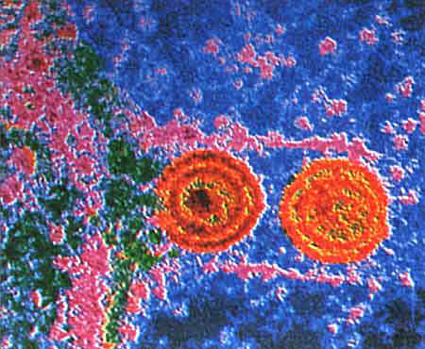
What functions can a virus perform?
Viruses must hijack cells in order reproduce
Viruses do not carry out any of the other basic life functions

Slide 4
Host vs. parasite
Your cells are considered the “host”. They provide a home and /or “food” for the parasite.
A virus can be considered a “parasite” since it “survives” by living on a host & harming it.

Slide 5
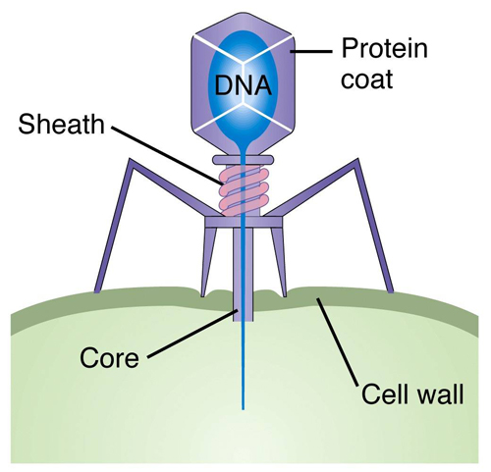
Bacteriophage
A bacteriophage is a virus that infects bacteria.

Slide 6
Virus reproduction
Virus reproduction is called the lytic cycle
It has 3 Steps

Slide 7
Lytic Cycle
1. Invade-Viral DNA/RNA must get past cell’s defenses and into the cell

Slide 9
Lytic Cycle
2. Biosynthesis-Viral DNA or RNA gets inserted into host cell’s DNA; cell starts producing virus parts

Slide 10
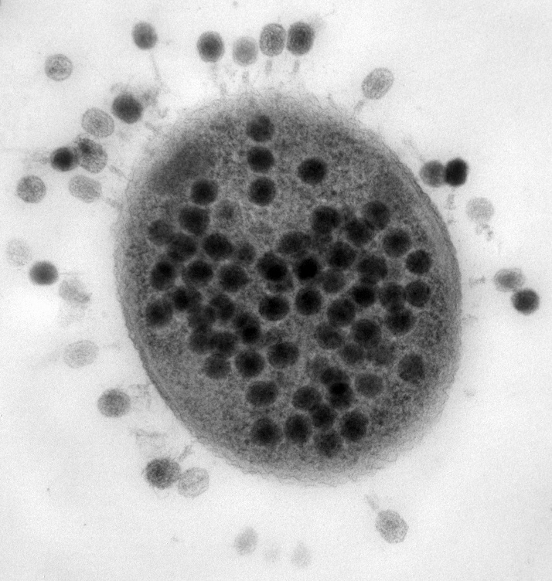
Lytic cycle…
3. Lysis- Cell bursts and new viruses infect other cells

Slide 11
Answer these questions while the movie plays… 1. Who did Jenner infect with cowpox on purpose? 2. What binds to the surface of viruses flagging them for death? 3. How do vaccines work? 4. Why do they put the viruses in a chicken egg?

Slide 12
Vaccine
Vaccine – A dead or weakened form of the pathogen that allows the patient to be immune to the real pathogen.
Ex- Polio Vaccine developed by Dr. Jonas Salk
Eradication – Removing a disease from the face of the Earth.
Ex- Smallpox
(NNN)“The annihilation of smallpox—the dreadful scourge of the human race—will be the final result of vaccination.”—Edward Jenner (1749–1823)

Slide 13
(NNN) Common Vaccinations
Polio
MMR (measles, mumps, rubella)
DTP (diphtheria, tetanus, pertussis)
Hepatitis B
Varicella (chicken pox)

Slide 14
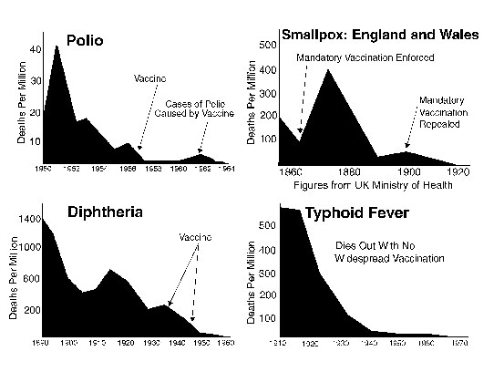
Results of Vaccination
Chlorinated drinking water

Slide 15
Online example of the Lysis Cycle
http://www.sci.sdsu.edu/~smaloy/MicrobialGenetics/topics/phage/lysis.html
http://www.cellsalive.com/howbig.htm

Slide 16
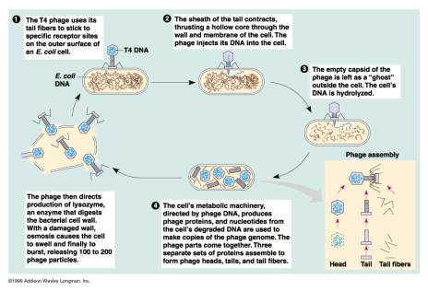
Another example of the lytic cycle.

Slide 17
