Slide 1
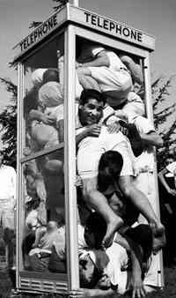
Diffusion Confusion?
High Concentration to Low Concentration!

Slide 2
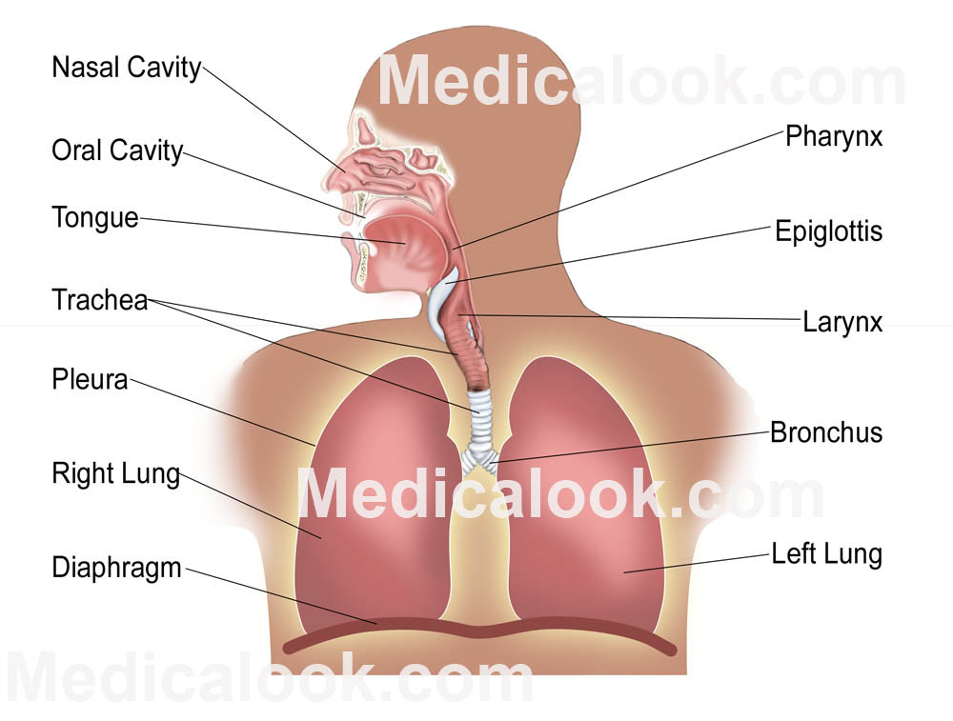

Slide 3
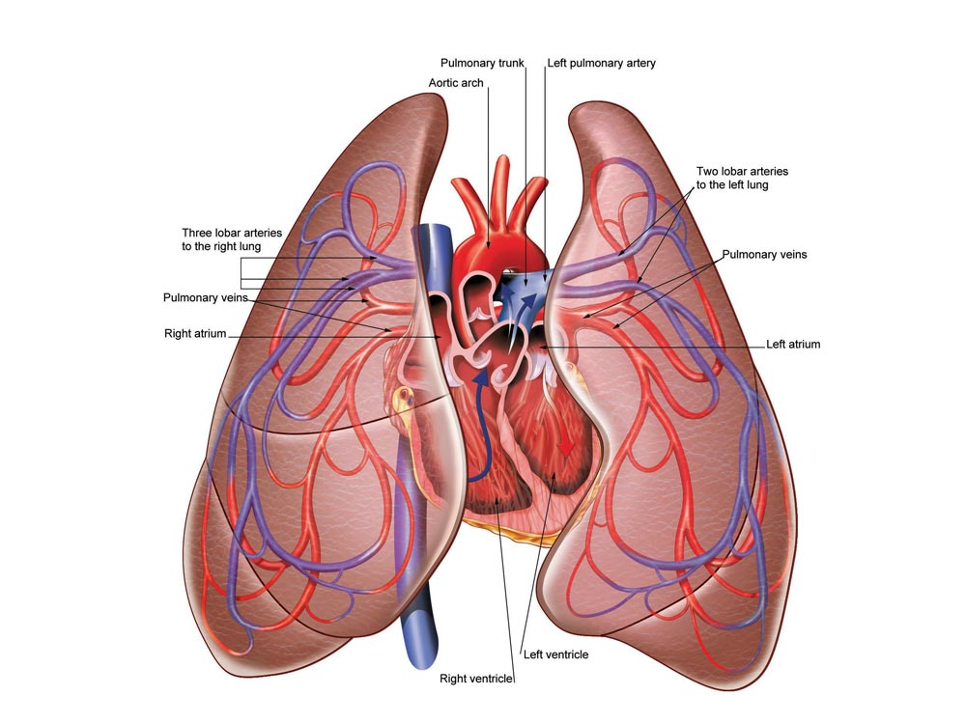

Slide 4
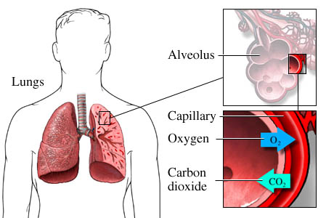
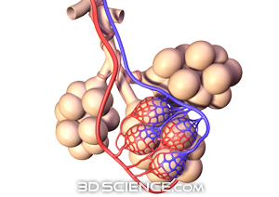

Slide 5
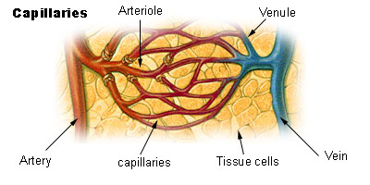

Slide 6
OXYGEN:
Nasal Cavity
Epiglottis
Trachea
Bronchus
Alveoli
Diffusion
Capillaries
Red Blood Cell
Pulmonary Vein
Left Atrium
Left Ventricle
Aorta
Arteries
Capillaries
Diffusion
CARBON DIOXIDE:
Diffusion
Red Blood Cell,
Capillaries,
Veins,
Inferior Vena Cava,
Right Atrium,
Right Ventricle,
Pulmonary Artery,
Capillaries,
Diffusion,
Alveoli,
EXHALE!

