Slide 1
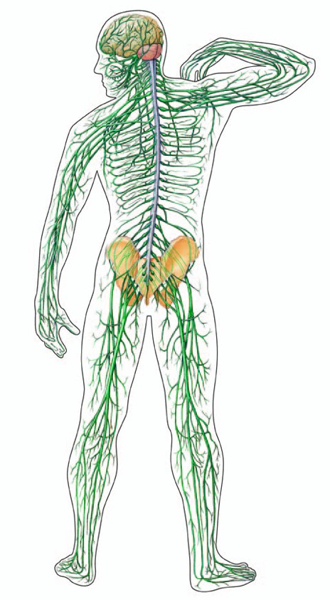
Central Nervous System!
Peripheral
Nervous
Life Science 2016
System

Slide 2
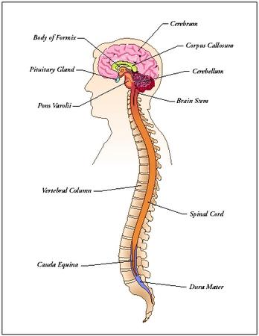
Central Nervous System (CNS)
The Central Nervous System is the control center of the body
It includes the…
Brain
Spinal Cord

Slide 3
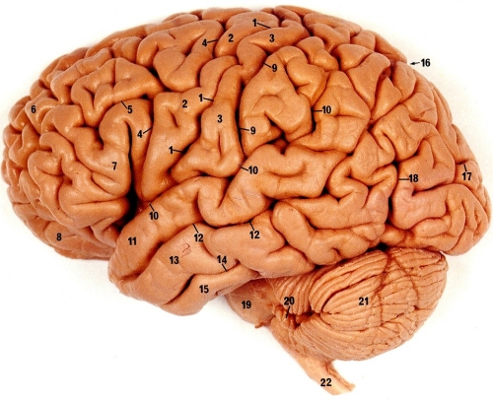
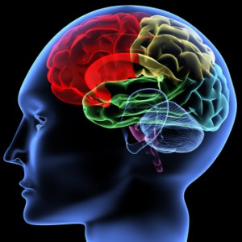
The Brain!
Controls most functions in the body!

Slide 4
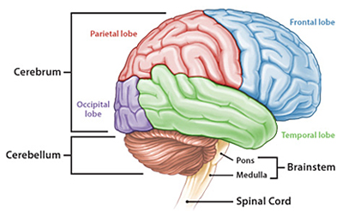
Parts O’ the Brain
Cerebrum
Interprets sensory input
Controls movement
Memory
Personality

Slide 5
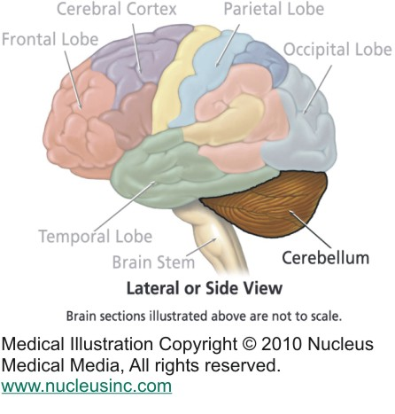
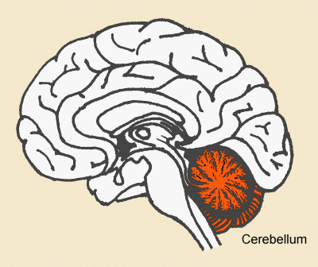
Parts O’ the Brain
Cerebellum
Coordinates the action of muscles (muscle memory)
Helps maintain balance

Slide 6
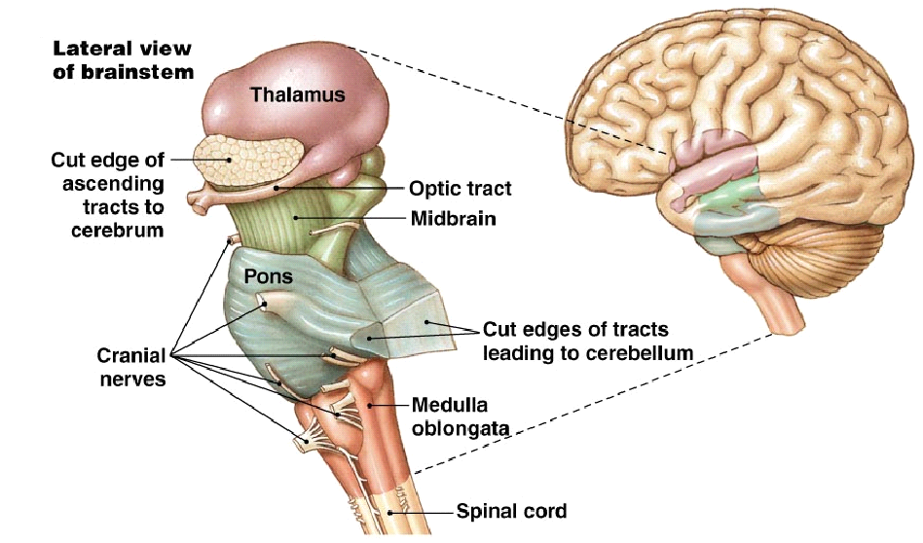
Parts O’ the Brain
Brain Stem
Controls involuntary actions
Regulates breathing
Controls heartbeat

Slide 7
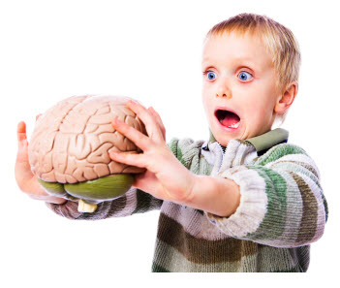
Food for thought
The Cerebral Cortex of a baby is only 25% of that of an adult. By age 1, it has reached 75% adult size. However, your brain does not reach full adult size until you are 16-17 years of age. In order for your brain to develop to its full potential, you need to provide it with good nutrition and experiences.

Slide 8
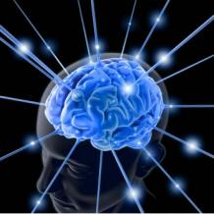
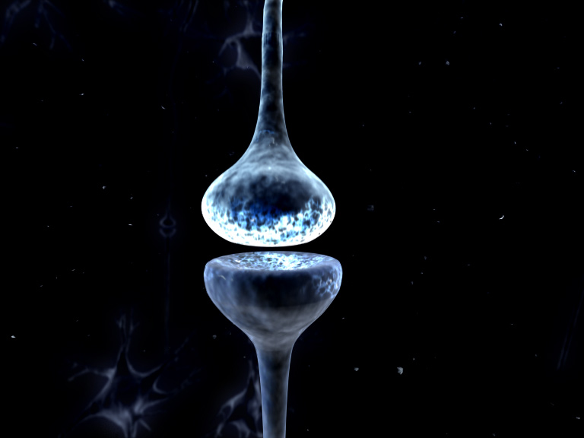
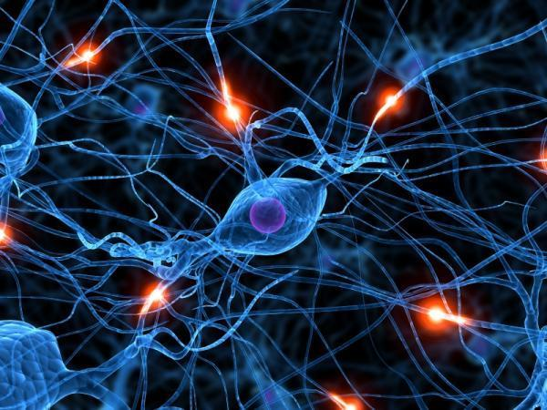
Food for thought
You can increase the number of connections in your brain! What does this mean?
You are as smart as you want to be!

Slide 9
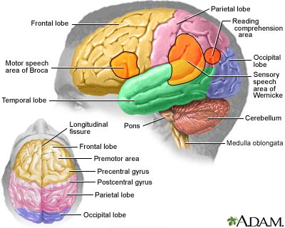

Slide 10
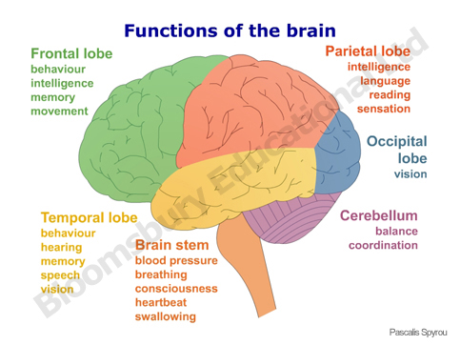
smell

Slide 11
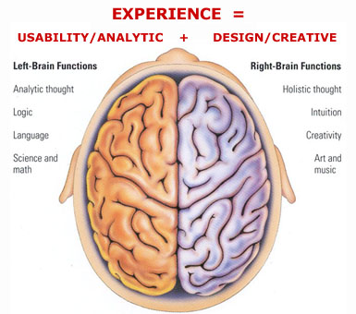

Slide 12
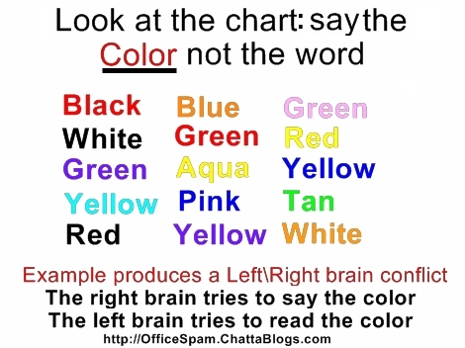

Slide 13
http://www.fireworkspop.com/colortest.htm
http://www.echalk.co.uk/amusements/OpticalIllusions/illusions.aspx

Slide 14
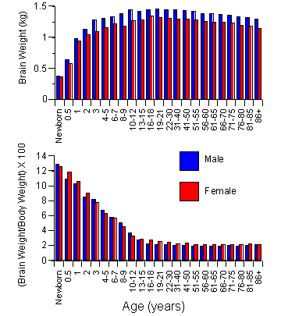

Slide 15
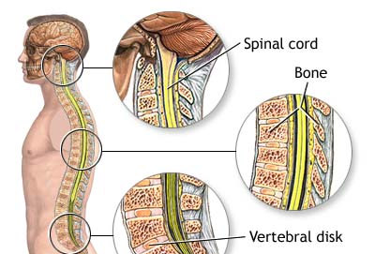
Spinal Cord
Acts as the link between your brain and the peripheral nervous system.

Slide 16
Peripheral Nervous System
Network of nerves that branch out of the Central Nervous System and connect it to the rest of the body.
Involved in involuntary and voluntary actions .

Slide 17
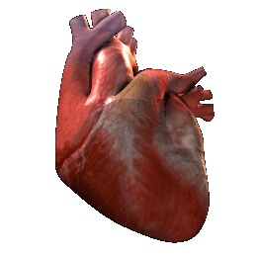
Peripheral Nervous System
Divided into these two groups
Somatic nervous system-these nerves control voluntary actions.
Autonomic nervous system-these nerves control involuntary actions.

Slide 18
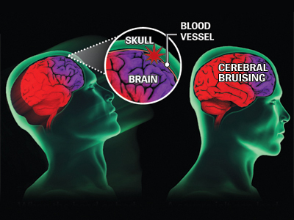
CONCUSSION!
A bruising of the soft tissue of the brain when it collides with the skull!

