Slide 1
THE MICROSCOPE

Slide 2
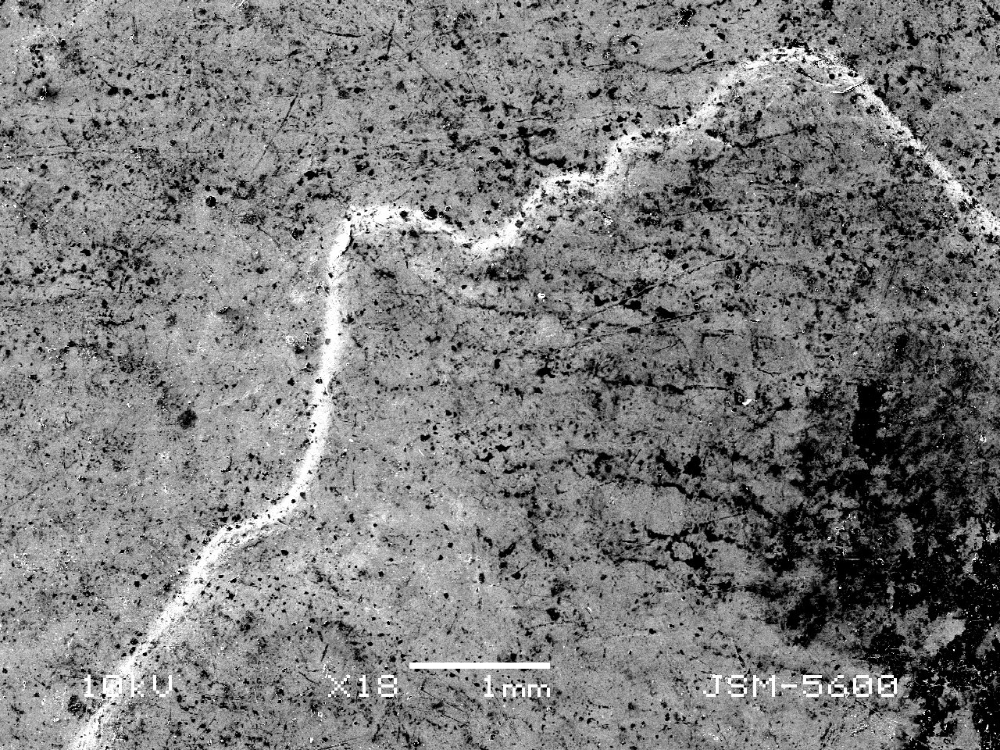
What is it?

Slide 3
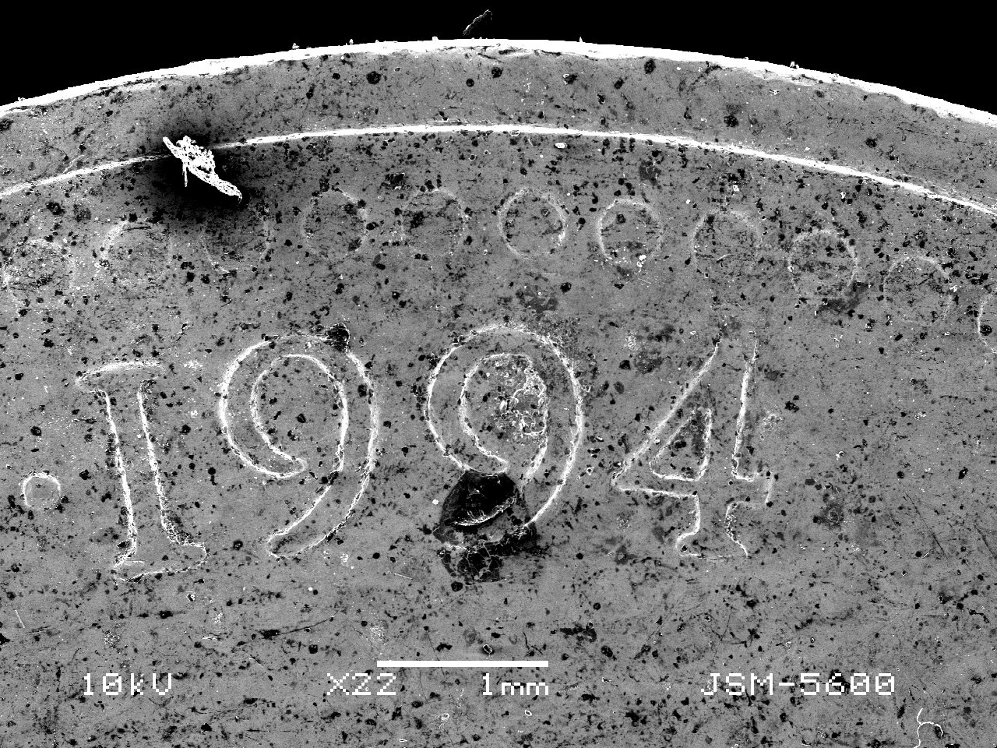
What is it?

Slide 4
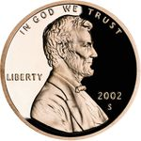

Slide 5
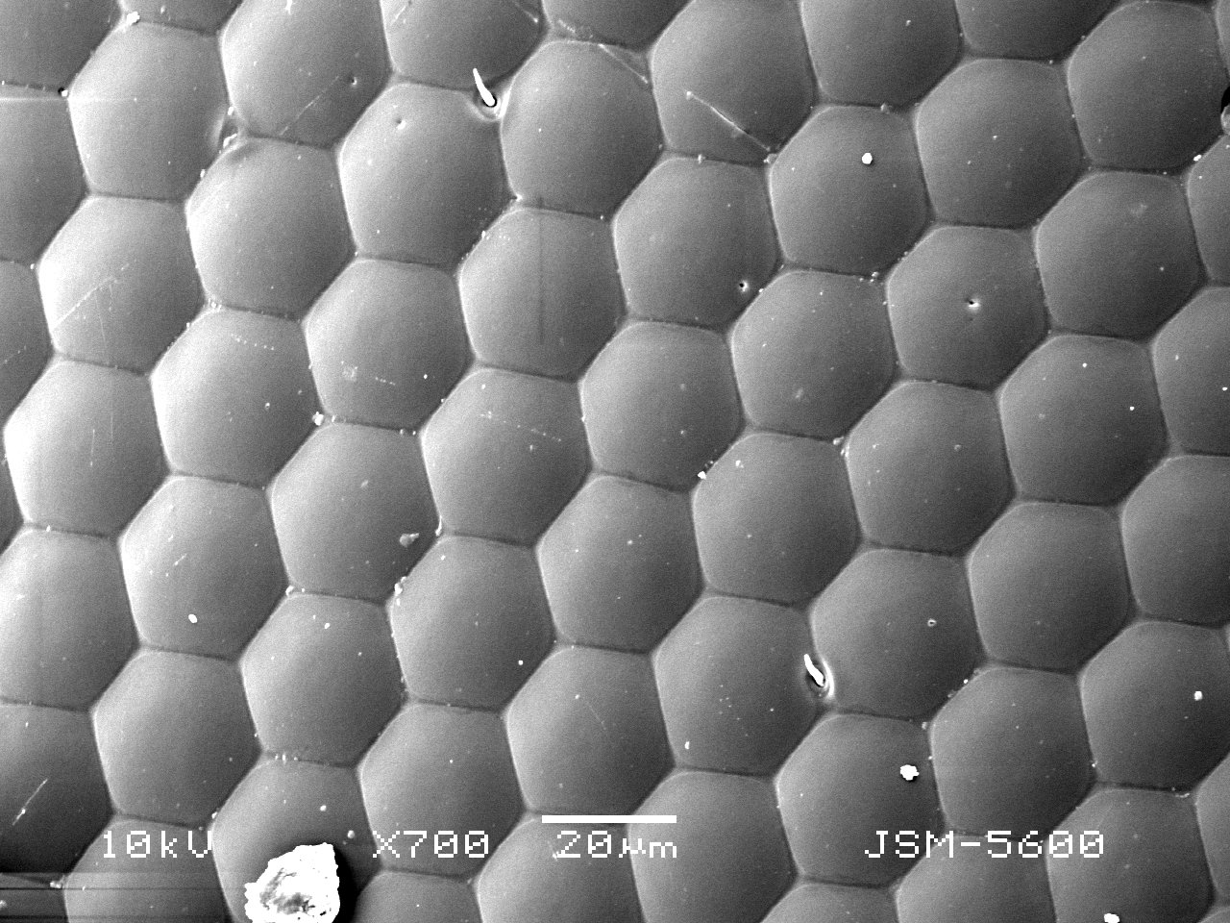
What is it?

Slide 6
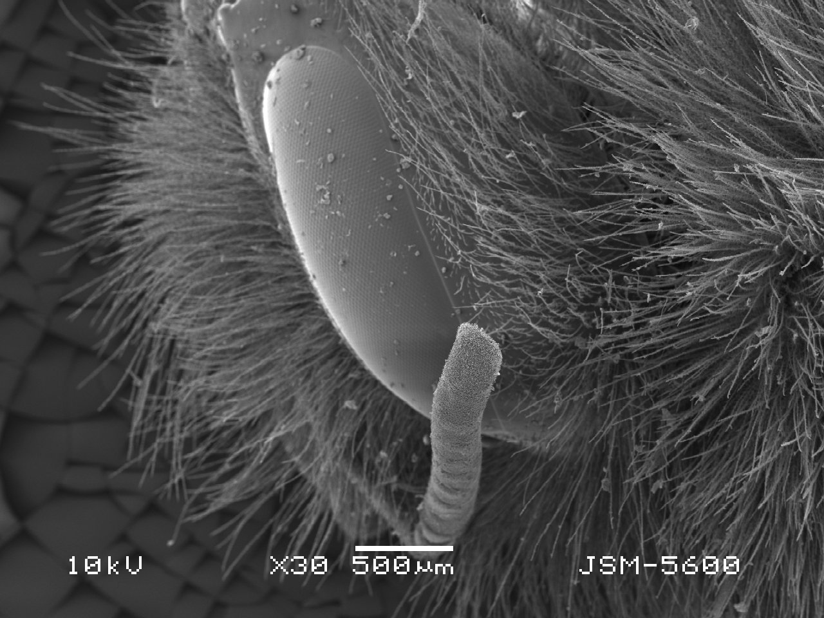
What is it?

Slide 8
Our Microscopes

Slide 9
The “first” microscope was believed to have been invented by Zacharias Jannssen in Denmark around 1590 or so. He and Hans Lepperdshey, also developed the telescope.
One of the first scientists to use the microscope was Robert Hooke – he described and named the first “cells” because they reminded him of tiny rooms.
Hooke’s microscope was improved by Anton van Leeuwenhoek. His lenses were considered “the best” for over 200 years. His scopes could magnify up to 275x.

Slide 10
The Light Microscope
Light microscope- uses light to form an enlarged image of the object being viewed.
Simple light microscope – uses one lens to magnify an object.
Compound Light Microscope – Uses two lenses to magnify an object.

Slide 11
Magnification – the apparent increase in an object’s size. Magnifying something decreases your field of view.
Resolution – an increase in visible detail – only available in Electron Microscopes.
We can only bring the sample in to focus.

Slide 12
Compound light microscope
Compound light microscope- has two lenses
1. Eyepiece (or ocular ) lens – One lens is near your eye. The image is reversed.
2. Objective lens – this lens is near the specimen (object) being viewed.

Slide 13
Total magnification =
(Power of the eyepiece) X (Power of the objective)
Example # 1 If the eyepiece magnifies 10 times and the objective magnifies 10 times, then:
Eyepiece = 10 X objective = 10X
Total magnification = 10 X 10 = 100

Slide 14
Example #2 If the eyepiece magnifies 10 times and the objective magnifies 43 times then:
Eyepiece = 10 X objective = 43 X
Total magnification = 10 X 43 = 430

Slide 15
Other Types of Microscopes
1. Stereomicroscopes
A. There is an eyepiece and objective for each eye.
B. Image is 3-D and magnified 5-60 times.
(The Image is like a viewmaster.)
C. The image is not reversed.

Slide 16
2. Phase Contrast Microscope
A. Can see details within a living specimen.

Slide 17
Electron Microscope
3. Electron Microscope
A. Create an image with a beam of electrons instead of a beam of light.
B. Specimens are embedded in plastic, sliced and then coated with metal.
C. Specimens cannot be alive.
D. EM has greater resolution (clearer picture) and magnification than light microscopes.

Slide 18
Electron Microscope (cont)
E. Transmission electron microscope (TEM) magnifies about 250,000 times.
F. Scanning electron microscope (SEM) magnifies about 100,000 times and produces a 3-D view.
G. Scanning tunneling microscope (STM)
used to view living specimens.

Slide 19
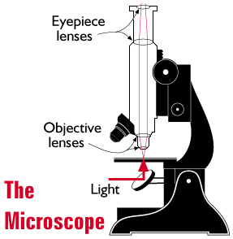
How does it work?
Light from the object moves through the objective lens and is magnified.
In the eyepiece (ocular lens) the light is bent (called refraction) and focused on a point on the lens.
The distance between the objective and ocular lenses is called the focal length.

Slide 20
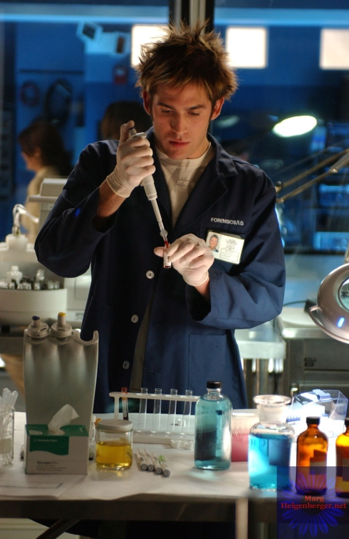
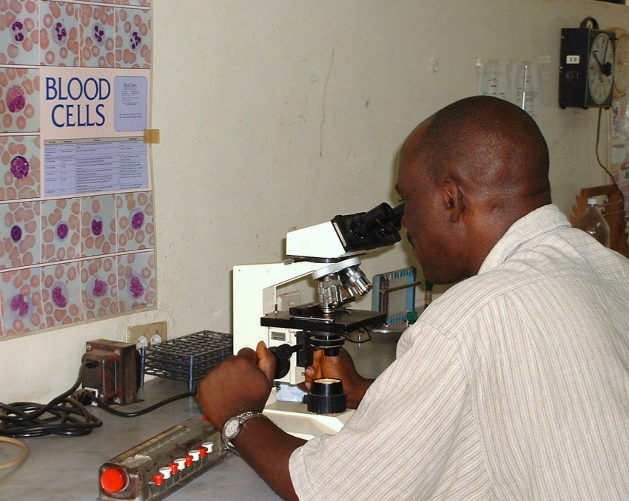
GET A JOB!
Jobs that employ a microscope include:
Science Teacher!
Lab Technician at a hospital
Crime Scene Investigator

Slide 21
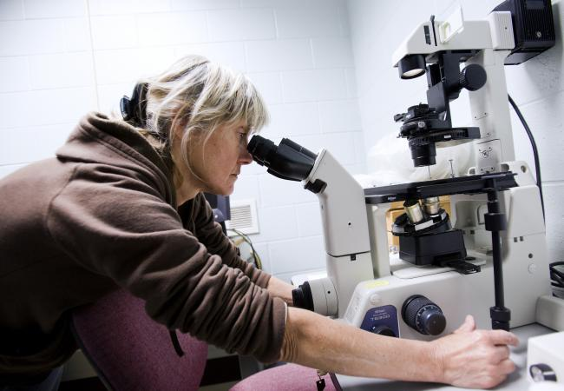
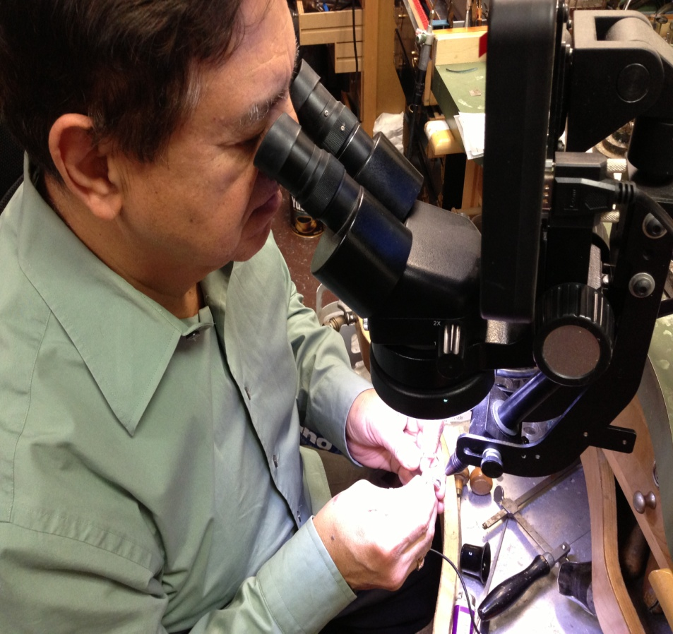
GET A JOB!
Gemologist
Research Scientist
Epidemiologist
And MANY MANY MANY MORE!!!!!!

Slide 22
Using the Microscope
1. Carry the microscope with two hands. One hand should be on the base and one hand on the arm.
2. Place your microscope several inches back from the edge of your table.

Slide 23
3. Use lens paper to clean the objective lenses and stage.
4. DO NOT move the stage when the high power objective is in place. (Do not use the coarse adjustment knob.)
5. Store the microscope with the scanning objective (black) in place.
Treat your scope as if you bought it – because if you break it… you’ll pay to fix it.

Slide 24
My Goals…
1. For you to learn to use a piece of scientific equipment.
2. For you to learn to make observations and collect data (your sketches).
3. For you to realize that there is a whole world much more numerous and smaller than us.

Slide 25
Draw two circles in your notes
Each about 3 inches in diameter.
Don’t forget to list the power and to describe what you view.
As you increase
power, you decrease the
field of view! Therefore,
you have to move your
slide more!
Field of view @ 40x
100x
400x

