Slide 1
Copy down the following questions and then answer them:
How do humans get malaria?
How do mosquitoes get the Plasmodium parasite?
In what continent does Malaria affect the most people?

Slide 2
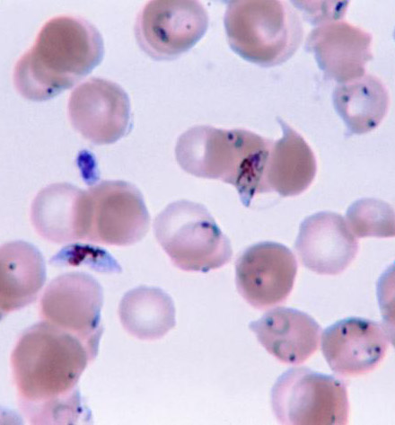
Malaria is an infectious disease caused by the protist Plasmodium that is potentially fatal.

Slide 3
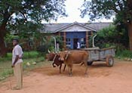
Malaria
Malaria is called the "stealer of dreams."

Slide 4
Malaria FACTS
Around 500 million cases of malaria a year (only 5 cases in the U.S.).
Accounts for more than 3,000,000 deaths a year (NNN 1,000,000 children U5 in Africa).
On average, one child dies in Africa from Malaria every 30 seconds!
Believed to be responsible for a quarter of deaths during the American Civil War.

Slide 5
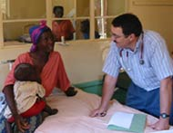
Malaria
Symptoms of malaria are:
Fever
Chills
Flu-like symptoms
More severe cases can lead to death in three weeks

Slide 6
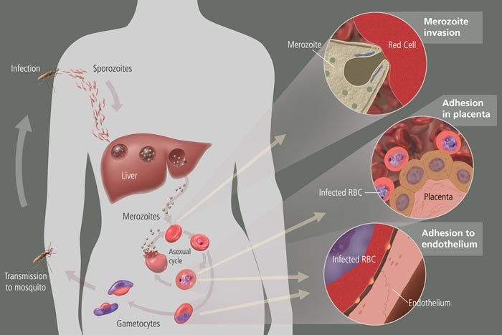

Slide 7
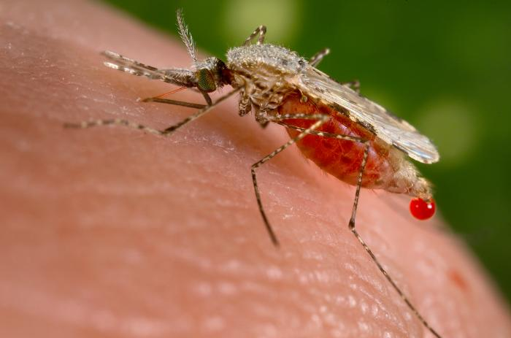
Life Cycle
Life Cycle of Malaria
1. Person is bitten by a mosquito infected with the Plasmodium protist.

Slide 8
Life Cycle
2. The Plasmodium cells infect the human’s liver. They grow and
change.

Slide 9
Life Cycle
3. This new form can infect normal Red Blood Cells, causing the cell to burst after they reproduce over and over again.

Slide 10
Life Cycle
4. An uninfected mosquito can become infected by biting a human that carries the Plasmodium protist.

Slide 11
Treatments?

Slide 12
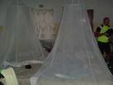
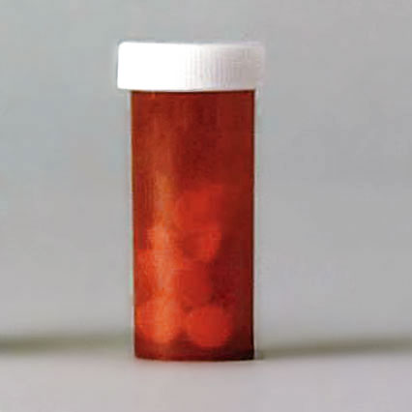
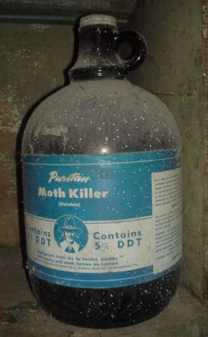
Treatments
The treatments of malaria are:
Mosquito nets
Medicine
Insecticide

Slide 13
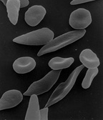
Sickle-cell anemia
An inherited disorder where red blood
cells are deformed and don’t carry oxygen as well.

Slide 14
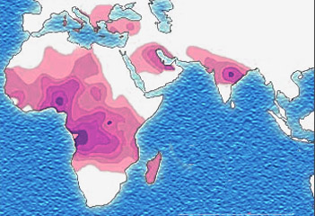
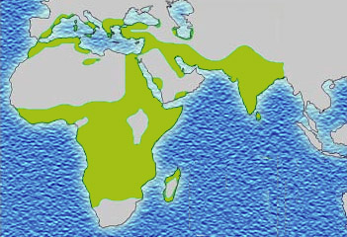
Sickle-cell and Malaria in Africa?
Sickle-Cell Malaria

Slide 15
Sickle-cell gives a person immunity to malaria, so it is more popular in malaria stricken places. Those people with sickle-cell have a better chance to survive until the age that they can have children and pass on their sickle-cell gene to their off-spring.

