Slide 1
The Cell Theory

Slide 2
The Cell Theory States that:
All living things are made of cells.
Cells are the basic units of structure and function in living things.
Living cells come only from other living cells.

Slide 3
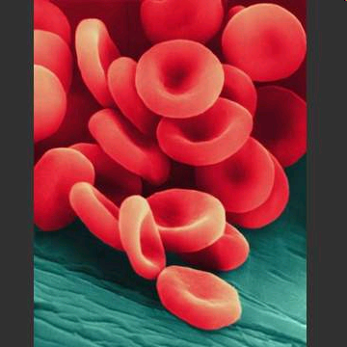
A cell is defined as …
The basic units of structure and function in living things.

Slide 4
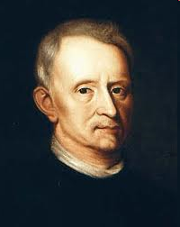
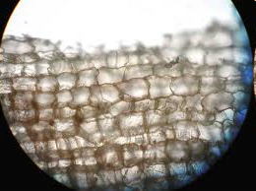
Cells were first described by the English scientist…
Robert Hooke, who thought they resembled the tiny rooms, or cells where monks live.
Actually, Hooke did not see living cells, just the cell walls of dead cork cells.

Slide 5
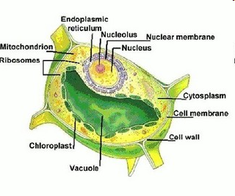
Cells contain structures called…
Organelles.
This term means tiny organs.

Slide 6
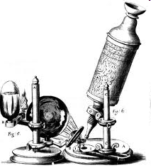
The discovery of cells and their internal parts was made possible by the invention of the…
Microscope in the late 16th century.
NNN - The first microscope is credited to two Dutch eyeglass makers, Hans Lepparshey and Hans Jannsen – Lepparshey also was the first to create a basic telescope.

Slide 7
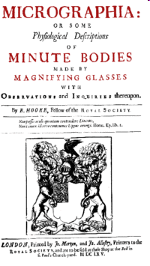
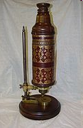
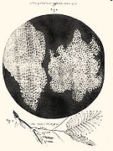
NNN
Hooke gets all the glory because of his best selling book, Micrographia, which has very detailed drawings.

Slide 8
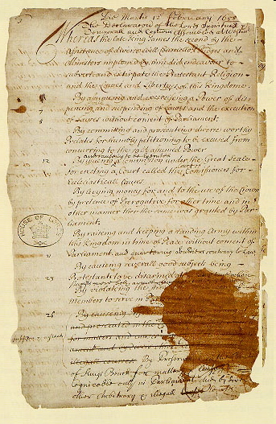
This was around the same time as the English Bill…
of Rights.

Slide 9
During the next two hundred years, the work of many scientists led to the development of the Cell Theory. This theory can be summarized by three statements:
{Look at the top of this paper}

Slide 10
Scientists that contributed to the Cell Theory:
Robert Hooke –English scientist, published Micrographia in 1665 w/ detailed sketches from the microscope.
Anton van Leewenhoek – looked at blood, rainwater, and scrapings from his teeth (yuk!), 1674.
Mathias Schleiden – 1838 – co-founder of cell theory, with Theodor Schwann - they were having dinner & discussing what they were studying.
Rudolph Virchow – 1855 – “All cells come from other living cells”

Slide 11
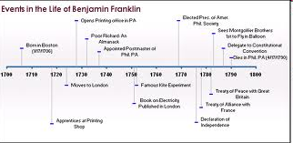
Putting your head together w/ your compadre, construct a timeline…
Here’s an example

Slide 12
Begin your timeline with the oldest year…
Next, determine what your most recent year is…
Fill in the rest…
You are doing this to try to correlate history with science.

Slide 13
Historical Events
In 1492, Columbus sailed the ocean blue
English Bill of Rights – 1689
French and Indian War – 1754-1763
Declaration of Independence – duh!
Our War for Independence – 1775-1783
Lewis and Clark’s expedition of the American West – 1804-1806

