Slide 1
Life Science
Heredity

Slide 2
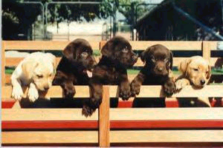
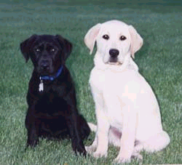
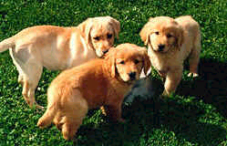
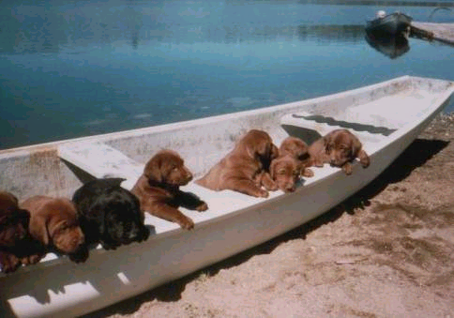
Genetics The study of heredity, how traits are passed from parent to offspring
or
x
=
or

Slide 3
Genetics
Small sections of DNA are responsible for a “trait”. These small sections are called “Genes”.
Gene - A segment of DNA that codes for a specific trait
Alleles – Different forms of a gene. One from mom and one from dad
Gene

Slide 4
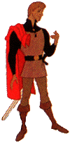
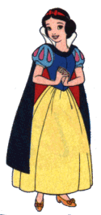
Genetics
Hair color is a perfect example of a trait
What color hair should their children have?
Prince Charming is blond
Snow White has dark hair

Slide 5
Genetics
There are two basic kinds of alleles:
Dominant - An allele that is always expressed and hides others
Recessive - An allele that is only expressed when a dominant allele isn’t present
There is also:
Incomplete Dominance – The dominant allele doesn’t completely mask the recessive.
Codominant – Both dominant alleles are expressed or shown – neither is masked.

Slide 6
Genetics
These combinations of alleles form two things
Genotype – the combination of alleles represented by two letters such as AA, Aa, or aa
Phenotype – the actual appearance of an organism that the combination makes

Slide 7
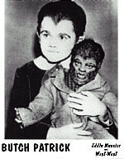
Genetics
Dominant and Recessive Genes
A dominant allele will always mask a recessive allele.
A “widows peak” is dominant, not having a widows peak is recessive.
If one parent contributes an allele for a widows peak, and the other parent doesn’t, the off- spring will have a widows peak.
Widows Peak

Slide 8
Genetics
Punnet Square - A tool we use for predicting the traits of an offspring
Letters are used as symbols to designate alleles Capital letters are used for dominant alleles
Lower case letters are used for recessive alleles
Alleles always exist in pairs

Slide 9
Genetics
A Widows Peak, dominant, would be symbolized with a capital “W”, while no widows peak, recessive, would be symbolized with a
lower case “w”.
Father - No Widows Peak - w
Mother - Has a Widows Peak - W

Slide 10
Genetics
All organisms have two copies of each allele, one contributed by the father, the other contributed by the mother.
Homozygous - Two copies of the same allele
Heterozygous - Two different alleles

Slide 11
Genetics
For the widows peak:
WW - has a widows peak Homozygous dominant
Ww - has a widows peak Heterozygous
ww - no widows peak Homozygous recessive

Slide 12
Genetics
Since Herman has no widows peak, he must be “ww”, since Lilly has a widows peak she could be either “WW” or “Ww”
Definitely ww Homozygous
recessive
Either Ww Heterozygous
or WW Homozygous dominant

Slide 13
Genetics
We can use a “Punnet Square” to determine what pairs of alleles Lilly has
A Punnet Square begins with a box 2 x 2
One gene is called an “allele”
One parents pair is split into alleles on top, the other along the side
Each allele is crossed with the other allele to predict the traits of the offspring
Assume Lilly is heterozygous
Ww
W
w
Assume Herman is homozygous recessive
ww
w
Ww
ww
w
Ww
ww

Slide 14
Genetics
Notice that when Lilly is crossed with Herman, we would predict that half the offspring would be “Ww”, the other half would be “ww”
Half “Ww”, Heterozygous, and will have a widows peak
Half “ww”, Homozygous, and will not have a widows peak
W
w
w
Ww
ww
w
Ww
ww

Slide 15
Genetics
Another possibility is that Lilly might be “WW”, homozygous dominant.
Assume Lilly is homozygous dominant
WW
W
W
Assume Herman is homozygous recessive
ww
Notice that all the offspring are heterozygous and will have a widows peak
w
Ww
Ww
w
Ww
Ww

Slide 16
Genetics
So which is true? Is Lilly homozygous dominant (WW) or is she heterozygous (Ww)?
W
w
W
W
w
Ww
ww
w
Ww
Ww
w
Ww
ww
w
Ww
Ww

Slide 17
Genetics
If Lilly were heterozygous, then there’s a 50% probability of their offspring having a widows peak.
If Lilly were homozygous, there’s a 100% chance of their children having a widows peak
W
w
W
W
w
Ww
ww
w
Ww
Ww
w
Ww
ww
w
Ww
Ww

Slide 18
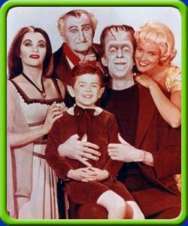
Genetics
Recall that Herman and Lilly had another offspring, Marylin. She had no widows peak, therefore, Lilly must be heterozygous.

Slide 19
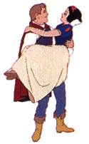
Genetics
So, back to the original question. What color hair will the offspring of Prince Charming and Snow White have?

Slide 20
Genetics
Hair color is different from widows peak, no color is truly dominant.
Dark and blond are the two, true traits
Homozygous conditions produce either dark or blond hair
Heterozygous conditions produce red hair

Slide 21
Genetics
For Snow White to have dark hair she must be homozygous dominant, “BB”, a blond Prince Charming must be homozygous recessive, “bb”.
B
B
b
Bb
Bb
b
Bb
Bb

Slide 22
Genetics
All the offspring from Prince Charming and Snow White will therefore be heterozygous, “Bb”, and since hair color is codominant….. all their children will have red hair.
+

