Slide 1
Atomic Theory

Slide 2
First Ideas about Matter...
Aristotle’s musings...
Matter is infinitely divisible
Everything is made of “hyle”
Different materials are because of varying degrees of moisture, dryness, heat and cold
Democritus’s shower thoughts...
Matter is made of tiny particles and empty space
“atomos” means “indivisible
Different materials are made of different atoms

Slide 3
How did the Greeks test their hypotheses?
Two class-system
Philosophers/upper class
Plebeians/lower class
THEY DIDN’T
Philosophers felt working with hands was beneath them
Plebeians were not allowed to use their minds for upper level thinking.
EXPERIMENTATION REQUIRES BOTH

Slide 4
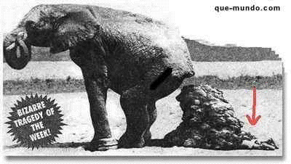
(~400 B.C.-1700 A.D.)
People blindly accepted Aristotle’s theories because he was Aristotle (wouldn’t you?)
Everyone accepted his “pile of hyle”

Slide 5
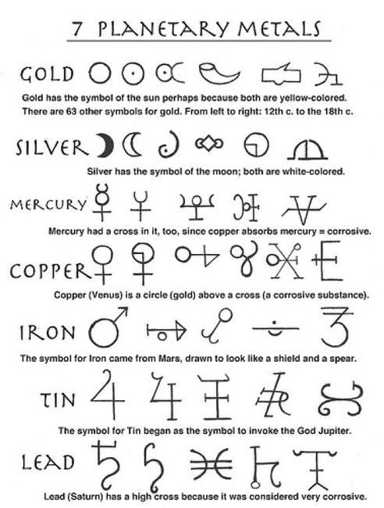
The Alchemists
Tried to make gold out of more common materials
EPIC FAIL
HOWEVER, they were successful in establishing many experimental techniques and systems of notation and symbols

Slide 6
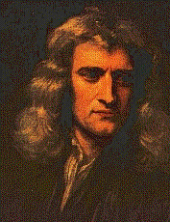
The Challengers
Sir Isaac Newton (invented calculus and devised the Laws of Motion) and Robert Boyle (considered the world’s first chemist)
Both challenged Aristotle’s views on matter

Slide 7
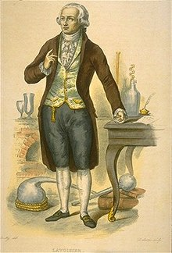
The Challengers
Antoine Lavoisier (“Father of modern chemistry;” recognized and named oxygen and hydrogen; determined oxygen’s role in combustion )
Established the Law of Conservation of Matter

Slide 8
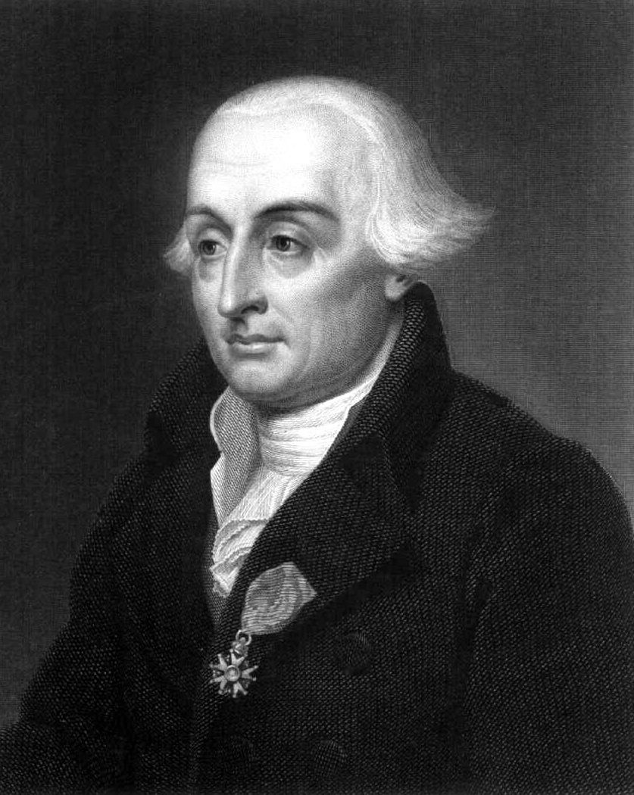
The Challengers
Joseph Proust (French Chemist who taught in Spain and who’s lab was burned when Napoleon invaded)
Established the Law of Definite Proportions (compounds form with elements in specific ratios to form compounds)

Slide 9
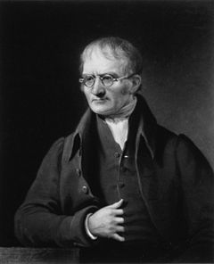
The Challengers
John Dalton FRS (English chemist known for proposing the modern atomic theory and researching hereditary color blindness)
Established the Law of Multiple Proportions (compounds form with other elements in specific whole-number ratios)

Slide 10
Still have mucho to learn...

Slide 11
Modern Atomic Theory – The Assumptions
John Dalton FRS (English chemist known for proposing the modern atomic theory and researching hereditary color blindness)
Four assumptions about matter:
All matter is made of atoms
Atoms of the same element are identical
Atoms of different elements are different
Atoms unite in simple ratios to form compounds

Slide 12
Modern Atomic Theory – The Flaws
Major advancement in understanding of matter, but to noticeable flaws...
“Atoms” = misnomer because we now know that atoms are NOT indivisible (they’re made of protons, neutrons, etc.)
Atoms of the same element are NOT identical; each element has two or more isotopes which have the same # of protons but a different # of neutrons (and, therefore, a different atomic mass)

Slide 13
Turn of the 20th Century.....
From pages 118-123 your orange book...
The year of their discovery (if possible)
What they discovered
The method or experiment they used to discover it (if it’s there)
Henry Moseley
J.J. Thomson
Walther Bothe & James Chadwick
Robert Millikan
Ernest Rutherford

Slide 14
J.J. Thomson (1897)
Exposed cathode rays to magnetic fields
Hoped to separate charges from rays
Rays were deflected WITH the charges
cathode rays &
-
+
magnetic fields

Slide 15
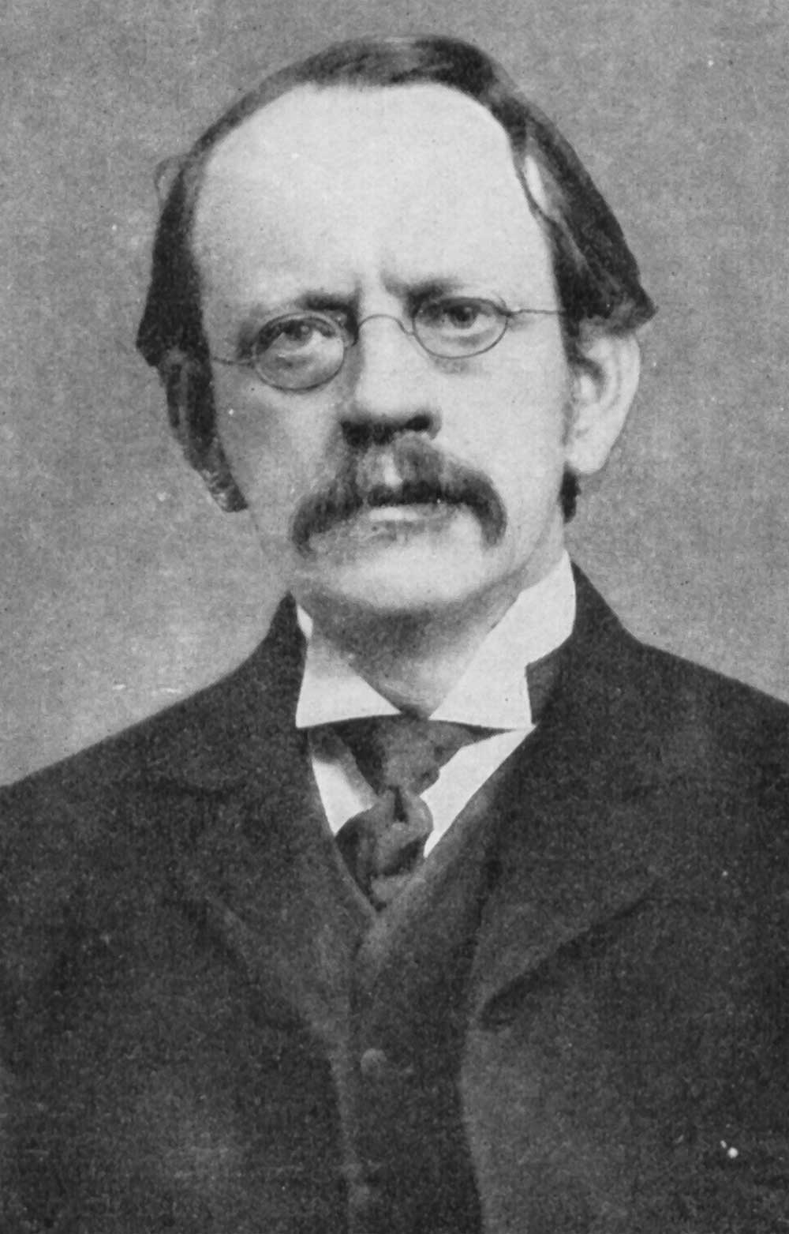
J.J. Thomson – What he concluded
Rays were composed of negatively charged particles
He called these particles “corpuscles”
These particles came to be known as “electrons”
(Note: Thomson was awarded a Nobel Prize in 1906)

Slide 16
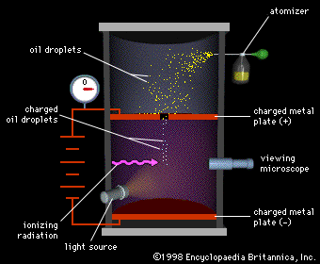
Robert Millikan - 1909
Adjusted the charge on the plates until gravity and charge balanced and oil droplets hovered
Calculated the charge on each droplet

Slide 17
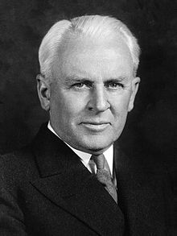
Robert Millikan – what he concluded
Observed that charges were different, but had a common denominator
Determined the charge on an electron (1.6 x 10⁻¹⁹ Coulombs)
(Note: Millikan was awarded a Nobel Prize in 1923)

Slide 18
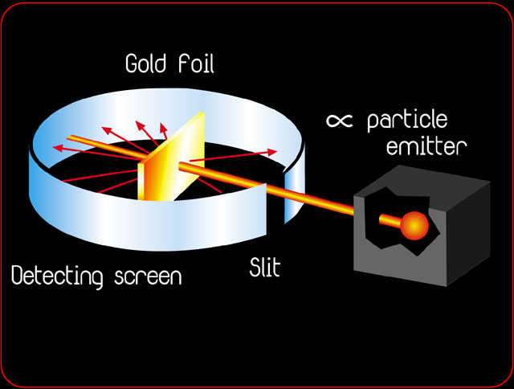
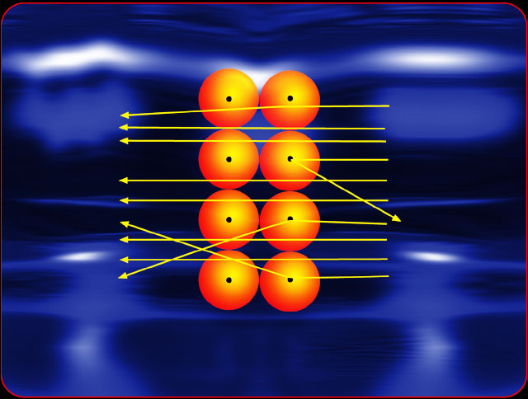
Ernest Rutherford - 1911

Slide 19
Ernest Rutherford – What he did
Experiment conceived by Rutherford but conducted by grad students Hans Geiger and Ernest Marsden
Fired alpha particles at gold foil
Saw that most particles passed straight through the foil, but some were deflected sharply

Slide 20
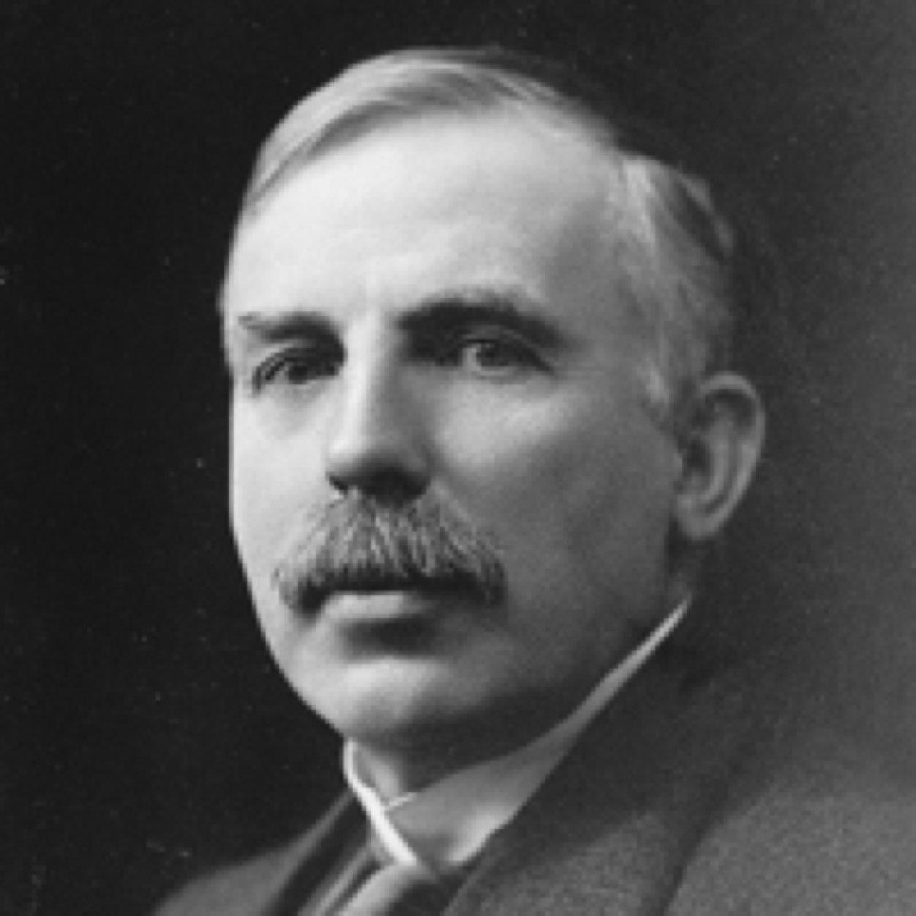
Ernest Rutherford - 1911
The atom has a very small mass center (nucleus)
This tiny mass center is surrounded by lots of empty space

Slide 21
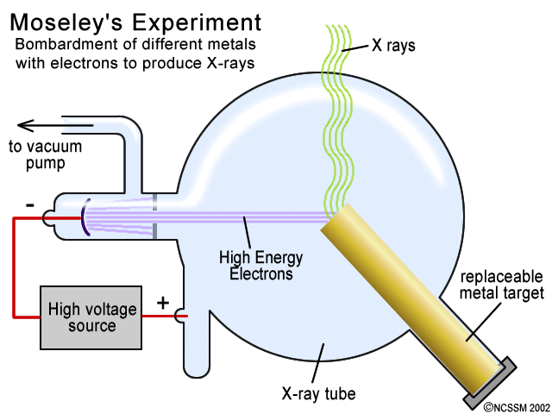
Henry Moseley - 1914

Slide 22
Henry Moseley – What he did
Experimented with x-ray tubes by changing the metal used for the anode
Measured the wavelengths of the resulting x-rays

Slide 23
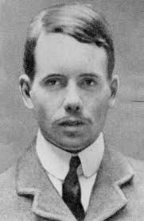
Henry Moseley– What he concluded
Each different metal is made of its own unique kind of atoms
Each element’s atoms have a characteristic number of protons in their nuclei (atomic number)

Slide 24
Walter Bothe & James Chadwick – 1930-1932
Beryllium-9
Parrafin Wax
α
α
α
α
-
+
-
+

Slide 25
William Bothe & James Chadwick – What they saw
Bombarded beryllium-9 with alpha particles.
This gave off high energy rays which were unaffected by a magnetic field.
These rays, when directed at parrifin wax, displaced high energy protons

Slide 26
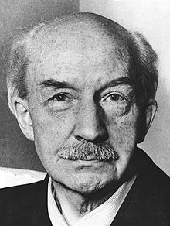
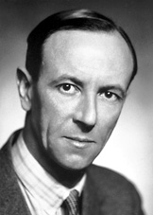
William Bothe & James Chadwick – Conclusions
Bothe didn’t know what conclusion to draw, but set the stage for Chadwick two years later
Chadwick repeated Bothe’s experiment and concluded that this particle with similar mass as a proton, but with no charge, must be the third subatomic particle which had been proposed for over 10 years by others, but was previously unproven.

Slide 27
Bottom Line……. 99% of ALL that we know about matter has been discovered within that last 3% of recorded history!!!! (That’s within the last 150 years! People believed Aristotle’s “pile of hyle” for about 2200 years

Slide 28
Inside the Atom
Atomic Number
Mass Number
Atomic Mass
number of protons in the nucleus of an atom. (defines an element)
number of protons plus neutrons in the nucleus of A SPECIFIC ISOTOPE!
weighted average of the masses of all isotopes of an element

Slide 29
So how do we know...
…the number of protons?
…the number of neutrons?
…the charge?
= the atomic number (Z)
= p⁺ + n = Mass # (A)
= Charge = p⁺ - e⁻

Slide 30
So how do we know...
…the average atomic mass? (Simple vs. Weighted average: What is the average age of people in this room?)
Chemistry: A Modern Course – p. 137, #8 & 9

Slide 31
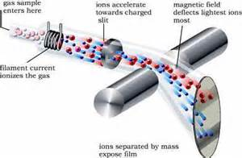
So how do we know...
…the relative abundance (percentage) of each isotope?
MASS SPECTROMETRY

