Slide 1
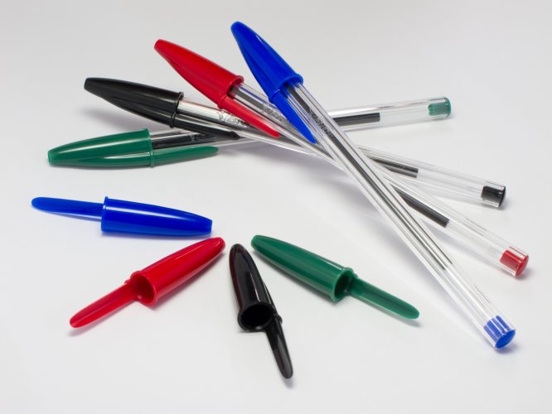
The Lowly Ballpoint Pen

Slide 2
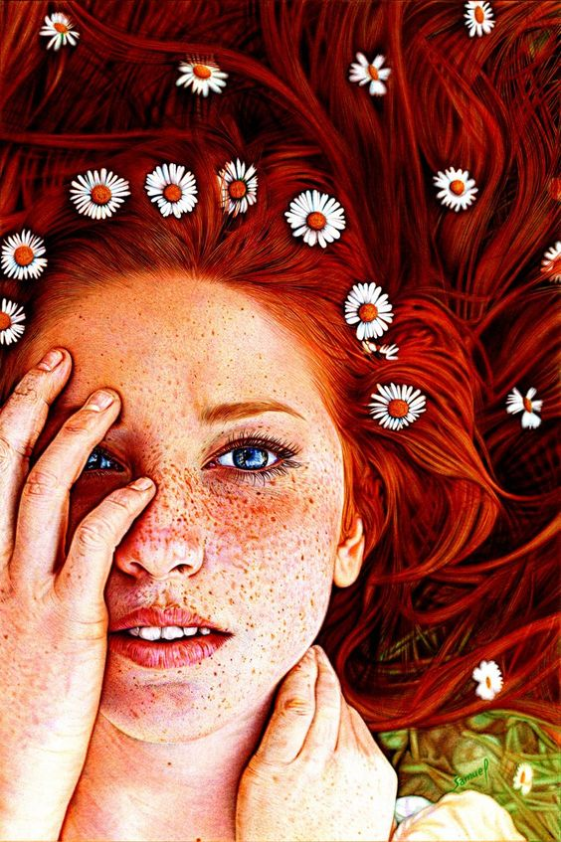
You will use ballpoint pens to create this piece.

Slide 3
You can choose from several different art styles.

Slide 4
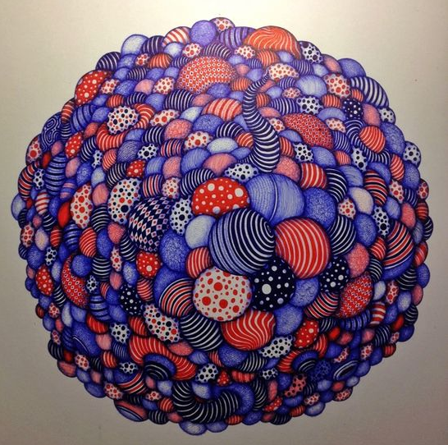
Non-Objective (not based on an object – design focused)

Slide 5
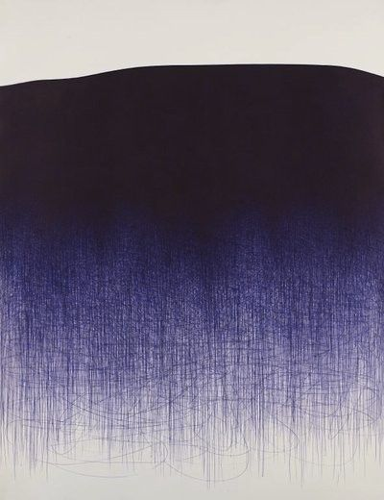
Korean born, Brooklyn based Il Lee is best known for his ballpoint pen abstract artworks which he has been doing for more than 30 years. It is stunning to think about the labor that goes into each of these works, and not to mention how many pens it must takes to do the larger pieces.

Slide 6
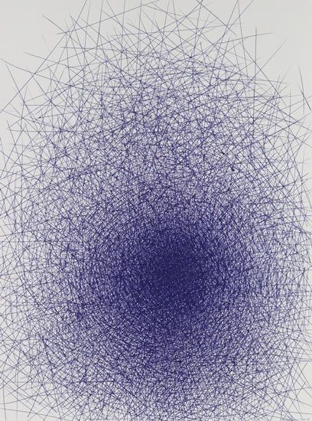

Slide 7
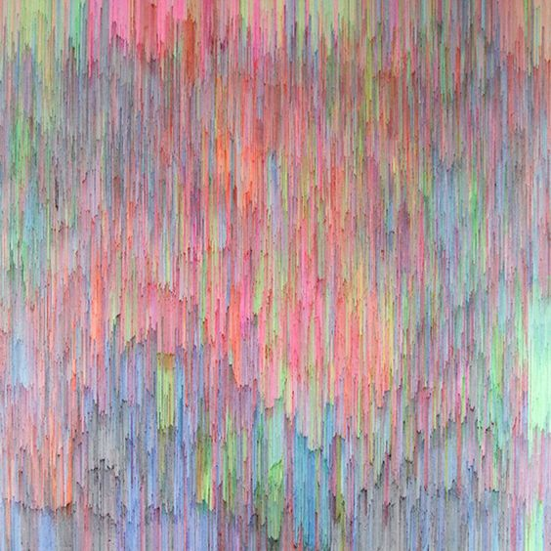
Joan Salo
Look her up on the Jealous Curator

Slide 9
Realistic

Slide 10
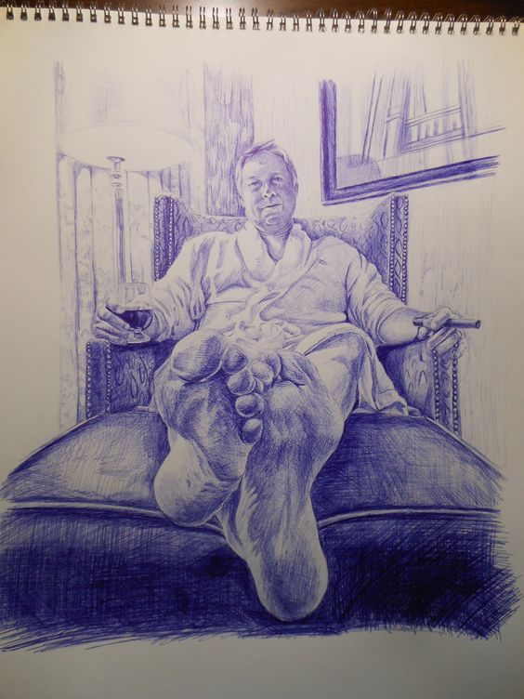

Slide 11
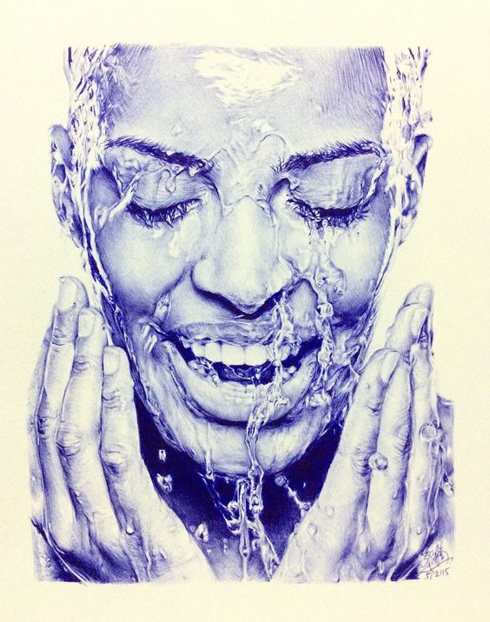

Slide 12
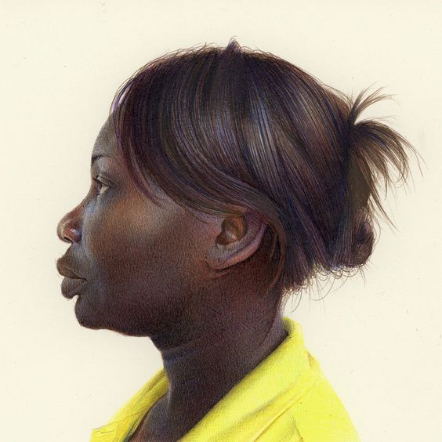
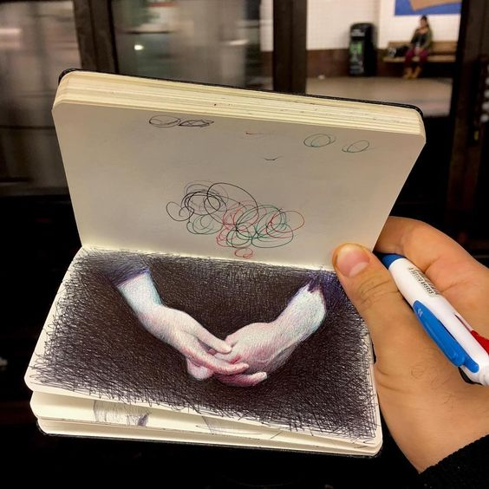
Ballpoint Pen Drawings by Nicolas V. Sanchez

Slide 13
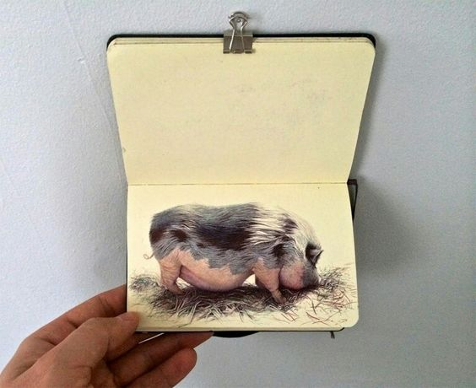

Slide 14
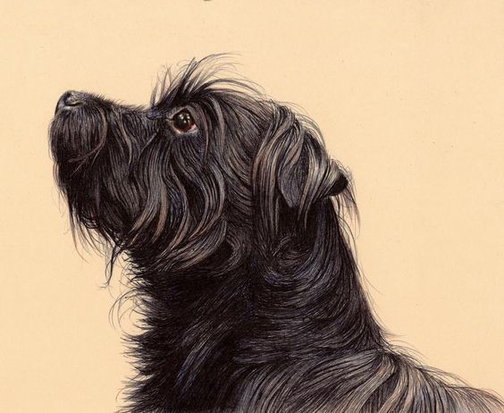

Slide 15
Contemporary Surrealism

Slide 16
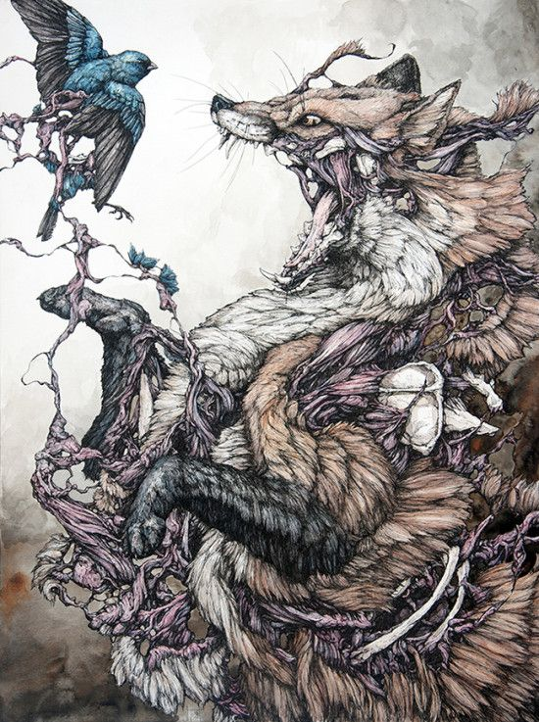
Caitlin Hackett

Slide 17
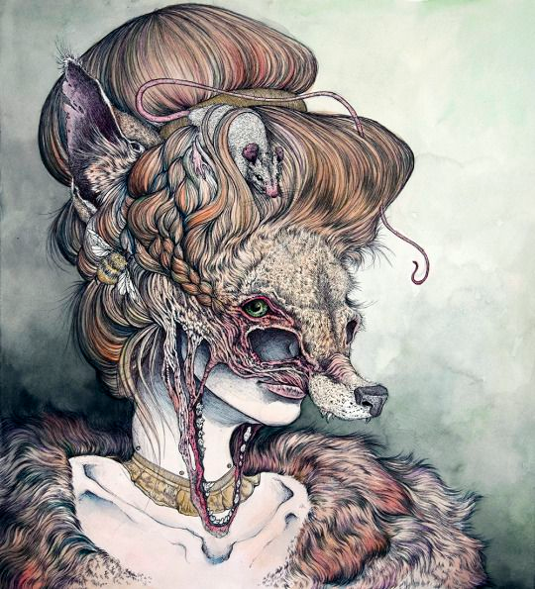

Slide 18
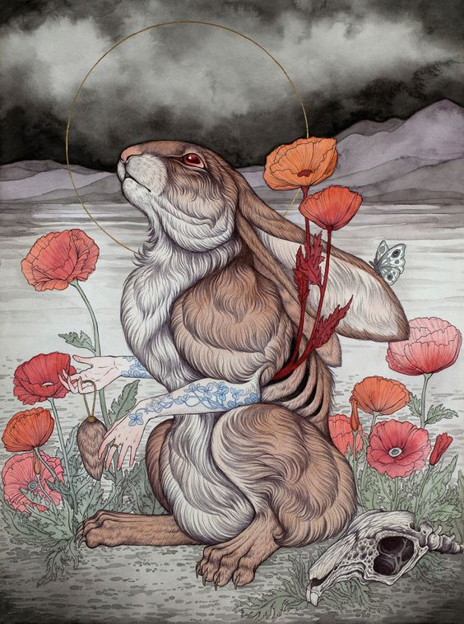

Slide 19
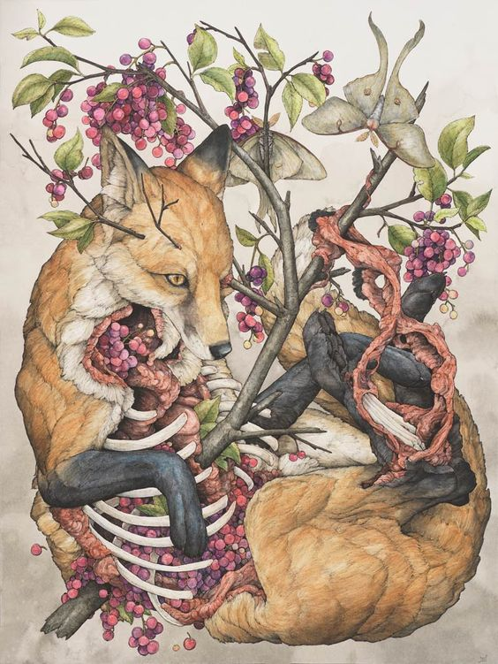
Lauren
Marx

Slide 20
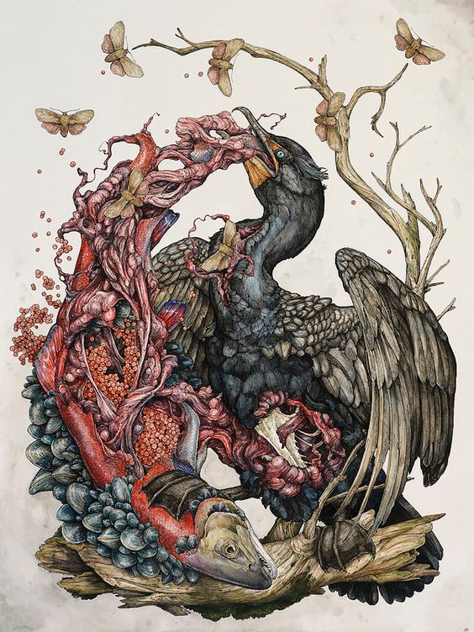

Slide 21
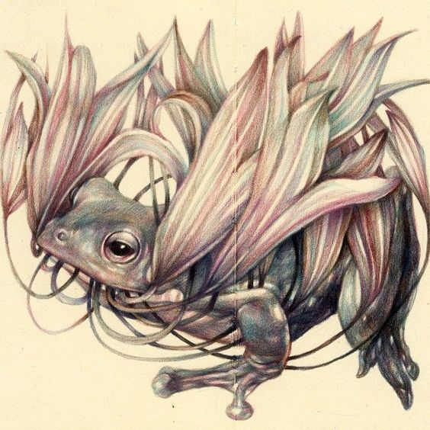

Slide 22
Requirements:
Choose a style from the proposed list.
Develop your own design based on your own reference images.
Layout design LIGHTLY in pencil
Choose either a monochromatic color scheme or use multiple colors.
Find your paper – can you use something nontraditional??
Create your drawing using a VARIETY of values.

Slide 23
Before you Start
Practice making a variety of values with your pens
Test pens and other media on the various types of papers available to see what works for your piece.
Create a series of thumbnails and sketches to work out your composition.

Slide 24
Possibilities:
Create a frame and extend the drawing outside of the frame.
Lightly watercolor a background.
Tone your paper.
Work on non-white paper

