Slide 1
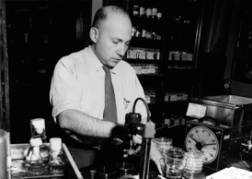
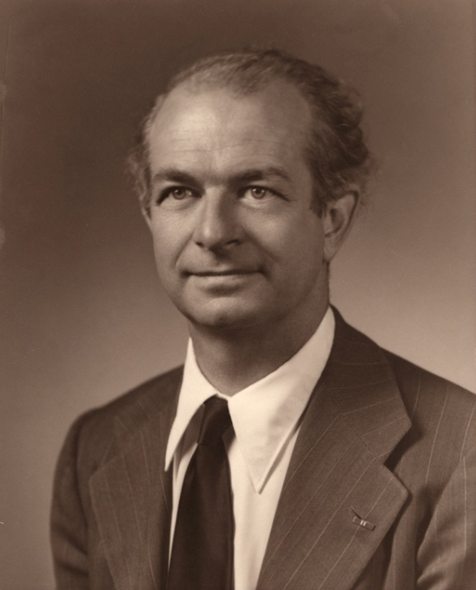
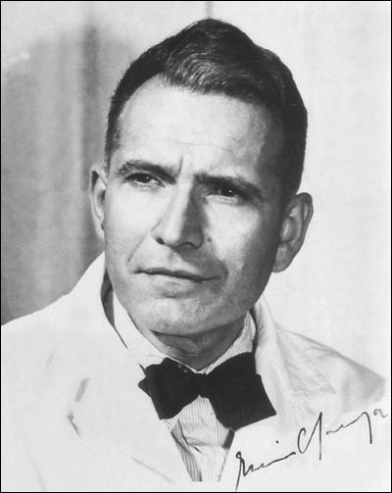
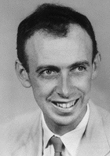
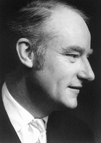
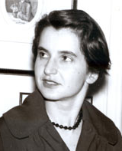
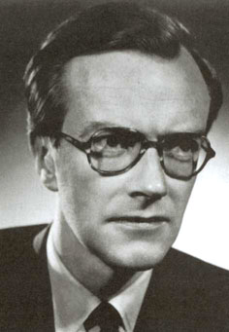
The Race to Discover DNA’s Structure
Avery
Pauling
Chargaff
Franklin
Wilkins
Watson
Crick
Notes:
Even in the 1920’s it was known that genes were located in chromosomes, and chromosomes were made of nucleic acid and protein and located in the nucleus of cells.
Most scientists thought that the genetic factor that was passed from generation to generation was proteins. They were complicated structures, in many forms. While the nucleic acids, on the other hand consisted of just 4 building blocks, and didn’t seem special enough to be the blueprint of life.

Slide 2
Oswald Avery 1944
Identified DNA as the genetic material
Notes:
Then in 1944, An american scientist, oswald Avery proved that DNA carries genetic information. He even suggested that DNA might actually be the gene, and not protein.

Slide 3
How did DNA: 1. Store information? 2. Duplicate itself easily?
These questions would be answered by discovering DNA’s structure
Notes:
If DNA was the genetic material, questions needed to be answered

Slide 4
1948 Linus Pauling
Discovered that proteins take the shape of an alpha helix
Spiraled like a spring coil.
Notes:
Linus Pauling gave a clue to the shape of DNA, when he……….

Slide 5
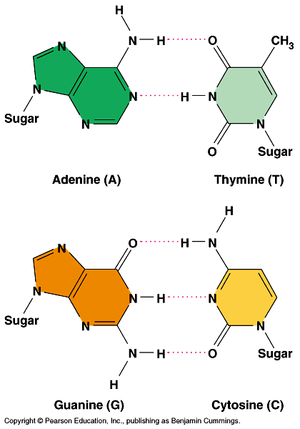
1950 Erwin Chargaff
Base Paring Rule:
A = T
G = C
Notes:
Chargaff discovered that the bases in DNA always paired the same way. AT, GC
From then on, the race to discover DNA was on!

Slide 6
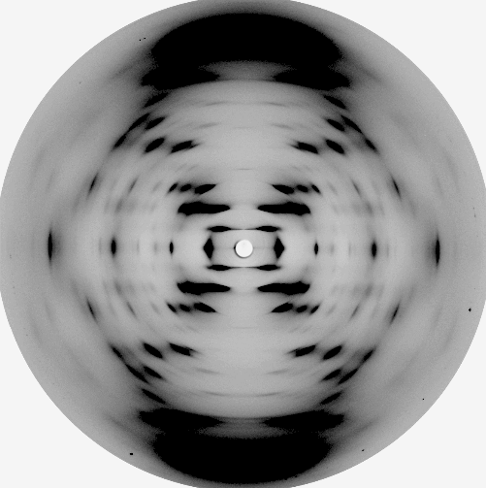
The Race to Discover DNA’s Structure
X-Ray diffraction image of DNA taken by Franklin in 1951
Maurice Wilkins
Rosalind Franklin
Notes:
At Kings college in London, Rosalind Franklin and her boss Maurice Wilkins were studying DNA. They looked at x-ray images of DNA to try and discover the structure

Slide 7
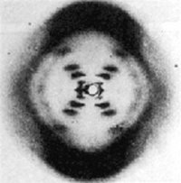
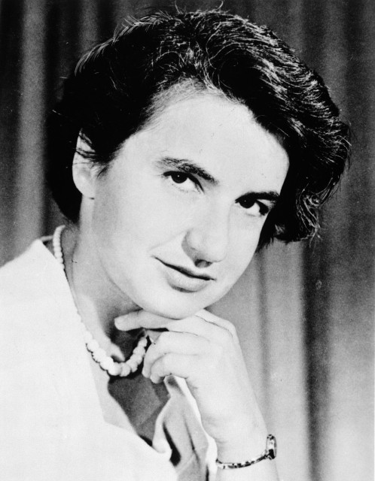
Rosalind Franklin 1951
Was an expert in X-ray crystallography
Used this technique to examine DNA fibers
Concluded that DNA was some sort of helix

Slide 8
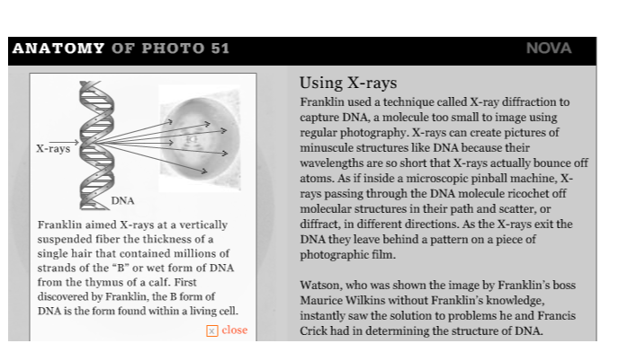

Slide 9
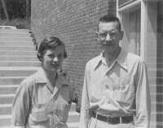
1952 – Al Hershey & Martha Chase
Proved that DNA is the genetic material in cells.

Slide 10
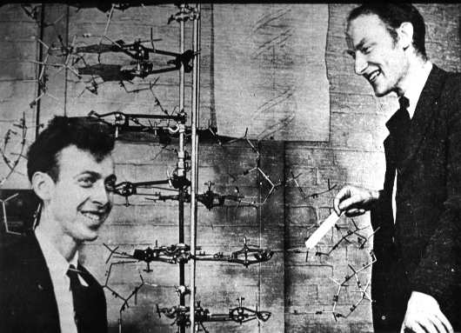
The Race to Discover DNA’s Structure
1953
Compiled data from previous scientists to build a double-helical model of DNA
James Watson
Francis Crick
Notes:
Also in the early 1950’s at Cambridge University in London, Francis Crick and James Watson were using the work of Linus Pauling (helix structure) to make physical models of DNA to narrow down the different possibilities. They used the base pair rule of Chargaff, and the x-ray pictures that Franklin took to finish the structure of DNA.
They showed that the molecule was made of 2 chains of nucleotides, each in a helix shape, with one going up, and the other going down. The matching base pairs interlocked in the middle of the double helix .
The structure perfectly fit the experimental data, and was almost immediately accepted.

Slide 11
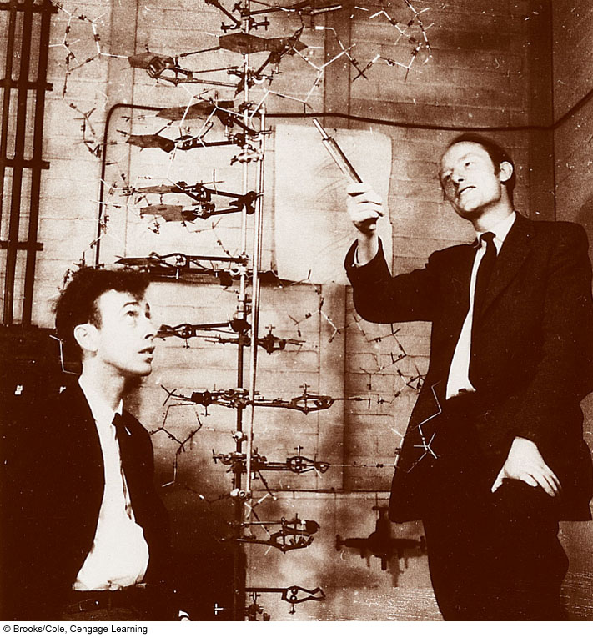
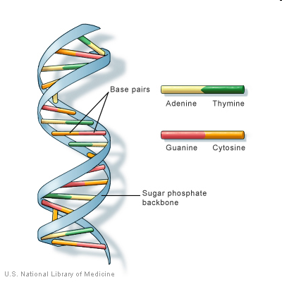
1953 James Watson & Francis Crick
Structure of DNA

Slide 12
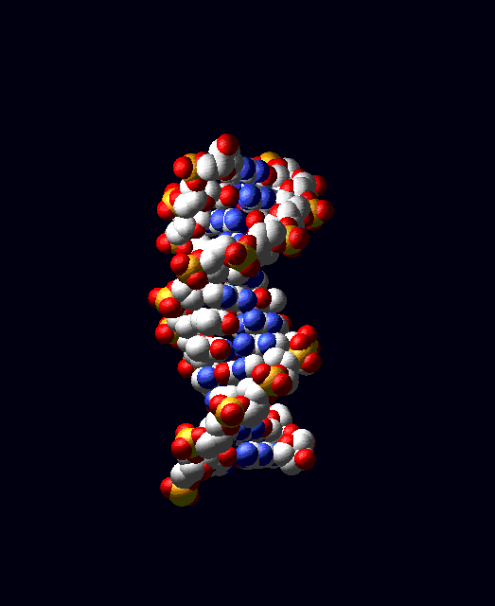
The Race to Discover DNA’s Structure was Over
DNA is made up of:
Four nucleotides: Adenine, Thymine, Guanine and Cytosine
These follow the rules of base-pairing:
A-T
G-C
A sugar-phosphate backbone
DNA is arranged in an double-helix

Slide 13
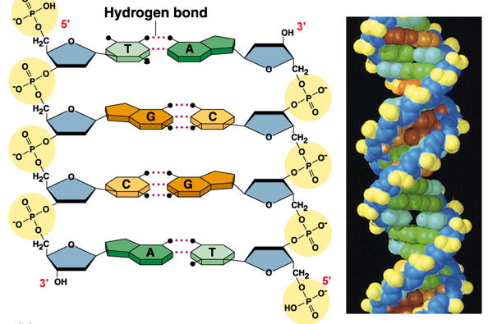
DNA
Notes:
DNA’s discovery has been called the most important biological work of the last 100 years.

Slide 14
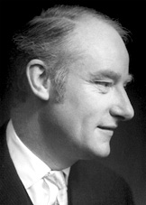
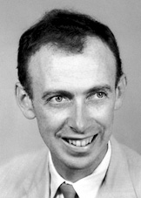
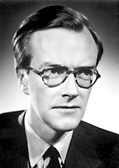
For discovering the structure of DNA- The Blueprint of Life
Francis Harry Compton Crick
James Dewey Watson
Maurice Hugh Frederick Wilkins
The Nobel Prize in Physiology or Medicine 1962 was awarded jointly to Francis Harry Compton Crick, James Dewey Watson and Maurice Hugh Frederick Wilkins "for their discoveries concerning the molecular structure of nucleic acids and its significance for information transfer in living material".
Notes:
The Nobel Prize did not go to Wilkins. By the time it was awarded, he had died.

Slide 15
Basic Functions of DNA
DNA reproduces an exact replica of itself during cell division and passes the heredity information from generation to generation.
DNA directs and controls protein synthesis in a cell.

Slide 16
DNA Replication
The double helix structure explains how DNA copies itself
We will study this process, DNA replication, in more detail

Slide 17
DNA Replication
The “parent” molecule has two complementary strands of DNA.
Each is base paired by hydrogen bonding with its specific partner:
A with T
G with C

Slide 18
DNA Replication
The first step in replication is the separation of the two strands.

Slide 19
DNA Replication
Each parental strand now serves as a template that determines the order of the bases along a new complementary strand.

Slide 20
DNA Replication
The nucleotides are connected to form the sugar-phosphate backbones of the new strands.
Each “daughter” DNA molecule consists of one parental strand and one new strand.

Slide 21
The Race to Replicate DNA
Two teams: A and B
Individually, each team member will run to the board to add a nucleotide to the “unzipped” strand of DNA.
The first team to finish base-pairing their DNA correctly will win the game.
Notes:
Run to the board game

