Slide 1
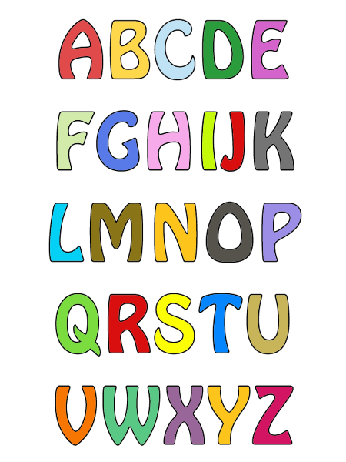
Alphabet Recognition and Formation

Slide 2
Check out those bags!
White board
Dry erase markers
Wikki sticks
Water pens
Traceables
Magnetic Letters

Slide 3
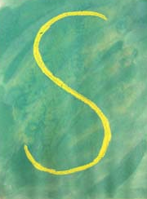
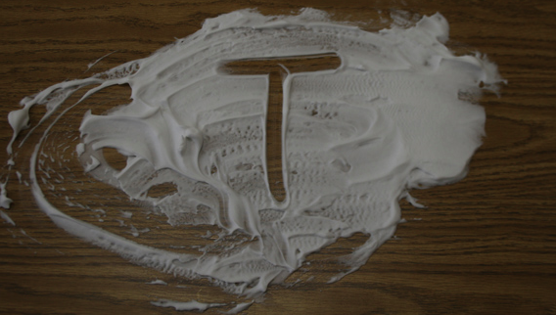
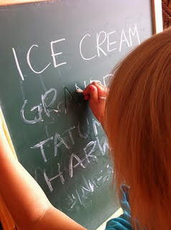
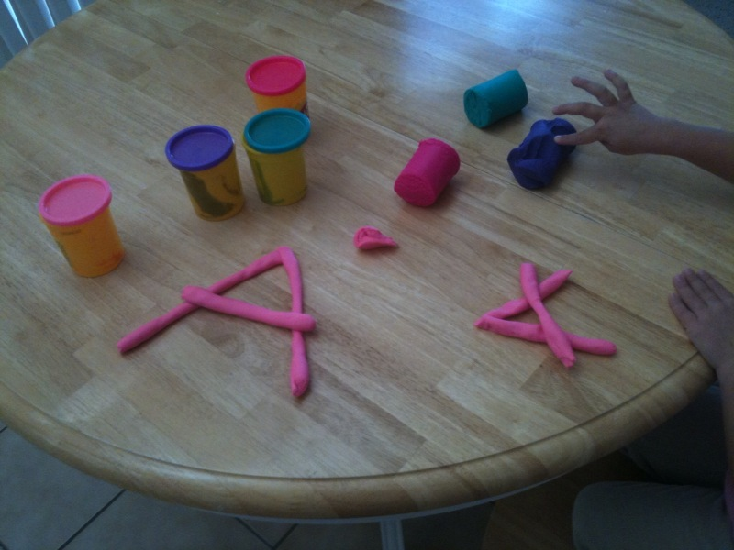
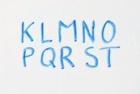
Letter Formation Use the Letter Terminology
Shaving cream
Crayons and paint
Paint/pudding in a ziploc bag
Wikki Sticks
Play-Doh letters
White boards
Chalkboard and water pen

Slide 4
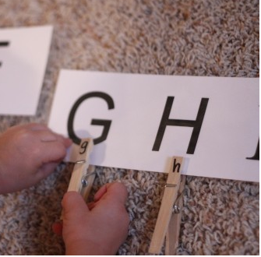
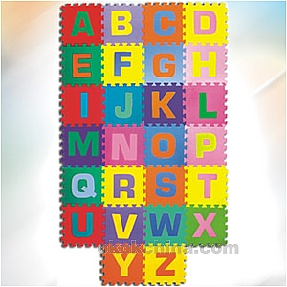
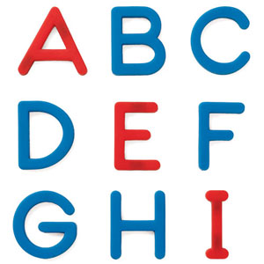
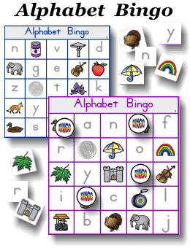
Letter Recognition
Magazines
Clothespins
Matching Games
BINGO
Magnetic Letters
Alphabet Puzzles

