Slide 1
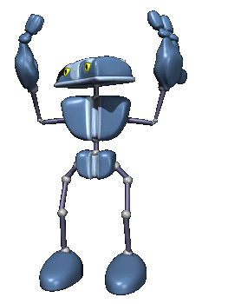
List the major adaptations that allow fish to live in water.

Slide 2
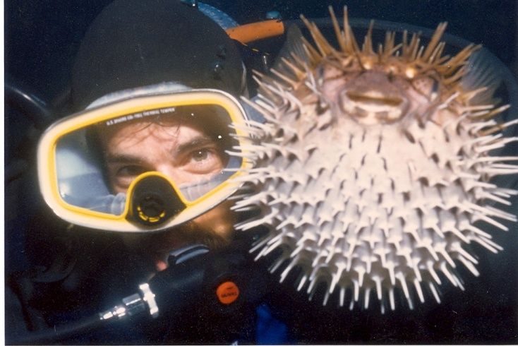
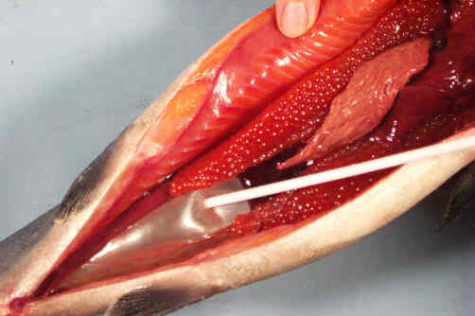
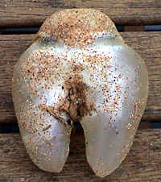
Fish Adaptations
Buoyancy is the ability to float. Fish have a structure called a “swim bladder” that allows them to be “neutrally buoyant”, or to maintain ones position in the water without sinking or floating to the surface.

Slide 3
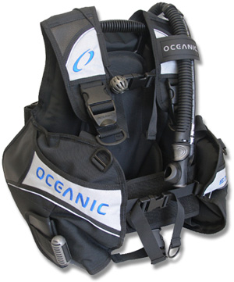
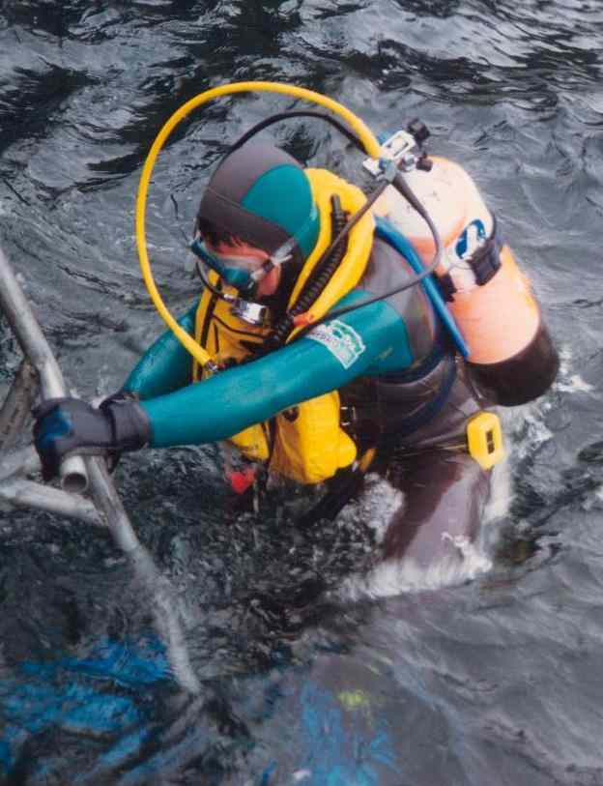
Swim Bladder=Buoyancy Control Device.

Slide 4
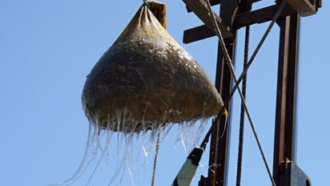
Mucus --------→
Fish can swim because they have a streamlined shape and muscular tail. Both adaptations enable them to move rapidly through the water. Mucus on their scales reduces friction.

Slide 5
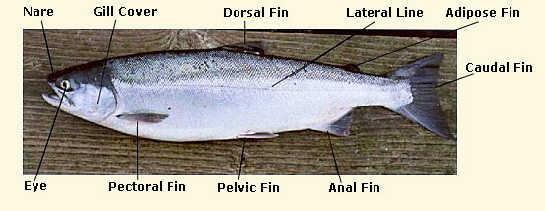
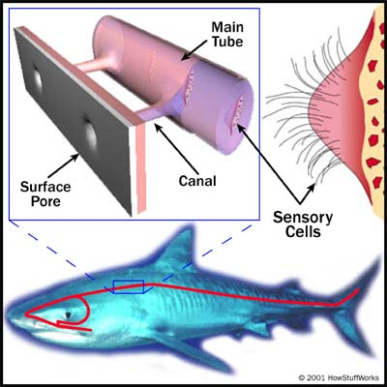
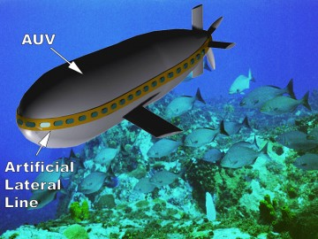
Their nervous system contains a Lateral line, or a row of nerves that detect vibrations in the water. The lateral line can often be seen on the side of the fish.

Slide 6
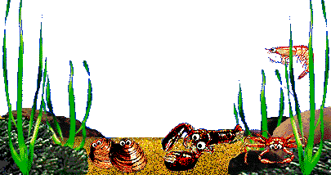
Chordates and Fishes

Slide 7
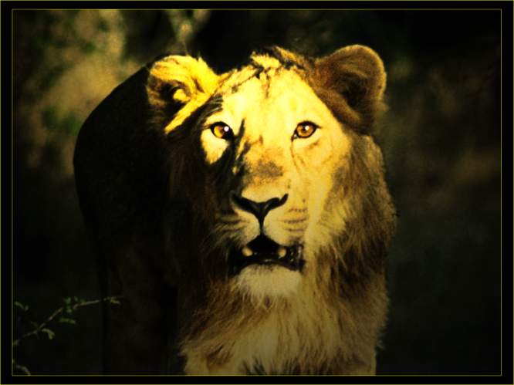
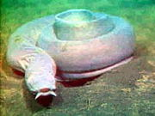
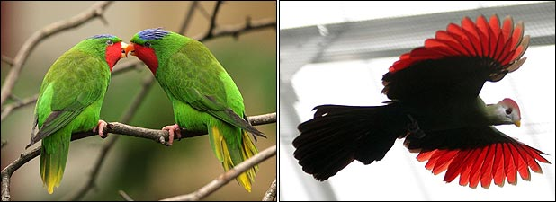
Chordates – a review
Remember - Chordates are the phylum of animals characterized by having a notochord at some point in their life.
The Notochord is a special rod of nerves along the dorsal side.
This Includes All Vertebrates!

Slide 8
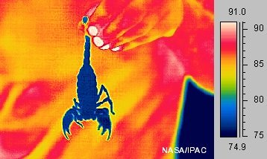
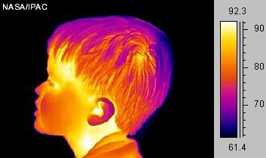
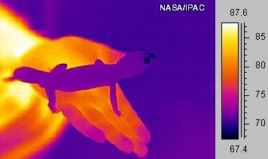
Chordates-review continued
Chordates are either endothermic or ectothermic.
Endotherms’ can maintain a constant body temperature (Us – Homeostasis)
Ectotherms’ body temperature depends on environment

Slide 9
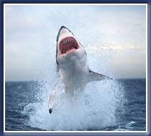
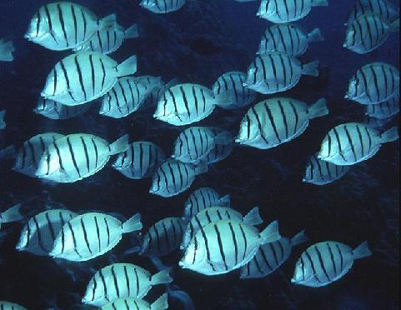
Fish
Fish can be broken into three categories:
Jawless
Cartilaginous
Bony

Slide 10
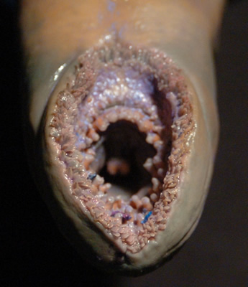
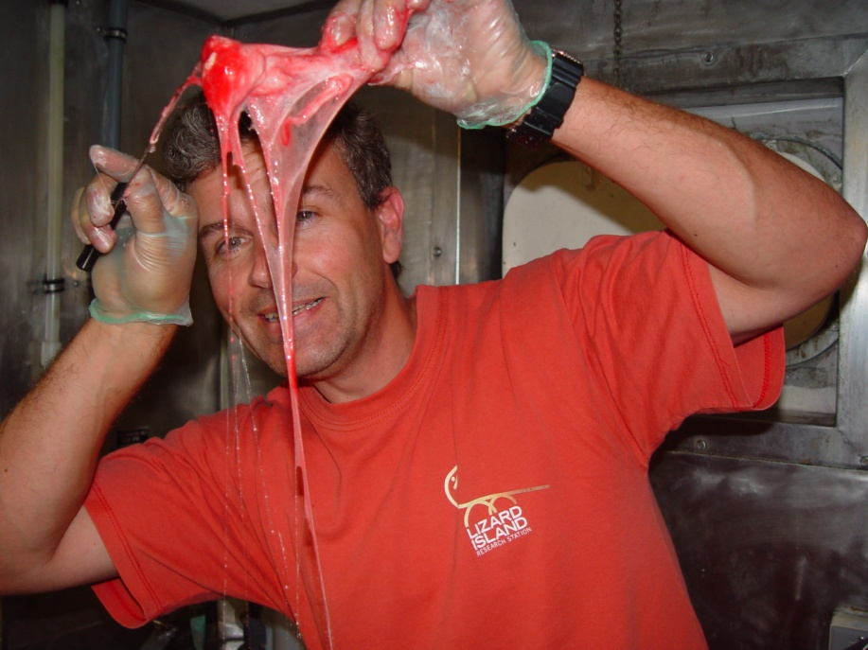
Jawless Fish
Survive by sucking the tissues of living (lampreys) and dead (hagfishes) organisms.
Hagfishes are considered the most primitive of all vertebrates.

Slide 11
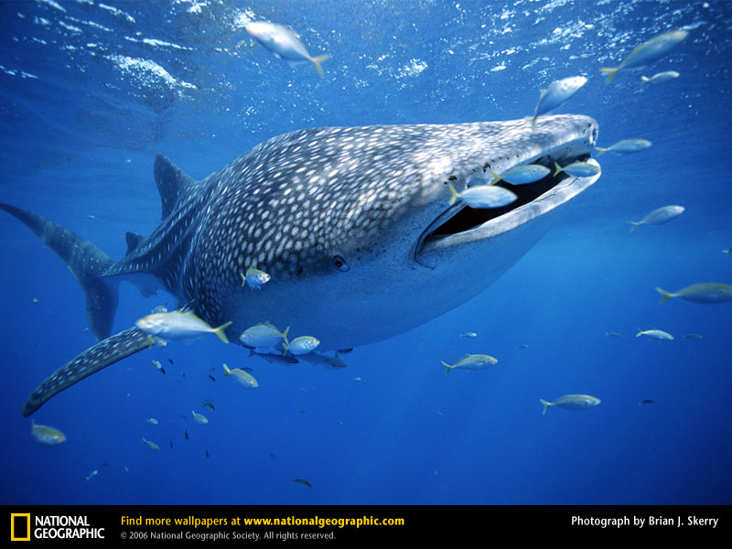
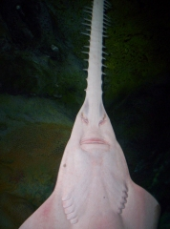
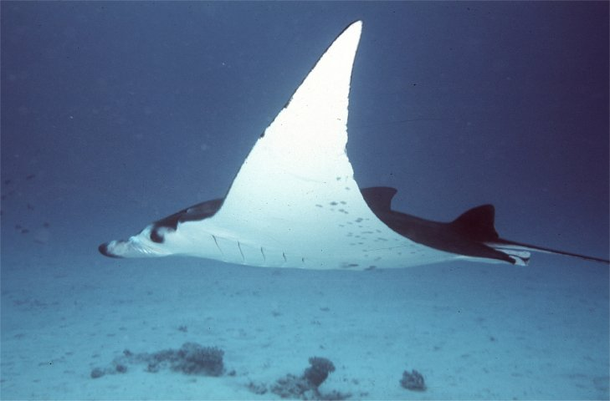
Cartilaginous Fish
Cartilaginous Fish include sharks and rays and have a skeleton of cartilage. Their teeth may be the only bony parts within the fish.
Most sharks cannot stop moving or they will not get enough oxygen.
Many Sharks are internally fertilized, meaning the egg meets the sperm inside of the mother.

Slide 12
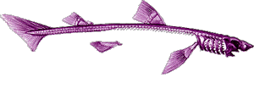
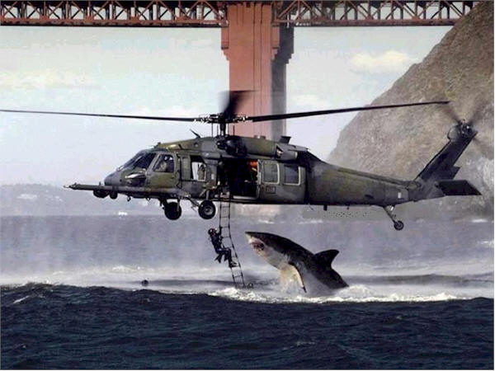
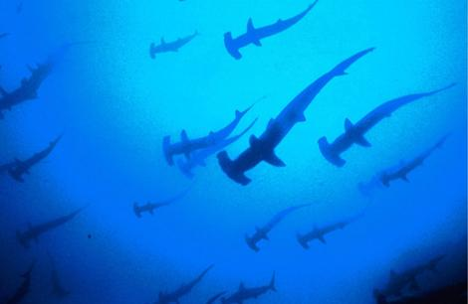
Cartilaginous Fish
Shark Vs. Octopus!!!

Slide 13
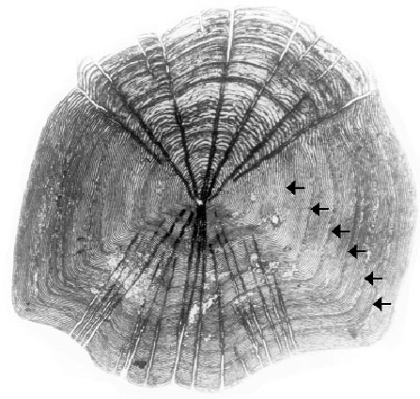
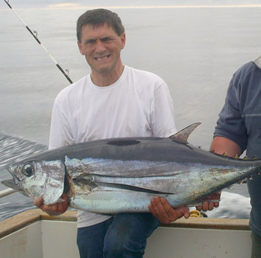
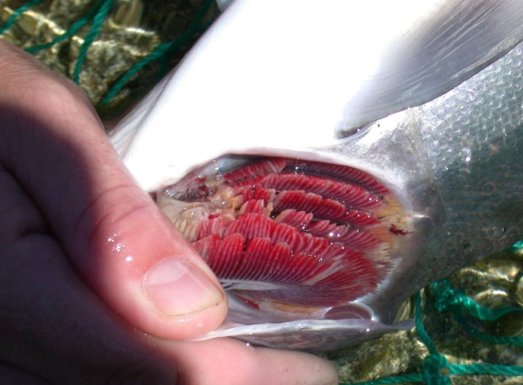
Fish - continued
All Bony Fish have:
Scales
Fins
Gills
Swim Bladder

Slide 14
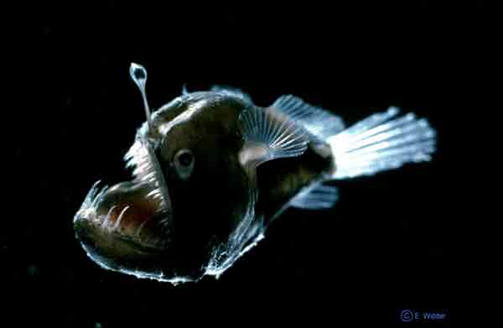
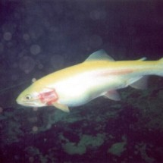
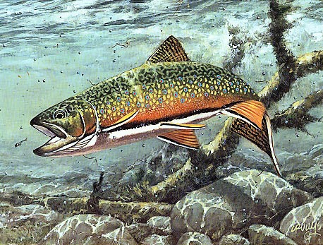
Bony Fish
Bony Fish Contain Salmon, Trout, Halibut, Haddock, Tropical Fish, Deep-Sea Fish, Tuna, Eels, Ling Cod! etc…

Slide 15
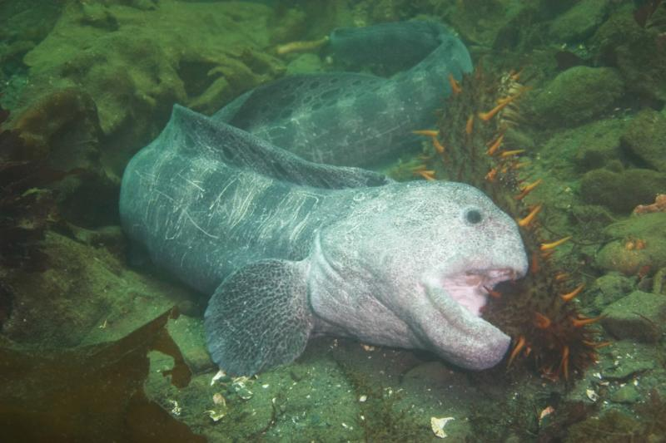

Slide 16
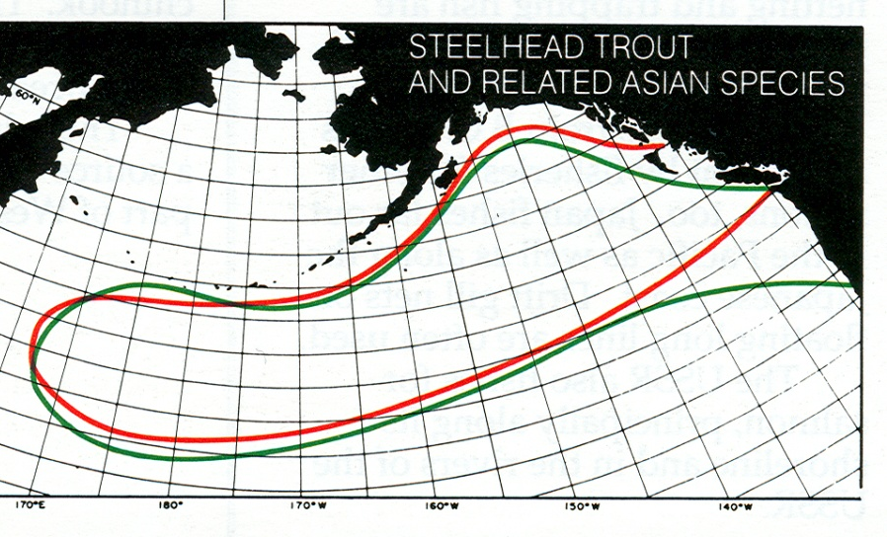
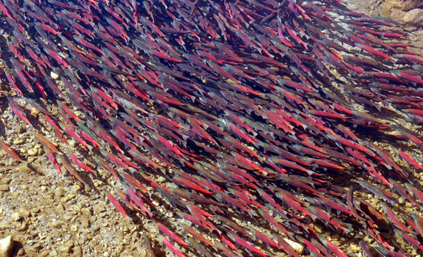
Spawning
Some ocean-dwelling fish will return to their homewaters (the very stream they were born in) to reproduce.

Slide 17
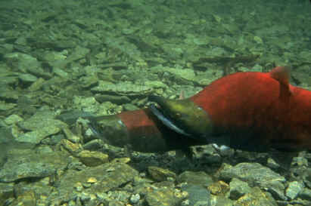
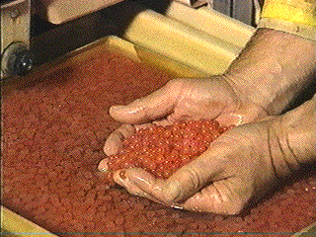
Spawning
Here females deposit eggs and males fertilize the eggs by putting sperm on top of the eggs.

Slide 18
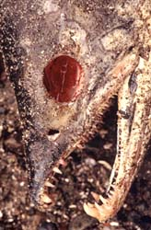
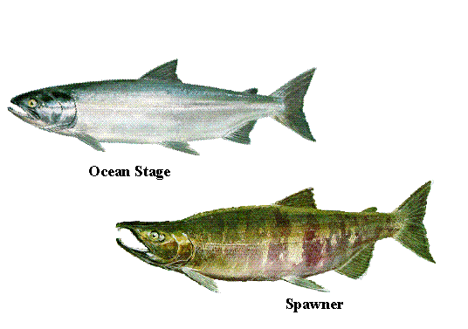
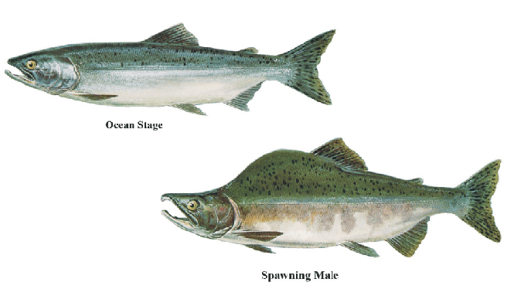
After Pacific Salmon deposit their eggs or sperm, they die.

Slide 19
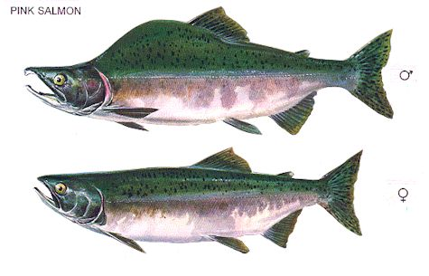
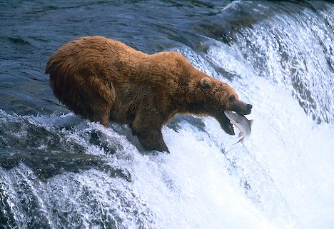
Male Vs. Female Spawning Salmon
Why do the males have a huge hump on their backs?

Slide 20
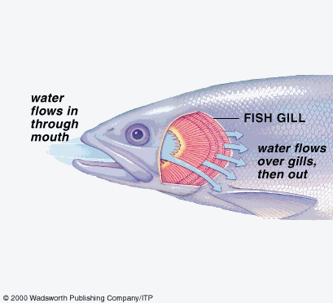
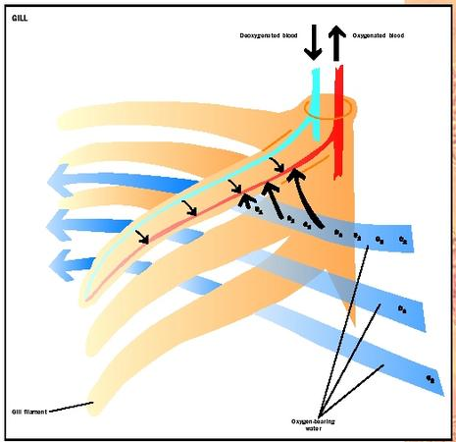
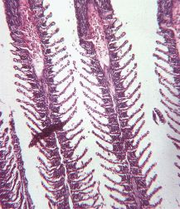
Gills=Obtaining O₂
Inside the gills, oxygen is taken out of the water and the gills give off carbon dioxide. The gasses flow from an area of higher concentration to an area of lower concentration…

Slide 21
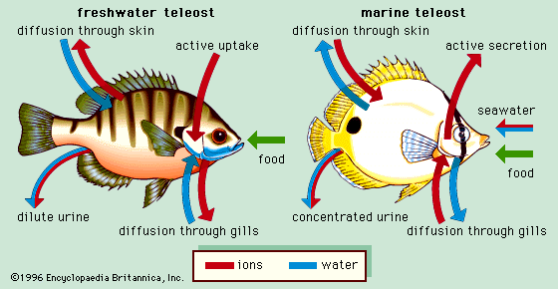
Osmosis and Fish
According to Osmosis, in saltwater, water will be drawn out of the fish because there is a higher concentration of pure water inside the fish than in the surrounding saltwater.
Remember – osmosis is the diffusion of water…

Slide 23
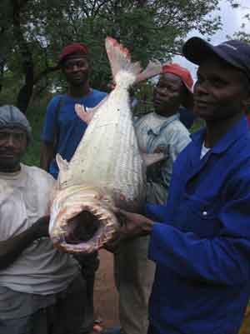
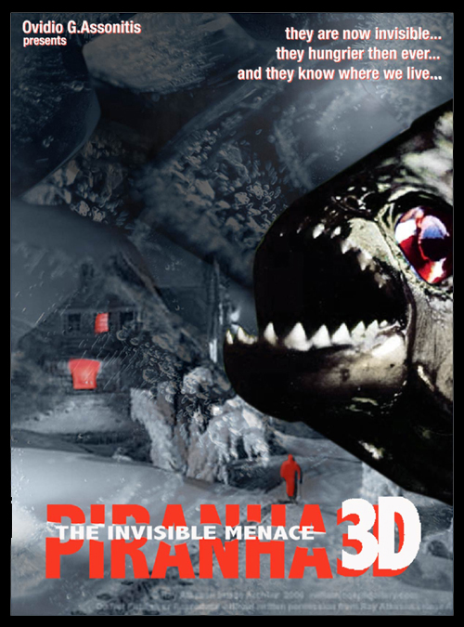
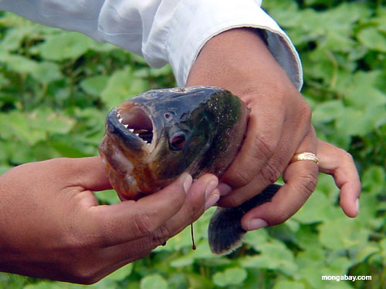
Osmoregularity
Salt water fish constantly swallow salt water and have very concentrated (high salt) urine.

Slide 24
Trout Spawning!

