Slide 1
Kingdom Animalia Aquatic Section

Slide 2
First – a review…
Domain
Kingdom
Phylum
Class
Order
Family
Genus
Species

Slide 3
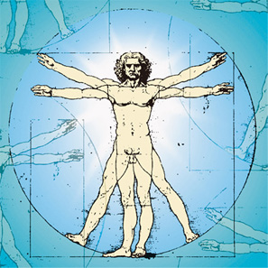
So what would a human being be?
Domain- Eukarya
Kingdom - Animalia
Phylum - Chordata
Class – Mammalia
Order – Primates
Family - Hominidae
Genus - Homo
Species – H. sapiens

Slide 4
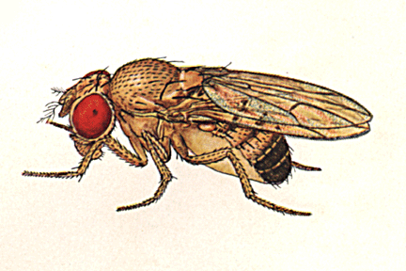
How about a fruit fly?
Domain - Eukarya
Kingdom - Animalia
Phylum - Arthropoda
Class - Insecta
Order - Diptera
Family – Drosophilidae
Genus - Drosophila
Species – D. melangaster

Slide 5
OR, remember a short acrostic…
Donkey Domain
Kong Kingdom
Plays Phylum
Chess Class
On Order
Fred’s Family
Green Genus
Sink Species

Slide 6
Sponges are known as Porifers
Kingdom - Animalia
Phylum - Porifera
Class
Order
Family
Genus
species

Slide 7
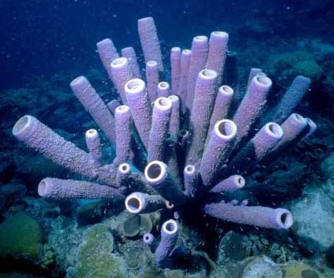
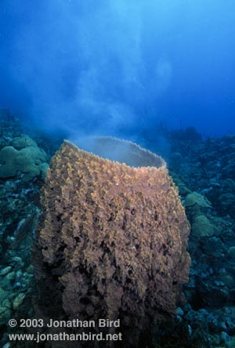
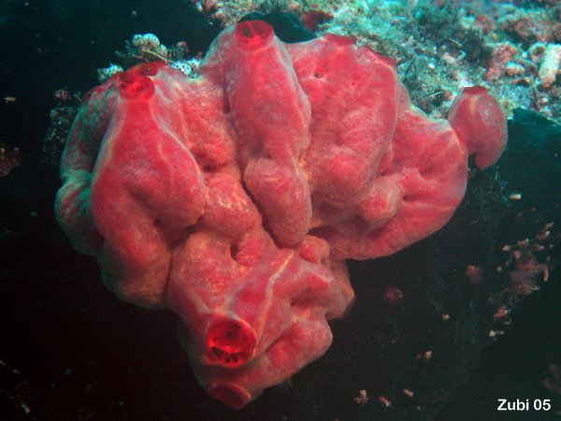
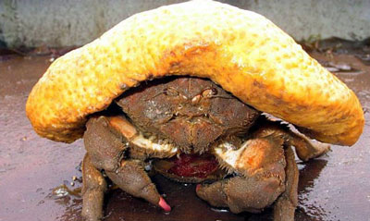

Slide 8
Sponges belong to the Kingdom Animalia
Sponges also belong to the phylum Porifera.
Porifera means “pore bearers”.
The body of a sponge is covered by thousands of tiny openings.

Slide 9
Sponges are invertebrates…
What does invertebrate mean?
An animal that has no backbone.

Slide 10
You are a vertebrate – what does that mean?
You have a backbone called your spine.
Sponges (and many other animals) do not have a backbone.

Slide 11
Sponges continued.
Many sponges produce spicules, or thin, spiny structures that form the skeleton of many sponges.

Slide 12
Cool facts about sponges
Sponges are filter feeders, meaning water filters through the sponge’s pores.
A sponge can filter up to 20,000 times its volume in 24 hours.
Sponges feed on bacteria and can trap up to 90% of the bacteria that filter through them.

Slide 13
Sponges can reproduce sexually or asexually.
What is sexual reproduction?
In sexual reproduction, a new organism forms from the joining of a female cell and a male cell.
What is asexual reproduction?
In asexual reproduction, an organism can produce a new organism by budding… just like yeasts.

Slide 14
Sponges Video

Slide 15
Cnidarians
Pronounced nigh-DAIR-ee-uh
You may have encountered a member of this phylum while at the beach…
Cnidarians include corals, jellyfish, hydra, and sea -------→.

Slide 16
Anemone

Slide 17
So what’s a Jellyfish anyway?
All cnidarians have a hollow central cavity with only one opening called the mouth.
They all have nematocysts – which are special stinging structures.

Slide 18
Scarier than a Man O’ War
A few are potentially deadly, such as the box jellyfish which lives in the waters off Northern Australia.
The Box Jellyfish’s tentacles can grow to 10 feet in length and may contain 5,000 stinging cells each.

Slide 20
Cnidarians’ Reproduction
Like sponges, jellyfish can reproduce both sexually (by producing eggs and sperm) or asexually

Slide 21
Corals
Corals can be quite beautiful as their hard exoskeleton can be virtually any color.
Their exoskeleton is made from limestone minerals extracted from the sea water (CaCO₃).

Slide 22
Hydras
Unlike most cnidarians, hydra can be found in salt and fresh water.
They can also reproduce sexually or asexually.

Slide 23
Sea Anemones
Pronounced uh-Nehm-uh-nee
Their tentacles are nematocysts – ie. They can sting you.
Unless, of course, you’re Nemo.

Slide 24
Man o' War vs. Nudibranch
Cnidarian Video

Slide 25
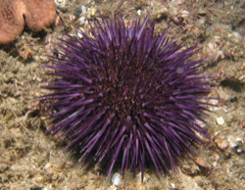
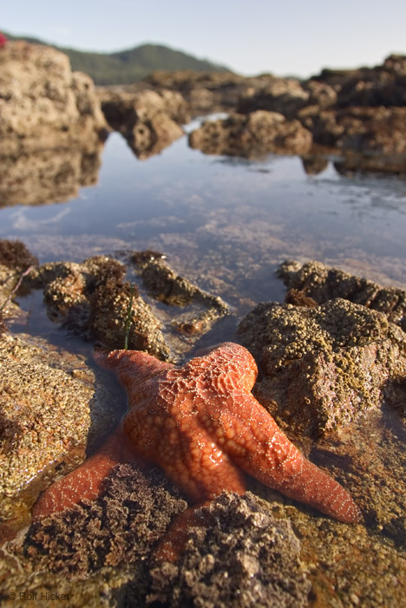
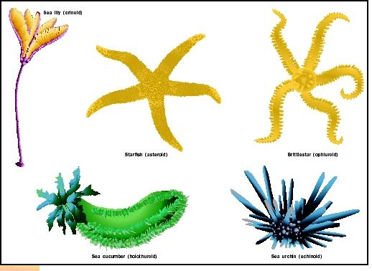
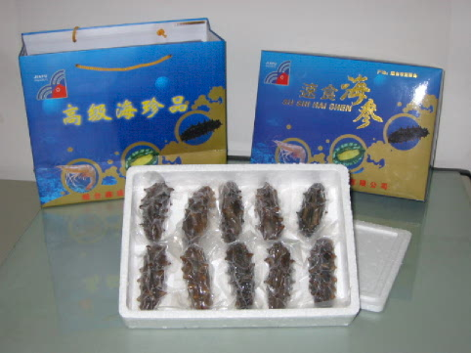
Echinoderms

Slide 26
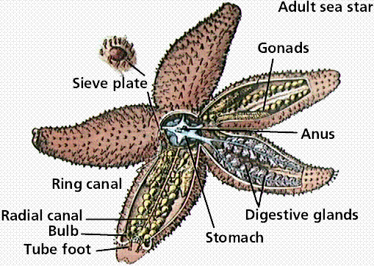
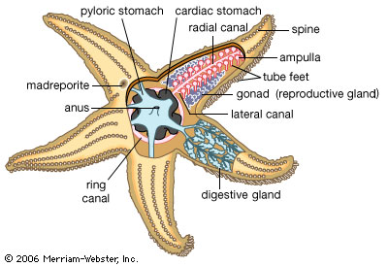
Echinoderms
Spiny skin
Internal skeleton
Water vascular system
Tube feet
Five-fold symmetry

Slide 27
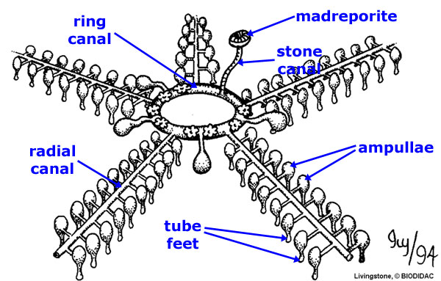
Water Vascular System
Uses pressurized water to help echinoderms move, and move food, wastes, and oxygen around the body

Slide 28
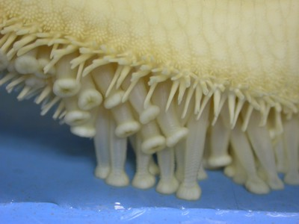
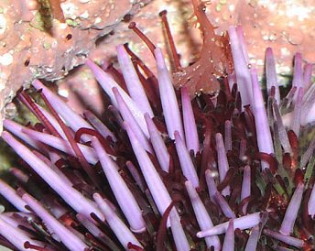
Tube FEET
Tube feet are the suction cup extensions that allow echinoderms to move

Slide 29
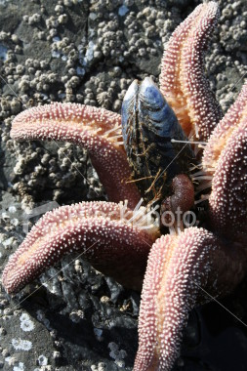
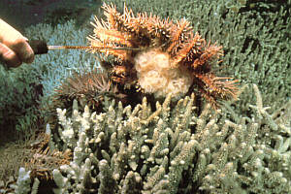
Starfish
Starfish tend to eat bivalves
They use their tube feet to pry the shell open
Then expel their stomach to envelop their meal

Slide 30
Starfish
They can survive for 9 months without eating!!!

Slide 31
Starfish
Can regenerate parts. Fishermen used to cut them apart and throw them back. Unfortunately, the starfish pieces would regenerate and occasionally take over the reef!

Slide 32
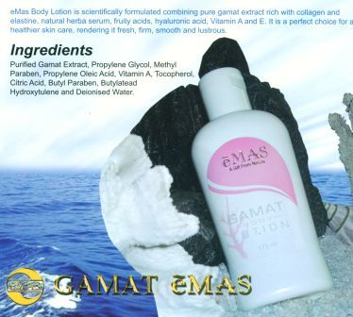
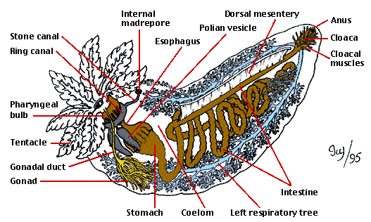
Sea Cucumber
Sea Cucumbers will expel their internal organs as a defense
Spilling his guts!

Slide 33
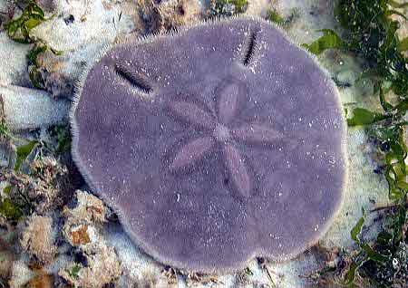
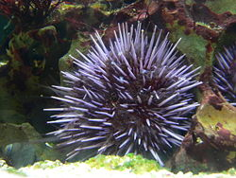
Sea Urchin
Sea Urchins and Sand Dollars are also echinoderms
Each reproduce externally by allowing their sperm and eggs to drift in the ocean hopefully finding each other
Breeding in Sea Urchins

Slide 34
Sand Dollars

Slide 35
Echinoderm Video

Slide 36
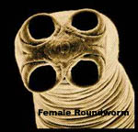
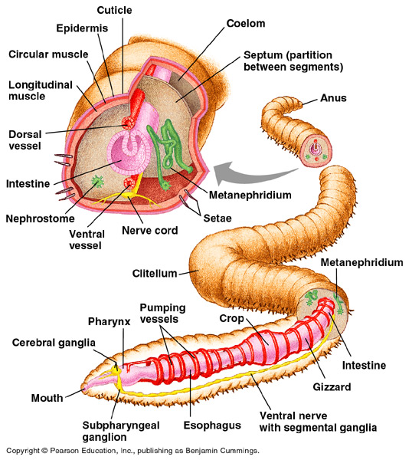
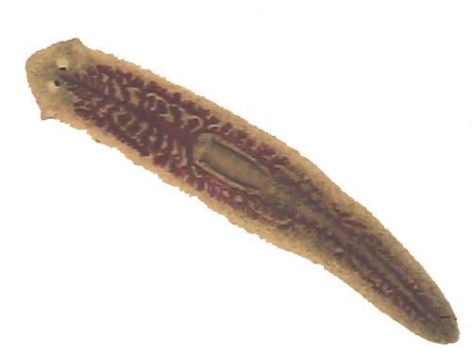
I got worms
There are three main types (phyla) of worms: flatworms, roundworms, and segmented worms.

Slide 37
Phylum Platyhelminthes, or flatworms
Members in this phylum are characterized by their flat bodies.
Regeneration! Planarians can regenerate an entire body from just a piece of themselves.
Flatworm
Video

Slide 38
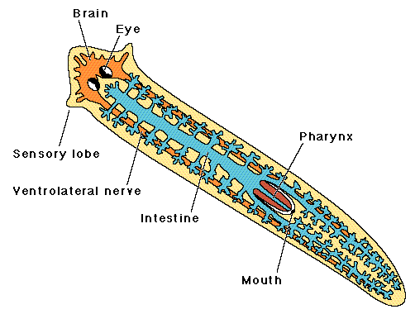
Flatworms, cont’d
Bilateral Symmetry is when an organism has a left and right side that are almost mirror images

Slide 39
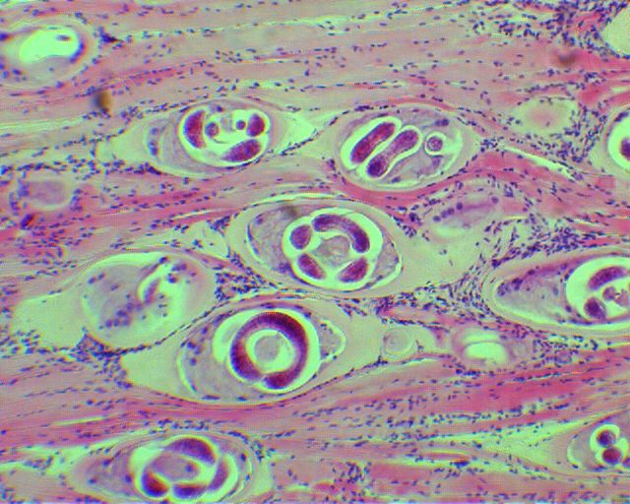
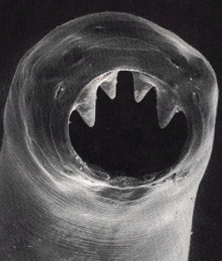
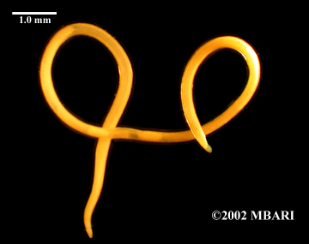
Phylum Nematoda
Nematoda: roundworms, are usually animal parasites.
Contaminate uncooked meat such as pork.

Slide 40
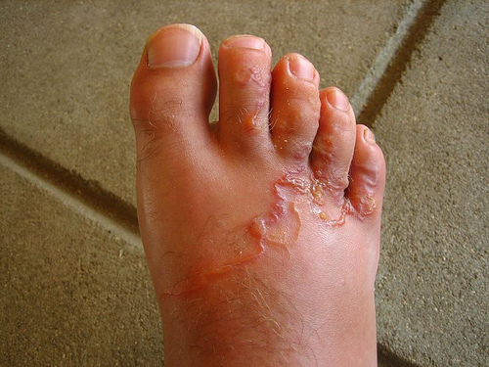
A good use? Worms were used to reduce swelling.

Slide 41
Phylum Annelida
Annelida are the common segmented worms such as earthworms.

Slide 42
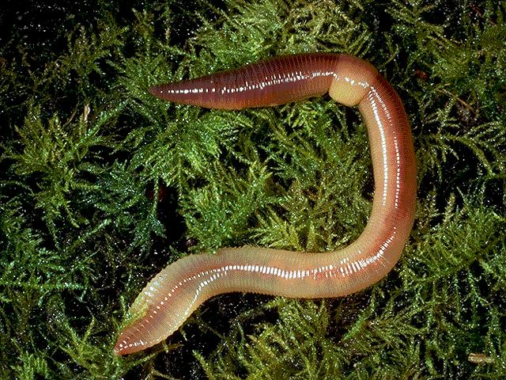
Earthworms
Earthworms have a closed circulatory system including 5 “hearts”. Really, they’re just 5 thicker “pumping” vessels.
They breathe through their skin which is why they must stay moist.
They have a brain (cerebral ganglia).
Annelid Video

Slide 43
Our friendly neighborhood earthworm…

Slide 44
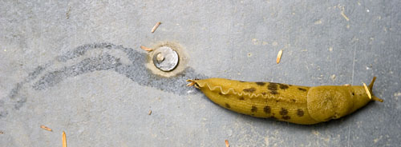
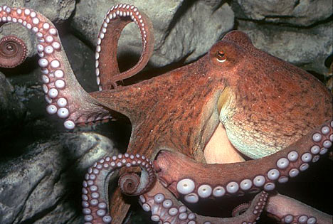
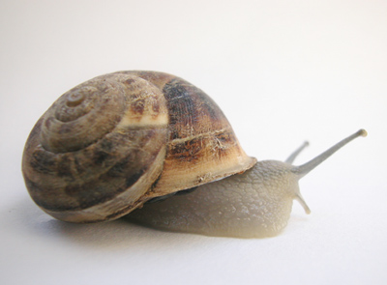
Mollusks
Mollusks are soft bodied animals that typically have inner or outer shells. There are three main types – Gastropods, Bivalves, and Cephalopods.
Ex. Snails, Slugs, bivalves (clams, oysters), octopi, squid, etc.

Slide 45
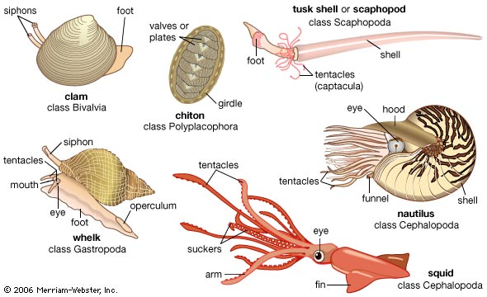
Characteristics
Mollusks have a thick muscular foot.

Slide 46
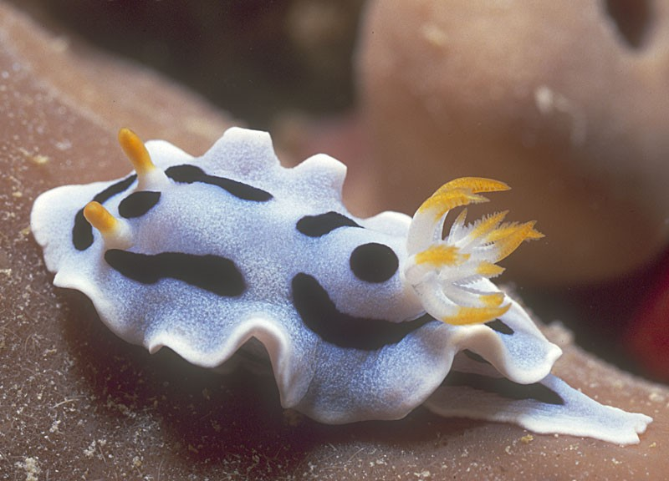
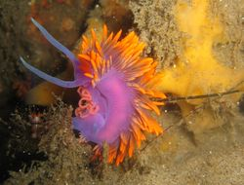
Gastropods
Gastropods include slugs, snails, and nudibranches. They secrete a mucus to aid in movement.

Slide 47
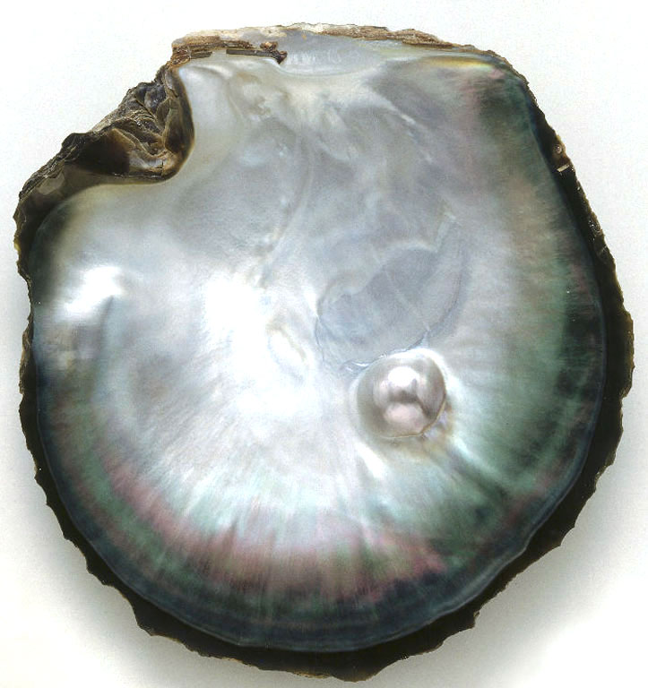
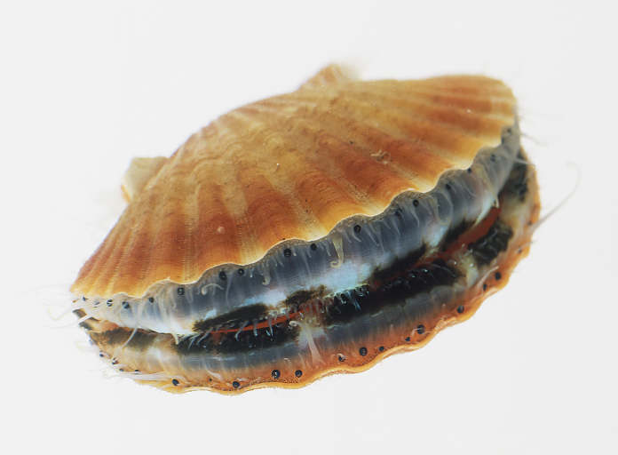
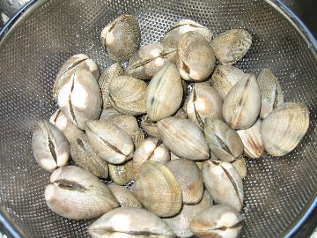
Bivalves
All Bivalves are two-shelled, filter feeding marine animals that use a strong muscle to hold the two shells together.

Slide 48
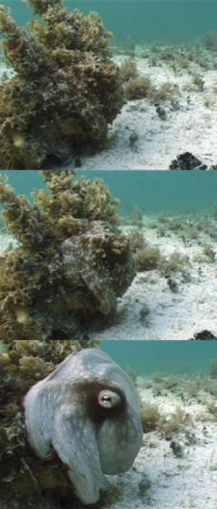
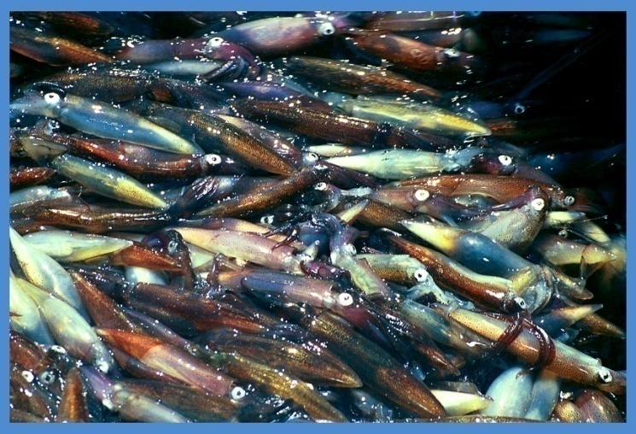
Cephalopods
This group included the tentacled mollusks: squid, nautilus, and octopus.
Squid have an inner shell.

Slide 49
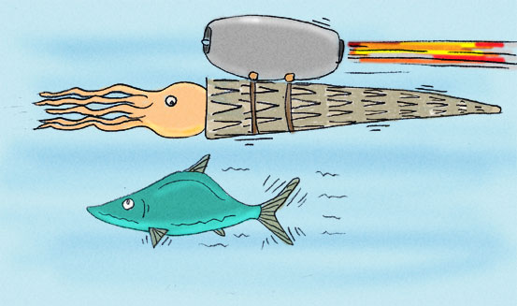
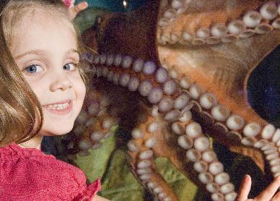
Cephalopods
Use tentacles to move and capture food.
All can move by a form of jet propulsion.

Slide 50
Mollusc Video

