Slide 1
Your FFA Program
Objective: Summarize the events that have shaped Agricultural Education and FFA

Slide 2
The FFA Mission
FFA makes a positive difference in the lives of students by developing their potential for premier leadership, personal growth, and career success through agricultural education.

Slide 3
What is FFA?
…an organization of high school students in agricultural education
students from all 50 states plus Guam and Puerto Rico.

Slide 4
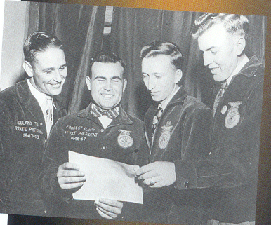
FFA History

Slide 5
1917 – Smith-Hughes Act
Named after a senator from Georgia.
Provided federal funding for Vocational Agriculture in public high schools.

Slide 6
1920’s Future Farmer Clubs
Virginia was the first
Boys only
North Carolina
Young Tar Heel Farmers

Slide 7
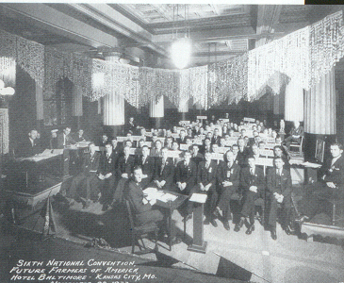
1928 – Future Farmers of America
FFA was established
The 1st convention was held in the Hotel Baltimore in Kansas City, Missouri
The first dues were 10 cents
Current chapter dues are $10.00

Slide 8
FFA History
1930
FFA Creed is written by E.M. Tiffany
1935
New Farmers of America (NFA) formed
For black students studying agriculture

Slide 9
New Farmers of America
Organization for African-American males in high school agriculture classes.
Colors were black and gold
Found mostly in southern states

Slide 10
FFA History
1950
Public Law 740
Gave the FFA a federal charter
The law said that each school teaching agriculture must have an FFA program

Slide 11
FFA History - Public Law 740
Created 3 integral components to an agricultural education program
Classroom/Lab Instruction
FFA
SAE (Supervised Agricultural Experience programs)
Classroom
SAE
FFA

Slide 12
FFA History
1965
FFA and the NFA merge
1969
Girls were admitted into the FFA
1971
National FFA Alumni Association was founded
Founded for supporters of FFA, not necessarily former members

Slide 13
FFA History
1988
Future Farmers of America changes its name to the National FFA Organization
1989
National Future Farmer Magazine changes its name to FFA New Horizons

Slide 14
FFA History
The 1990’s
National FFA Center moves to Indianapolis, Indiana

Slide 15
FFA History
1999
National FFA Convention moves to Louisville, Kentucky
This is the 1st time the convention is held outside Kansas City, Missouri

Slide 16
Structure of the FFA

Slide 17
National FFA
Eastern Region
Pennsylvania FFA Association
South Central Region
Gifford Pinchot FFA Chapter

Slide 18
The FFA Emblem

Slide 19
The Ear of Corn
Provides the foundation of the emblem, just as corn has historically served as the foundation crop of American agriculture.
A symbol of unity, because corn is grown in every state in the nation.

Slide 20
The Eagle
A national symbol which serves as a reminder of our freedom and ability to explore new horizons for the future of agriculture.

Slide 21
The Rising Sun
Signifies progress and holds a promise that tomorrow will bring a new day glowing with opportunity.

Slide 22
The Plow
Signifies labor and tillage of the soil, the backbone of agriculture and the historic foundation of our country’s strength.

Slide 23
The Owl
Long recognized for its wisdom, it symbolizes the knowledge required to be successful in the industry of agriculture.

Slide 24
Words of FFA & Agricultural Education
“Agricultural Education” and “FFA” are emblazoned in the center to signify the combination of learning and leadership necessary for progressive agriculture.

Slide 25
The FFA Official Colors
National Blue
Corn
Gold

Slide 26
The FFA Motto
Learning to Do
Doing to Learn
Earning to Live
Living to Serve

Slide 27
FFA Code of Ethics
FFA has established guidelines for member actions and behavior
All FFA members should follow the code and should use it as a guideline to live by.
This class uses the FFA Code of Ethics as its classroom rules.

Slide 28
FFA Officers and Stations

Slide 29
FFA Officers and Stations
President
Stationed by the rising sun
Vice President
Stationed by the plow
Secretary
Stationed by the ear of corn

Slide 30
FFA Officers and Stations
Treasurer
Stationed by the emblem of George Washington
Reporter
Stationed by the American Flag
Sentinel
Stationed by the door and the shield of friendship

Slide 31
FFA Officers and Stations
The Advisor
Stationed by the owl
This office held by the agriculture teacher
Minimum of six officers
Additional officers may be established by the local chapter
Chaplin
Historian

Slide 32
Ceremonies
Rituals conducted at each meeting
Opening ceremony
Closing ceremony
Outlined in the FFA Student Manual

Slide 33
Opening Ceremony- “All in Unison”
President:
“FFA members, why are we here?”
All members say:
“To practice brotherhood, honor agricultural opportunities and responsibilities, and develop those qualities of leadership which an FFA member should possess.”

Slide 34
Closing Ceremony- The FFA Salute
“I pledge allegiance to the flag of the United States of America and to to the republic for which it stands, one nation under God, indivisible, with liberty and justice for all.”

Slide 35
FFA Official Dress
Males
Black Socks
White Collared Shirt
Official FFA Tie
Official FFA Jacket zipped to the top
Black shoes and socks

Slide 36
FFA Official Dress
Females
Black skirt of appropriate length or Slacks
White Collared Blouse
Official FFA Scarf
Official FFA Jacket zipped to the top
Black shoes

Slide 37
FFA Degrees
Discovery FFA Degree (Middle School)
Greenhand FFA Degree
Chapter FFA Degree
State FFA Degree
American FFA Degree

Slide 38
Types of FFA Membership
Active
Students in middle school, high school, and college (up to age 21)
Alumni
Former active members, parents of FFA members, and others interested in and supportive of FFA
Collegiate
Honorary
Local, state and national levels

Slide 39
FFA Programs of Activities
It is a plan that directs the chapter’s activities for the year
Activities are determined by the student membership of the local chapter
Committees are appointed to look at different areas of the POA
Voted on by the total membership

Slide 40
Career Development Events
Individual or team competitions covering several subjects in agriculture and leadership
Examples
Parliamentary Procedure
Public Speaking
Agricultural Sales
Land Judging

Slide 41
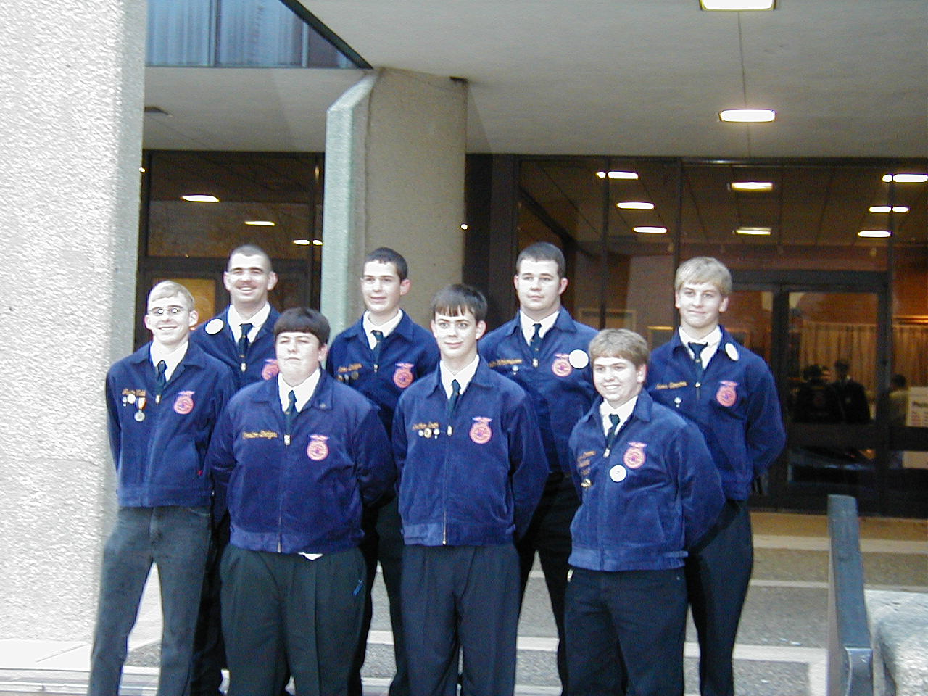
Conventions
State FFA Convention
Penn State University in State College
June
National FFA Convention
Indianapolis, IN
Late October

Slide 42
FFA Websites
National FFA Organization
www.ffa.org
Pennsylvania FFA Association
www.paffa.org

