Slide 2
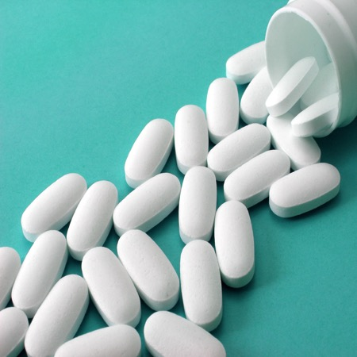
There are 129 drug overdose deaths per day in the United States. Sixty-one percent of those deaths are related to pharmaceutical opioids or heroin.
About 15 million people indicated misusing prescription painkillers in 2014.
Nearly one in five teens say they have used prescription medicine at least once in their lifetime to get high.
Opioids have been linked to 60 percent of drug overdoses in the U.S.
In 2015, 58 percent of 12th grade students reported a “great risk” in trying heroin.
Notes:
Each fact will appear with each click.

Slide 3
Addiction is rare.
When used to treat pain, prescription opioid drugs are not addictive.
Only certain people are at risk of abusing opioid drugs.
Prescription opioids are the most rapidly growing class of abused drugs.
Notes:
Instructor Notes:
Create 2 groups to review statements about prescription opioids and heroin.
Anyone can be affected by drug misuse and abuse. There are no barriers that make anyone safe from this issue.
Prescription drugs are the most rapidly growing class of abused drugs.
Many factors determine the likelihood that someone may become addicted to a drug. This includes both inherited and environmental factors.
Opioids have been linked to 60 percent of drug overdoses in the U.S. There are 129 drug overdose deaths per day in the United States. 61% of those deaths are related to pharmaceutical opioids or heroin.
Each fact will appear with each click.

Slide 4
Opioids work in your body the same way that over-the-counter pain relief medications do.
It is easy to quit opioid dependency if you are disciplined.
Prescription opioids and heroin affect your body the same way.
Heroin affects the body but not the brain.
Notes:
Instructor Notes:
5. Prescription pain relief medication interacts with your body differently than over the counter medications.
6. Addiction to opioid prescription drugs and/or heroin is very strong. It alters the body and the mind, and professional help is often necessary to get away from the addiction.
7. Prescription opioids and heroin both interact with our body by attaching to a specific receptor in the brain.
8. Heroin affect both brain and body and can cause people to become physically and psychologically dependent on them to perform normal daily functions.
Each fact will appear with each click.

Slide 5
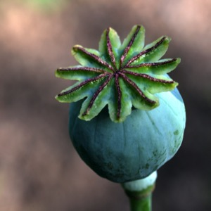
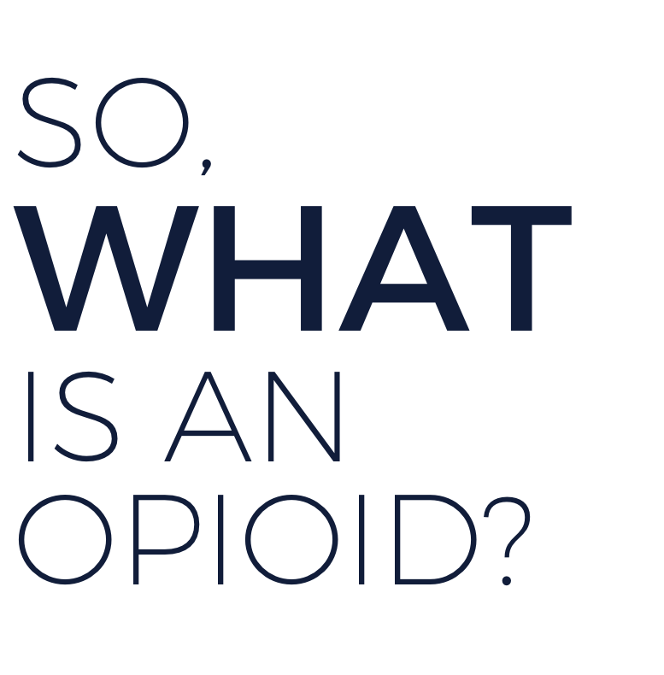
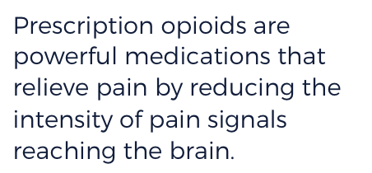
?
Opioids are drugs that come from the opium poppy plant or are synthetic equivalents.
Prescription opioids are powerful medications that relieve pain by reducing the intensity of pain signals reaching the brain.
Notes:
Instructor Notes:
Brainstorm with students about what they think opioids are and where they come from.
Definition will appear with click.

Slide 6
Morphine
poppy
opioids
heroin
Fully synthetic
Fentanyl
manmade
opioids
Notes:
Instructor Notes:
Missing words for students to choose from:
poppy
Morphine
opioids
heroin
fully synthetic
opioids
Man-made
Fentanyl
Answers will fill-in with click.

Slide 7
What might someone who is addicted to opioids look like?
Are there certain features?
How could
you tell?
Notes:
VIDEO LINKS:
Anyone Can Become Addicted to Drugs – English https://vimeo.com/188196247
Anyone Can Become Addicted to Drugs – Spanish - https://vimeo.com/188178805
Instructor Notes:
Arrange students in small groups. Provide each group with a handout they will list their group answers on. Review one of the potential misconceptions, “addiction is a choice,” with students by watching this video from NIDA: “Anyone Can Become Addicted to Drugs”:
Questions enter with click.

Slide 8
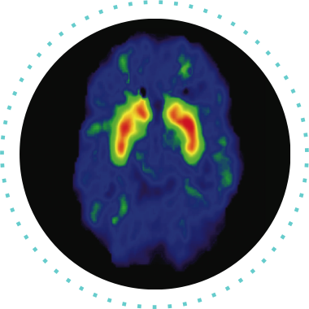
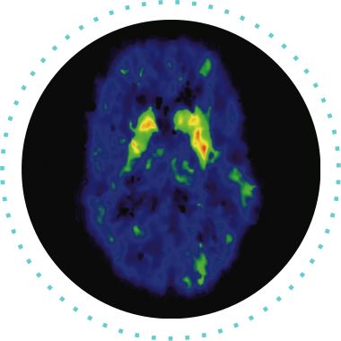
What do you notice about the two brains in each image?
How are they different?
How do you think these differences might be impacting the human body?
Notes:
Video link: https://vimeo.com/188196249
Instructor Notes:
As they view the images, students should note how the brains are different:
In Image, the left side shows normal activation of the brain during a cognitive task. The right side shows brain activation with the influence of drugs. Activation is shown by color: red shows strongest activity, then orange, then yellow, then green. The image on the left shows strong activation in red and orange in the target area while the image on the right shows much less and weaker activation, with only a little yellow or green.

Slide 9
Notes:
Instructor Notes:
Clarify with students that opioids act upon the opioid receptors in our nervous system. This is a big deal because of all the different parts they just learned our nervous system controls. Ask students to identify parts of the nervous system that could be affected by opioid misuse and to explain their reasoning.

Slide 10
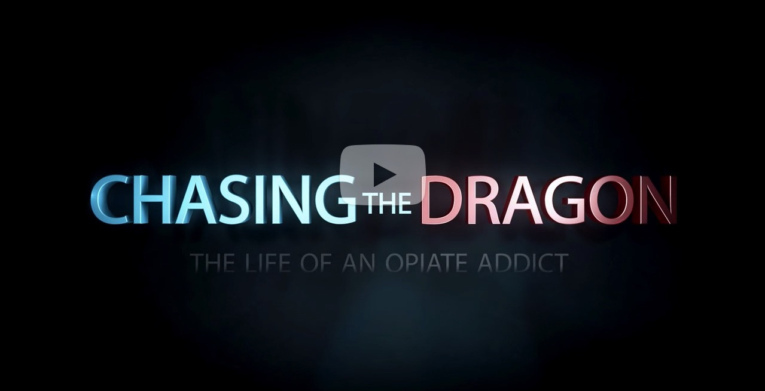
Notes:
Video Link: https://vimeo.com/188343786
Instructor Notes:
Preface this video by explaining that the Federal Bureau of Investigation (FBI) and the Drug Enforcement Agency (DEA) collaborated on this hour-long documentary that features “stark first-person accounts told by individuals who have abused opioids or whose children have abused opioids, with tragic consequences.” Parts of the documentary contain explicit language and subject matter; only a few segments are incorporated into this lesson.

Slide 11
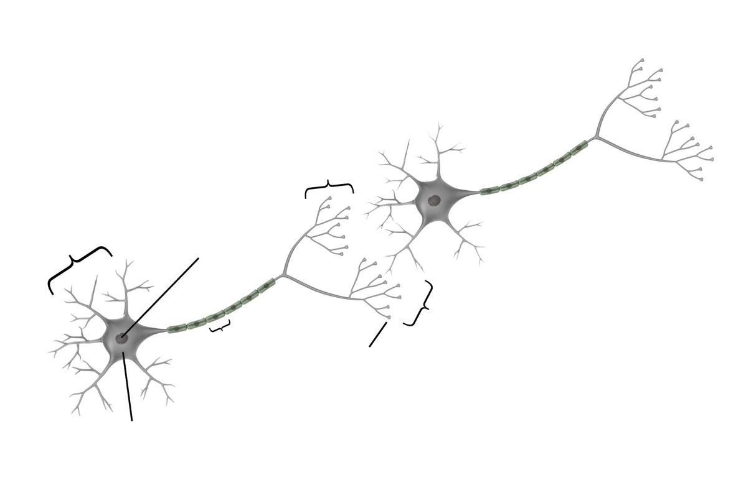
branches of axon
dendrites
nucleus
synaptic gap
axon
terminal bulbs
cell body
Notes:
Provide small groups of students a set of descriptions of the nervous system using the Parts of the Human Nervous System student activity sheet. Invite students to match each part of the nervous system to the color they think it corresponds with on the slide.
Each label will appear with each click.

Slide 12
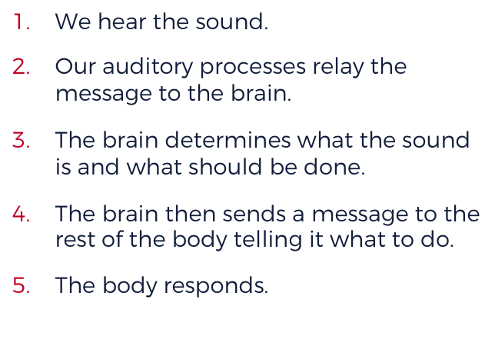
What do you think when you hear the sound of buzzing?
We hear the sound.
Our auditory processes relay the message to the brain.
The brain determines what the sound is and what should be done.
The brain then sends a message to the rest of the body telling it what to do.
The body responds.
Notes:
Instructor Notes:
“Bottom-up” and “top-down” processing refer to the direction in which the message, or impulse, travels. The brain is considered to be at “the top” of the nervous system, so if the brain sends the message the direction is top-down; if the message is sent to the brain the direction is bottom-up.
Buzzing sound will play at start of slide. Click to reveal bee image and message.

Slide 13
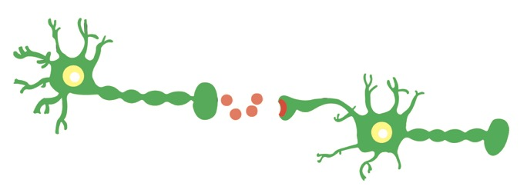
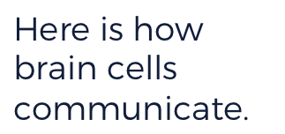
Notes:
Instructor Notes:
Emphasize that even when we take prescription opioid drugs correctly, we are still altering the messaging process in the brain; the opiate acts on certain neurotransmitters to increase pain relief and block pain signals. In other words, the opioid prevents the pain message from reaching the brain; because we are not conscious of the pain, we do not experience it.

Slide 14
Notes:
Video Link: https://www.nimh.nih.gov/brainbasics/index.html
Instructor Notes:
The “Brain Basics” web page consists of numerous short videos on a variety of topics. For this lesson, students will watch one video categorized under “The Working Brain” titled “Neurotransmitters”. Roll the cursor over the appropriate category to reveal the video; clicking on a video title will cause the video to play in the main section of the web page.

Slide 15
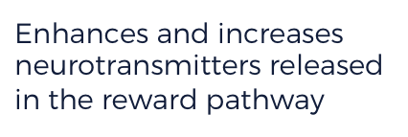
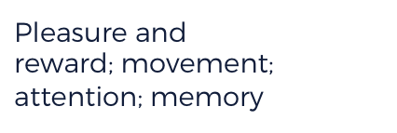
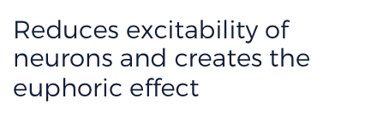
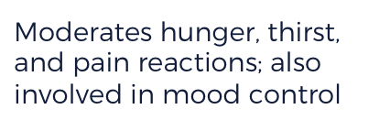
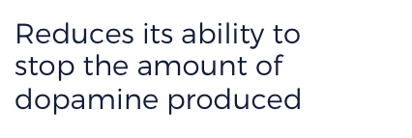
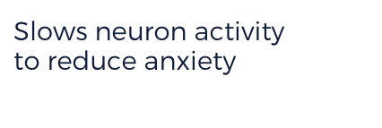
Enhances and increases neurotransmitters released in the reward pathway
Pleasure and reward; movement; attention; memory
Dopamine
Reduces excitability of neurons and creates the euphoric effect
Moderates hunger, thirst, and pain reactions; also involved in mood control
Reduces its ability to stop the amount of dopamine produced
Slows neuron activity to reduce anxiety
Notes:
Instructor Notes:
Invite students to consider how each of these neurotransmitters, affected by opioids, could impact the human body by completing the last column of the chart.
Answers will fill-in with click.

Slide 16
LIE
Notes:
Present four statements using the slide. Explain to students that three of the statements are true while one is false. Guide students to identify the false statement and correct it. False statement will reveal with click.

Slide 17
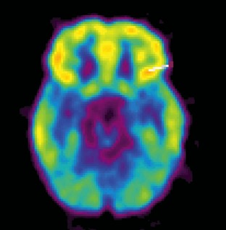
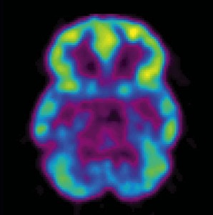
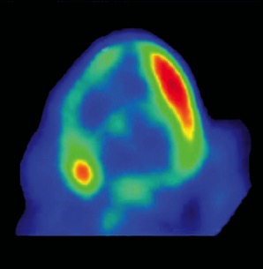
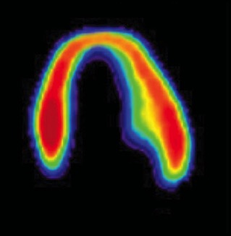
Scans of a healthy heart and a diseased heart show similarities,
respectively, to a healthy brain and a brain on drugs.
What do you notice about these images?
BRAIN / HEART COMPARISON
Notes:
Instructor Notes:
To help students interpret this image, you may need to explain that metabolism refers to how the body uses energy. Red areas of the image are using more energy than blue or black areas are using.

Slide 18
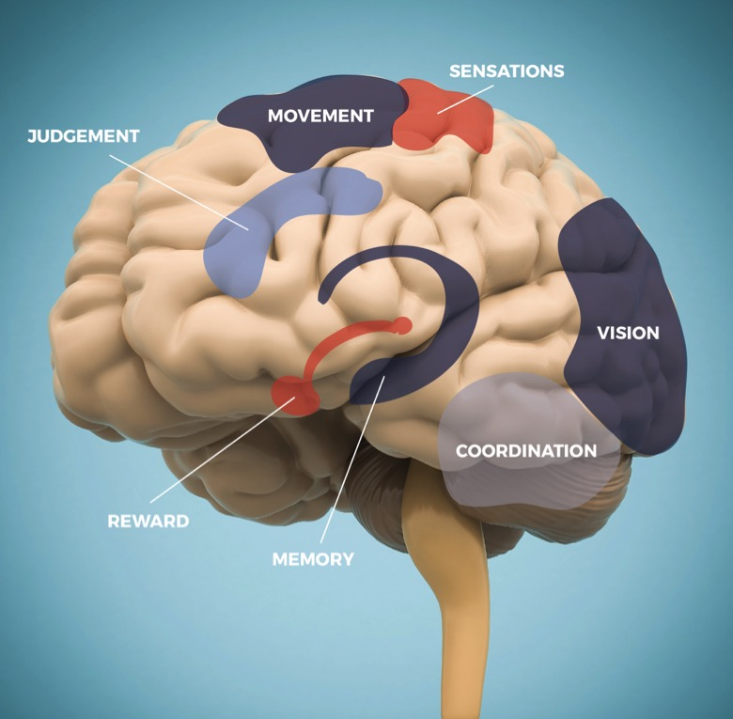
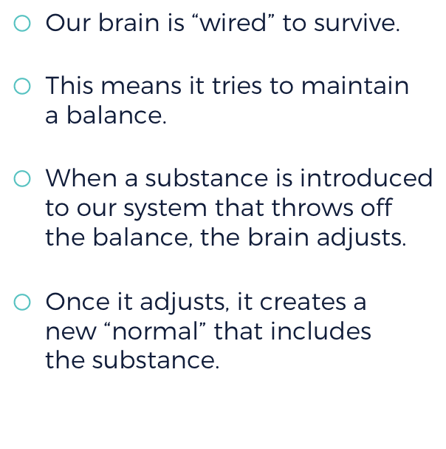
Notes:
Instructor Notes:
Based on the information students learn about the different parts of the brain, ask students to predict factors that make the still-developing adolescent brain vulnerable to taking risks through impulsive actions

Slide 19
THE
ADOLESCENT
BRAIN
STUDENT
RESPONSES
Notes:
Instructor Notes:
After reviewing the slide, divide the class into pairs or small groups and ask them to come up with a list of factors that might influence risk based on adolescent brain development. Combine these lists into a full class list, and then together, rank them from “most influential” to “least influential.” Be sure that students explain their rankings.
Student responses can be captured in the space on the slide using a Smart Board or typing the ideas in the space.

Slide 20
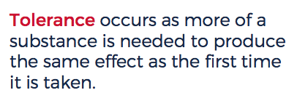
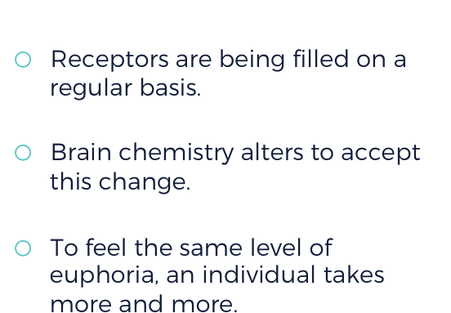
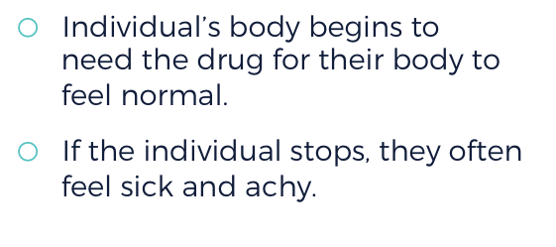
Notes:
Invite students to use the text on the slide to identify similarities and differences in a person that has developed a tolerance to one that is dependent on the misuse of opioids.

Slide 21
Notes:
Video Clip: https://vimeo.com/188199459
Instructor Notes:
In this section of the lesson, students will continue watching the video “Chasing the Dragon” to see the end result of one of the cases presented. They should watch from 37:13 to 42:05. Then, discuss the video as a class. First, ask them what they think about this case and the end result. Based on brain mechanism, what happened to Trish’s daughter, Cierra? Why? Direct students to consider how the changed homeostatic system leads to psychological changes in judgment and the perception of need.

Slide 22
Notes:
Instructor Notes:
Using this slide, students should be able to define the terms homeostasis and allostasis. They should also be explain to explain how stress to the physiological system leads to adaptation. Create one set of six notecards for each pair of students. On each notecard, there should be one step in the process. Students should work together with a partner to be the notecards in the correct order. See Educator Guide for the steps and correct order.
Balance image will equalize with click.

Slide 23
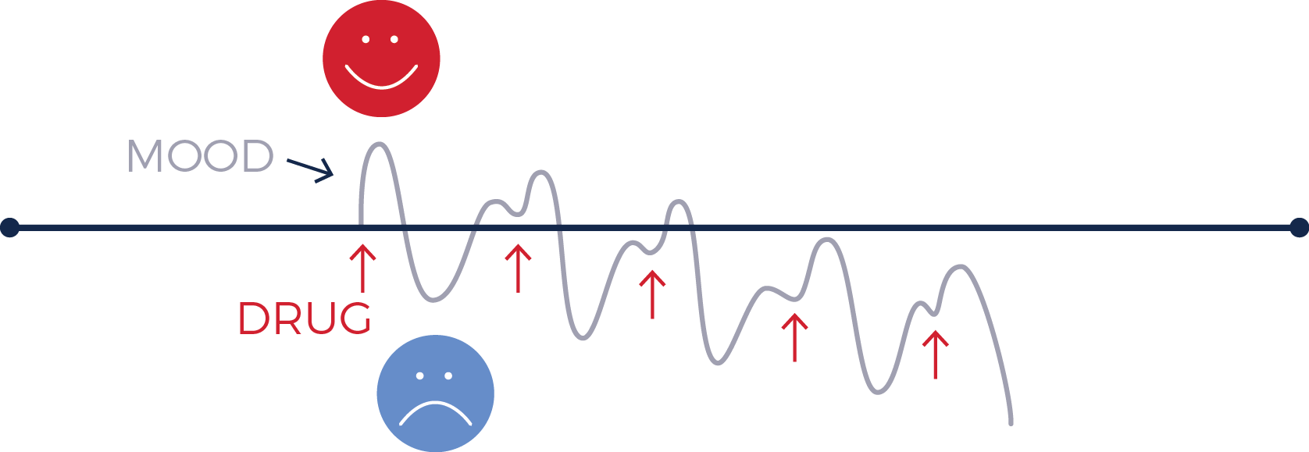
Notes:
Instructor Notes:
Students should work together with their same partner/group as the previous slide to create six new cards describing how heroin affects the allostasis and homeostasis processes. By the end of this activity, students should understand how adaptation leads to heroin addiction as the body seeks to create a “new normal,” or a homeostatic system.

Slide 24
Look back at the chart you created at the beginning of the lesson.
Is there anything you would now add or remove?
Notes:
Revisit the discussion on facts and misconceptions by reviewing slides 1–4. Invite students to return to their original groups to reevaluate their earlier charted facts and misconceptions. Ask student groups to discuss changes to their list and add at least three big takeaways they would want other teens to know.

Slide 25
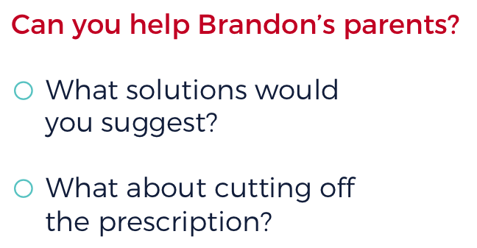
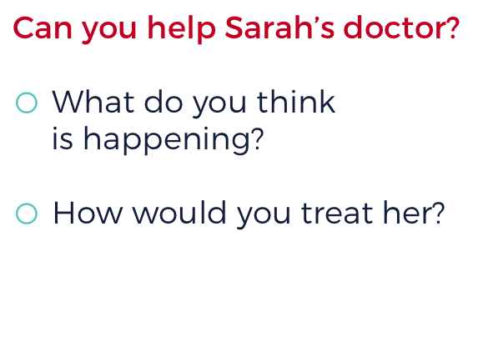
Notes:
Invite students to read the two case studies using the Opioid Misuse Case Studies student activity sheet.

