Slide 1
WELCOME TO PHYSICAL EDUCATION GOALS IN PHYSICAL EDUCATION: To learn a variety of physical activities/sports Improve overall health and personal fitness Have fun trying new things!!

Slide 2
NORTHERN MIDDLE SCHOOL PHYSICAL EDUCATION
All students have PE 2 times per cycle all year
It's either....
Days 1 & 4
Days 2 & 5
Days 3 & 6

Slide 3
BOYS LOCKER ROOM
-Enter boys locker room from hallway door across from boys restroom
-Go up stairs
-Select Day locker
-Change clothes quickly if needed
-Line up at opposite end of locker room
-When told, students go downstairs at far end of locker room to gym
End of class….
-Students wait at door behind sign until dismissed by teacher
[usually whistle]

Slide 5
LOCKER ROOM RULES
Keep clean ...no garbage, grass & clothes on floor
Hands off others belongs.... clothing, shoes, locks, books...etc
No Running
No Food or Drinks
No Gum in PE at any time
Do not get IN or ON lockers
No cell phones visible
Computer Care
Destruction of school Property unacceptable!!

Slide 6
PE ATTENDANCE PROCEDURES
Students immediately sit in Attendance Rows on Gym Floor
During attendance, students may talk quietly and stretch

Slide 7
PHYSICAL EDUCATION DRESS REQUIREMENTS
Students must wear....
Shorts/sweatpants/leggings [No jeans, jean shorts, cutoffs, skirts]
T-Shirts [short sleeve/long sleeve/sweatshirt] no tank tops/cut offs
Sneakers & Socks [extra pair for outside if needed due to wet grass]
No flip flops, sandals, dress shoes, boots...etc
No Hats
Swimsuit and towel will be needed for 6th & 7th Grade Swim Unit
NOTE...
School clothes CAN be worn for PE, only if above proper attire !!

Slide 8
PHYSICAL EDUCATION GRADING 3 Categories...
Participation / Preparation / Behavior
= 10 Points Each Class
Skill Assessments [Students demonstrate 1-2 basic unit skills]
= Typically 10 points
Knowledge Assessments [Ex…Quiz, Writing Prompt, Reflections]
= Typically 10 Points

Slide 9
PREPARATION & PARTICIPATION -Lose 5 points each class if you do not have proper PE clothes - 3 no dresses = letter home to be signed by parents - 4+ no dresses = 10 points off grade each time thereafter [ per semester, not marking period ]

Slide 10
DRESS APPROPRIATELY FOR WEATHER CONDITIONS
Warm Weather or Cold Weather

Slide 11
PERSONAL HYGIENE
Deodorant Use .... Strongly recommended
YES NO
No aerosol spray cans allowed
No jewelry (stud earrings and Fitbit/Apple watch allowed)
Again...No Gum
Long hair must be pulled back

Slide 12
SAMPLE UNIT GRADE CALCULATION
SOCCER UNIT
Grade Category Possible Points Points Earned
Participation/Preparation/Behavior 60 53
Skill Check Assessment [2 skills= dribble & pass] 10 10
Quiz or Writing Prompt 10 9
80 72 = 90% B
WAYS TO LOSE POINTS…
Not dressed appropriately for PE [ flip flops instead of sneakers [-5 points]
Gum [ -1 points]
Little to no effort [-1 to -5 points ]
Not following rules, directions, poor behavior [ -1 to -5 points ]

Slide 13
PHYSICAL EDUCATION MEDICAL EXCUSES
- All medical / parent excuses MUST be taken to Mrs. Strouse, school nurse!
Not Mr. Robison or Mrs. Rucker!
Mrs. Strouse will keep your excuse on file and write a PE Medical Pass for you to give to teacher. ( Mr. Robison or Mrs. Rucker)
For extended medical excuses, written assignments will be given to student.

Slide 14
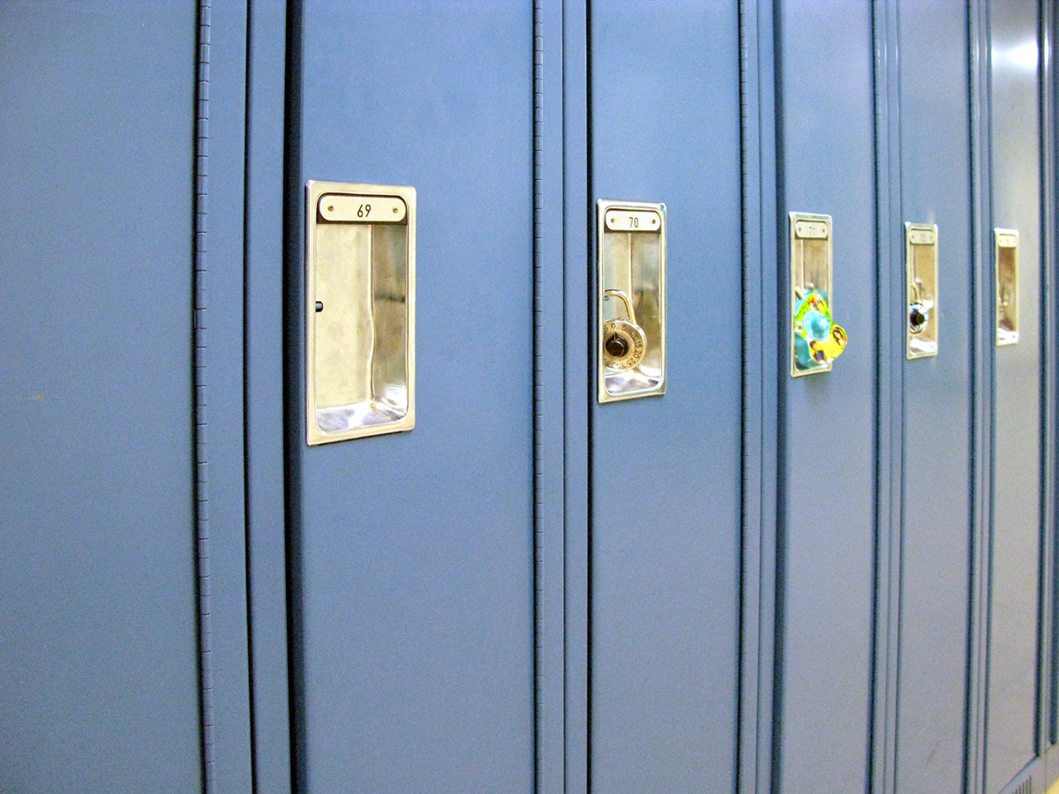
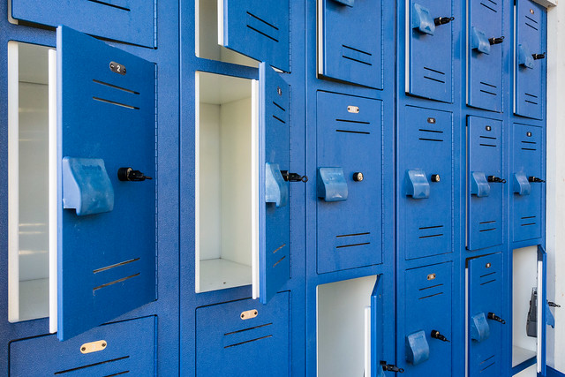
PE LOCKER ASSIGNMENTS
Combination Locks only [approved & registered with PE Teacher]
Will have locker for entire year
Long lockers and empty small lockers may be used for day use….
…. but items may not be left in lockers overnight.
You are responsible for lost items [lost and found bin in locker Room]

Slide 16
PHYSICAL EDUCATION CURRICULUM
WHAT ARE YOU DOING THIS YEAR?
Classes will typically begin with General Strength & Cardio Exercise
Physical Education Units

Slide 17
8th grade Physical Education Curriculum
Girls Boys
Lacrosse Ultimate Sports
Field Hockey Lacrosse
Coed Volleyball Coed Pickleball
Coed Pickleball Coed Volleyball
Fitness Center Basketball
Coed Team Building Coed Team Building
Fitness Testing Fitness Testing
Cooperative Activities Cooperative Activities
Basketball Strength Training
Mile Run Mile Run
Team Handball Team Handball

Slide 18
7th Grade Physical Education Curriculum
Girls Boys
Soccer Football
Ultimate Sports Intro to Lacrosse
Basketball Strength & Conditioning
Strength & Conditioning Basketball
Team Handball Team Handball
Coed Team Building Coed Team Building
Swimming Fitness Testing
Fitness Testing Swimming
Intro to Lacrosse Indoor Soccer
Mile Run Mile Run
Wellness Unit Wellness Unit

Slide 19
6th Grade Physical Education Curriculum
sGirls Boys
Outdoor Fitness Outdoor Fitness
Field Hockey Intro to Soccer
Coed Volleyball Coed Pickleball
Coed Pickleball Coed Volleyball
Fitness Center Intro to Basketball
Coed Team Building Coed Team Building
Swimming Fitness Testing
Fitness Testing Swimming
Basketball Fitness Center
Mile Run Mile Run
Track and Field Track and Field
Notes:
Mm l

Slide 20
CLASS BEHAVIOR EXPECTATIONS
R E S P E C T
[ Teachers – Classmates – School Property – Other’s Belongings ]
No talking while teacher is speaking!
You will be treated as you act!
Treat Others As YOU Wish To Be Treated !

